Slide 1


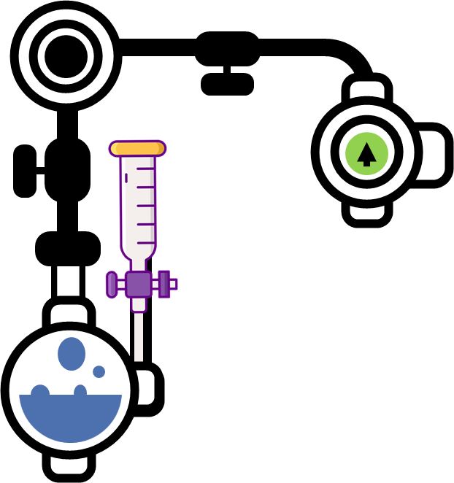

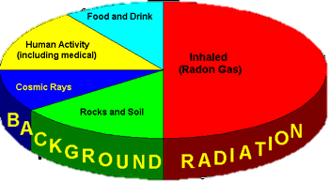
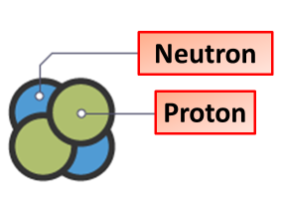
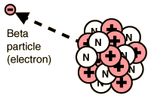

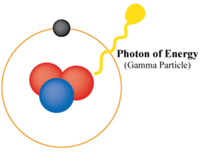

Radioactivity Notes
Radioactivity refers to the particles which are emitted from nuclei as a result of nuclear instability. Because the nucleus experiences the intense conflict between the two strongest forces in nature, it should not be surprising that there are many nuclear isotopes which are unstable and emit some kind of radiation.
The majority of background radiation occurs naturally from minerals and a small fraction comes from man-made elements. Naturally occurring radioactive minerals in the ground, soil, and water produce background radiation. The human body even contains some of these naturally-occurring radioactive minerals
Alpha radiation consists of alpha particles. An alpha particle is identical to the nucleus of a helium atom, which comprises two protons and two neutrons.
Made from 2 protons & 2 neutrons
Has a mass of 4
Is highly ionizing
Is stopped by air
Has a charge of +2
Is slightly deflected by a magnetic field
Beta radiation consists of high energy electrons emitted from the nucleus. These electrons have not come from the electron shells or energy levels around the nucleus. Instead, they form when a neutron splits into a proton and an electron. The electron then shoots out of the nucleus at high speed, leaving the new proton behind in the nucleus.
Made from a high energy electron
Is stopped by a few cms of aluminium
Has a mass of 0
Is ionizing
A charge of -1
Highly deflected by a magnetic field
Is a high energy wave length
Gamma radiation is very short wavelength, high frequency electromagnetic radiation. This is similar to other types of electromagnetic radiation, such as visible light and X-rays, which can travel long distances.
Is not deflected by a magnetic field
Is stopped by a thick layer of lead
Half Life
The nuclei of radioactive atoms are unstable. They breakdown and change into a completely different type of atom. This is called radioactive decay.
For example, carbon-14 decays to nitrogen-14 when it emits beta radiation. As this breakdown occurs, the activity of any radioactive source becomes less. This activity is measured in becquerels.
It is not possible to predict when an individual atom might decay. But it is possible to measure how long it takes for half the nuclei of a piece of radioactive material to decay. This is called the half-life of the radioactive isotope.
Has a mass of 0
Isn’t ionizing
Has no charge

