Slide 1
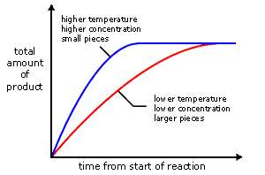
Rate of Reaction Practice Question
In a reaction the greater the frequency of successful collisions, the greater the rate of reaction. If the concentration of a reacting solution or the pressure of a reacting gas is increased.
This can be shown in the graph below:
Describe the factors affecting rate of reaction and their effects on collision of partials within a reaction.
Surface area:
The greater the frequency of successful collisions, the greater the rate of reaction. If the surface area to volume ratio of a reacting solid is increased:
more reactant particles are exposed at the surface
the frequency of collisions between reactant particles increases
A catalyst is a substance that:
speeds up the rate of a reaction
does not alter the products of the reaction
is not chemically changed or used up at the end of the reaction
Answer
Temperature
The greater the frequency of successful collisions, the greater the rate of reaction. If the temperature of the reaction mixture is increased:
reactant particles move more quickly
the energy of the particles increases
the frequency of successful collisions between reactant particles increases
the proportion of collisions which are successful increases
Concentration
An increase in concentration increases the number of molecules there are to react
This increases the chance of collisions
Which increases rate of reaction

Slide 2
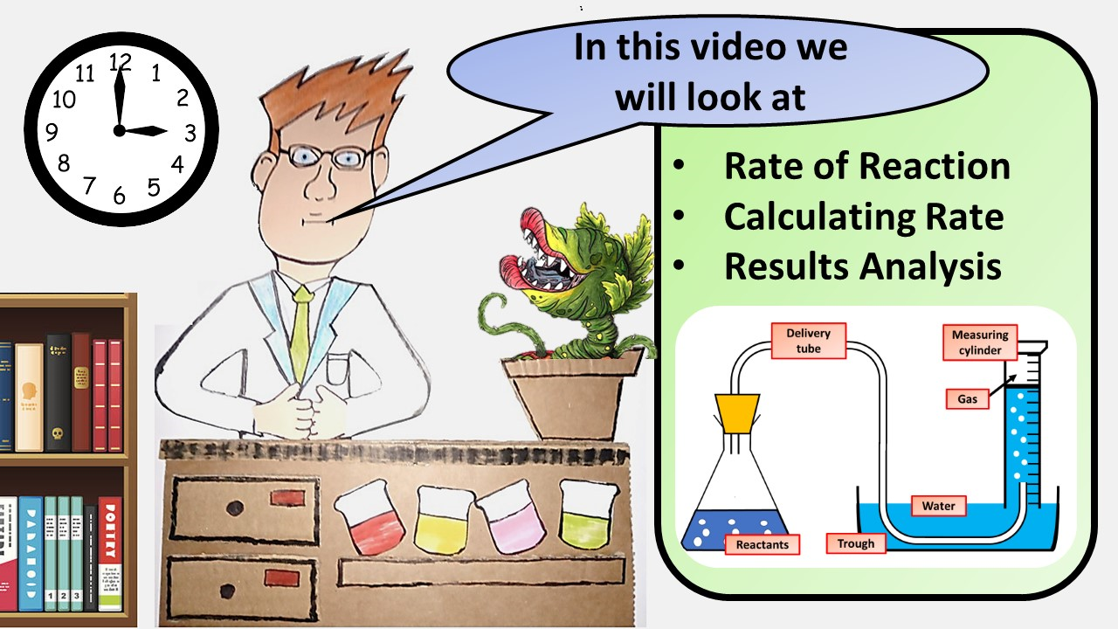
Click here to access my youtube videos
Resources that this activity would work well with
Lesson on TES
Lesson on TPT
Follow me on social media to stay in touch
Keep up to date with my new content:

