Slide 1


Reacting Mass Calculation
In the reaction between sulfuric acid (H2SO4) and potassium hydroxide (KOH), excess sulfuric acid reacts with 8.00 grams of potassium hydroxide to form potassium sulfate (K2SO4) and water (H2O).
H2SO4 + 2KOH → K2SO4 + H2O
Calculate the mass of potassium sulfate produced.
How many moles of potassium hydroxide
Ratio of KOH to K2SO4?
Answer
How many moles of K2SO4?
What is the mass of that many moles?
Link to answer video

Slide 2
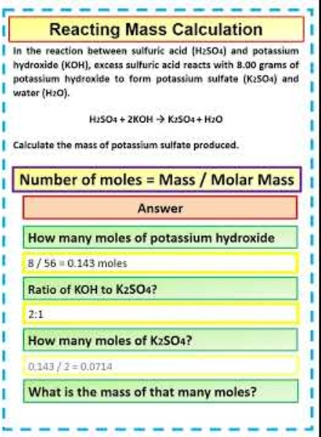
Reacting Mass Calculation

