Slide 1


Reacting Mass Calculation
When 10.0 grams of calcium carbonate (CaCO3) reacts with excess hydrochloric acid (HCl), it produces calcium chloride (CaCl2), carbon dioxide (CO2), and water (H2O).
CaCO3 + 2HCl → CaCl2 + CO2 + H2O
Calculate the mass of carbon dioxide produced.
How many moles of calcium carbonate?
Ratio of calcium carbonate to carbon dioxide?
Answer
How many moles of carbon dioxide?
What is the mass of that many moles?
Link to answer video

Slide 2
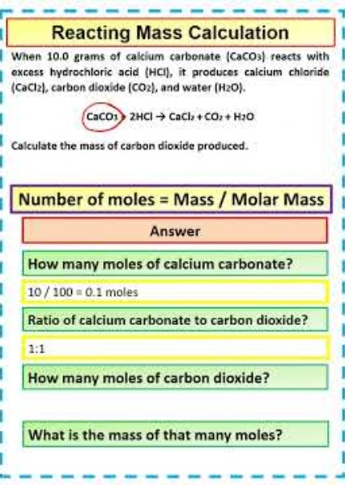
Reacting Mass Calculation

