Slide 1
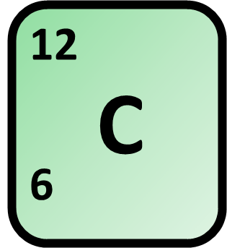
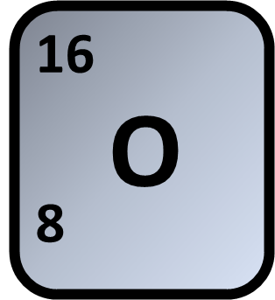
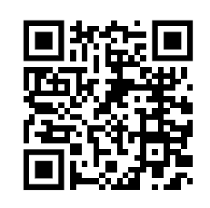
Reacting Mass Calculation
How many grams of carbon dioxide (CO₂) are produced when 4 moles of methane (CH₄) react with excess oxygen (O₂)?
Balance the equation
What is the ratio?
Answer
How many moles?
What is the mass of that many moles?
Link to answer video

Slide 2
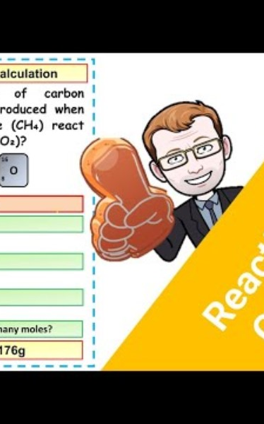
Reacting Mass Calculation

