Slide 1
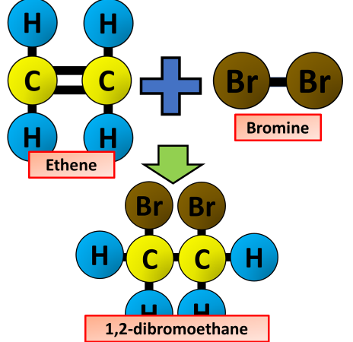
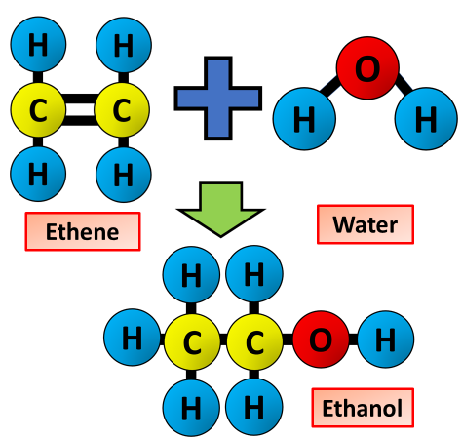
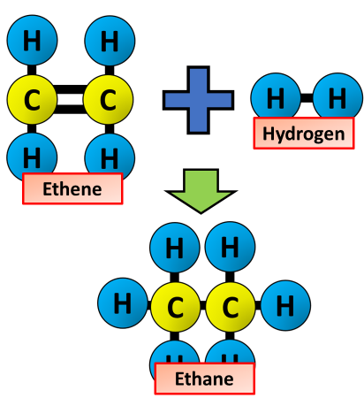
Reactions of Alkenes
Specification Link:
Organic Chemistry: 4.7.2.4
Reaction with Bromine
The functional group, C=C, allows alkenes to undergo addition reactions. For example, ethene reacts with bromine to form 1,2-dibromoethane
The reaction is an ‘addition’ reaction because one molecule combines with another molecule, forming one larger molecule and no other products.
Why do alkenes turn bromine water colourless?
__________________________________________________________
But-1-ene, CH2=CHCH2CH3, reacts with bromine. Predict the structure of the product formed.
__________________________________________________________
Reaction with Water
It is the presence of this double bond that makes alkenes more reactive than alkanes. Alkenes undergo an addition reaction with water in the presence of a catalyst to form an alcohol. This type of addition reaction is called hydration. The water is added directly to the carbon – carbon double bond.
Describe the conditions required for the reaction of alkenes with water to occur
____________________________________________________________________________________________________________________________________________________________________________________________________________________________________
Reaction with Hydrogen
The net addition of water to alkenes is known as hydration. The result involves breaking the pi bond in the alkene and an OH bond in water and the formation of a C-H bond and a C-OH bond.
What conditions are necessary in the reaction of alkenes with hydrogen?
_________________________________________________________
What does hydration mean?
_________________________________________________________
Describe the process of hydration of ethene
__________________________________________________________________________________________________________________
Describe addition polymerisation of alkenes
____________________________________________________________________________________________________________________________________________________________________________________________________________________________________________________________

