Slide 1
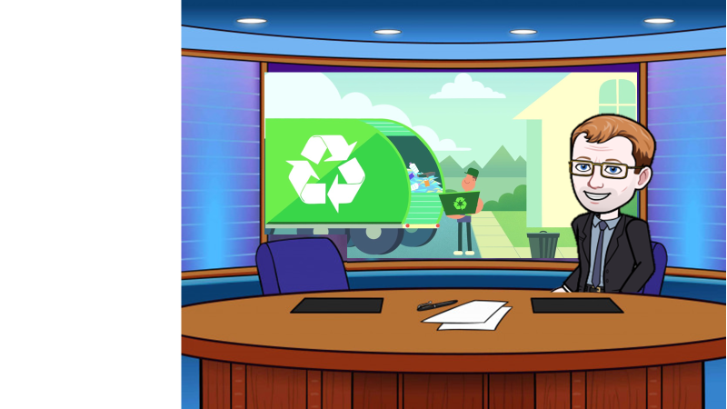
In a world where we are using more paper, lets have a look at how it’s recycled

Slide 2

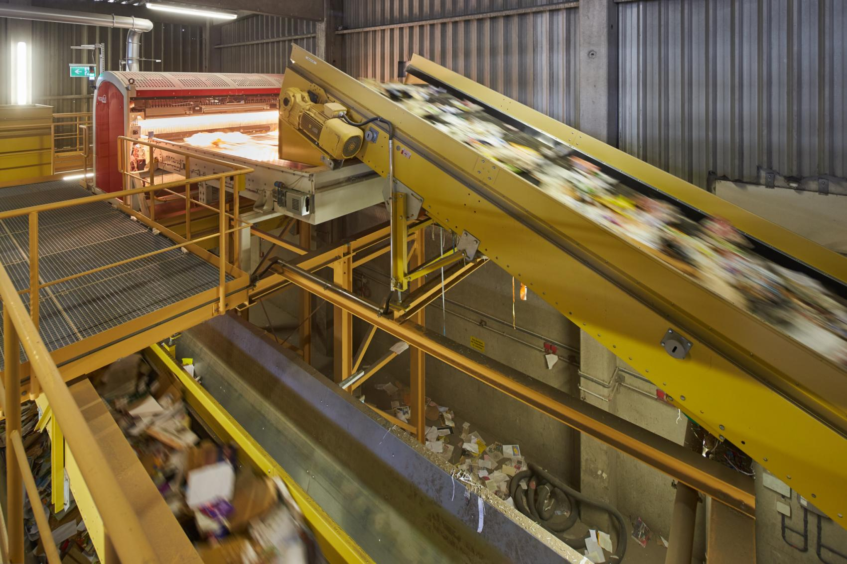

The paper is sorted by removing any contaminants like plastic, metal or other trash.
Key questions
What might be mixed in with the paper?
What different types of paper do you think might need separating?

Slide 3
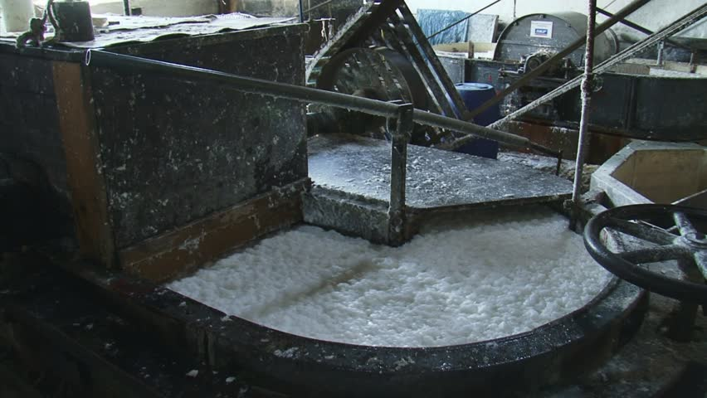

The pulper is a large vat that has chemicals and water. The paper is chopped into tiny pieces and then heated in the vat.
Key questions
Why is the paper chopped into pieces before being pulped?
What could you do to increase the speed the pulp is produced?

Slide 4
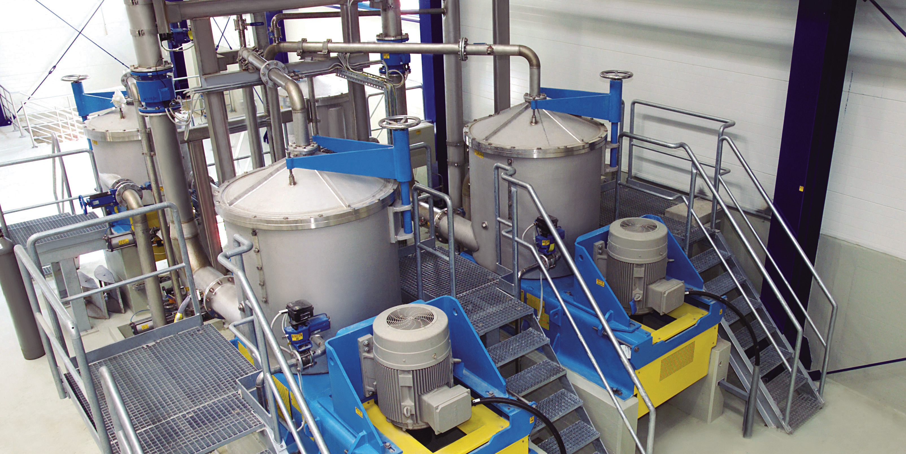
The mushy pulp is then screened. Basically the pulp is pushed through screens that have holes and slots of different shapes and sizes.
.
Key questions
Why do you think the pulp is screened?
Why do you want just fine fibres?
How could this process be sped up?

Slide 5
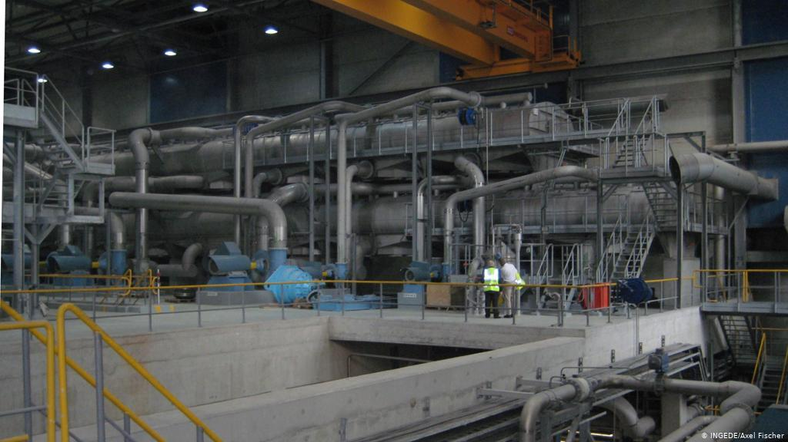
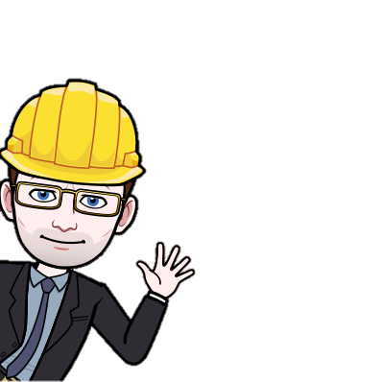
After this, depending on the paper, the pulp might go through the de-inking phase.
Key questions
What could be added to deink the paper?
What problems would be caused by any by-products?

Slide 6
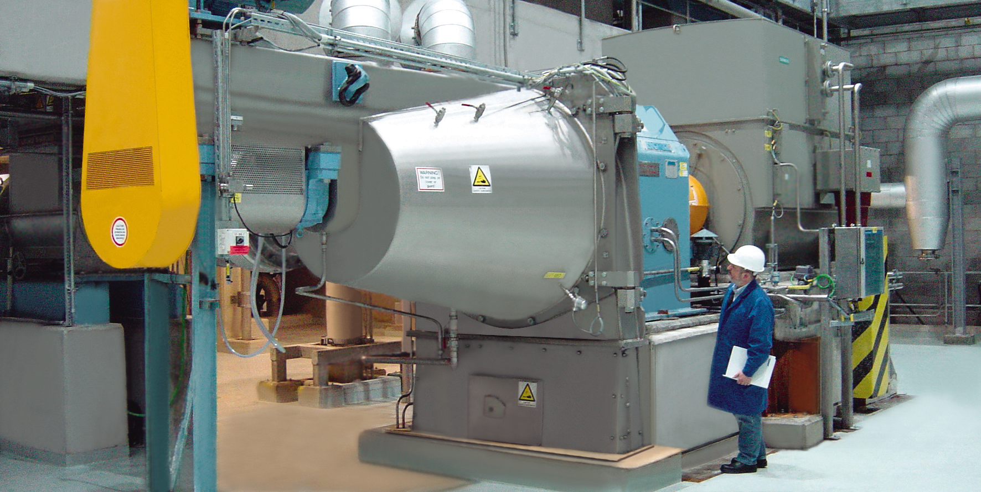
If white paper is going to be made then hydrogen peroxide, oxygen or chlorine dioxide is used to bleach it.
Key questions
Why is paper bleached?
What is paper bleached with?
When might paper not be bleached?

Slide 7
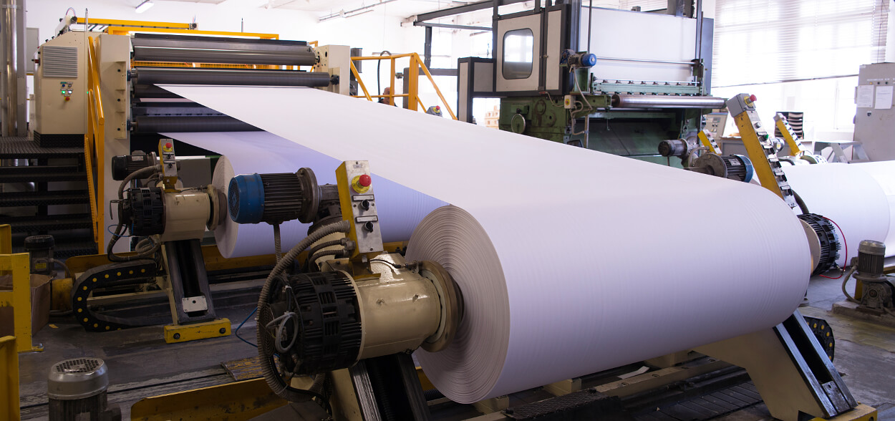

The pulp is then sprayed onto wire screens, which drains the water and bonds the recycled fibres to form a watery paper sheet. This watery sheet is pressed through a number of press rollers to remove all the water. It is then dried using heated metal rollers and wound into a giant roll.
Key questions
Why are the sheets pressed?
Why are they dried?
How could you get thinner paper?

Slide 8
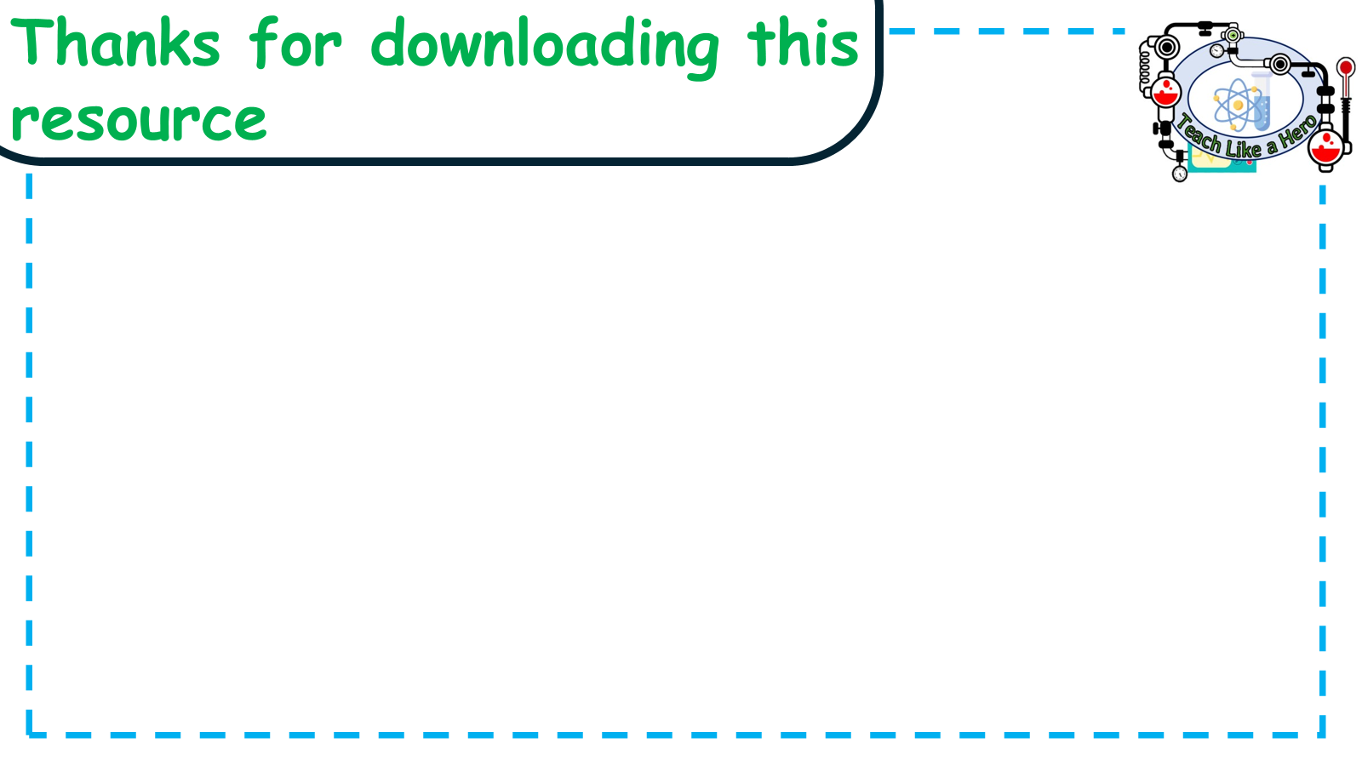
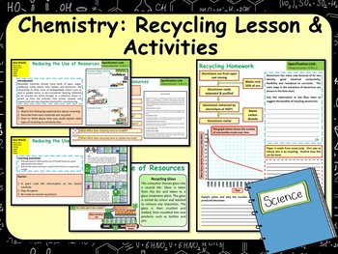
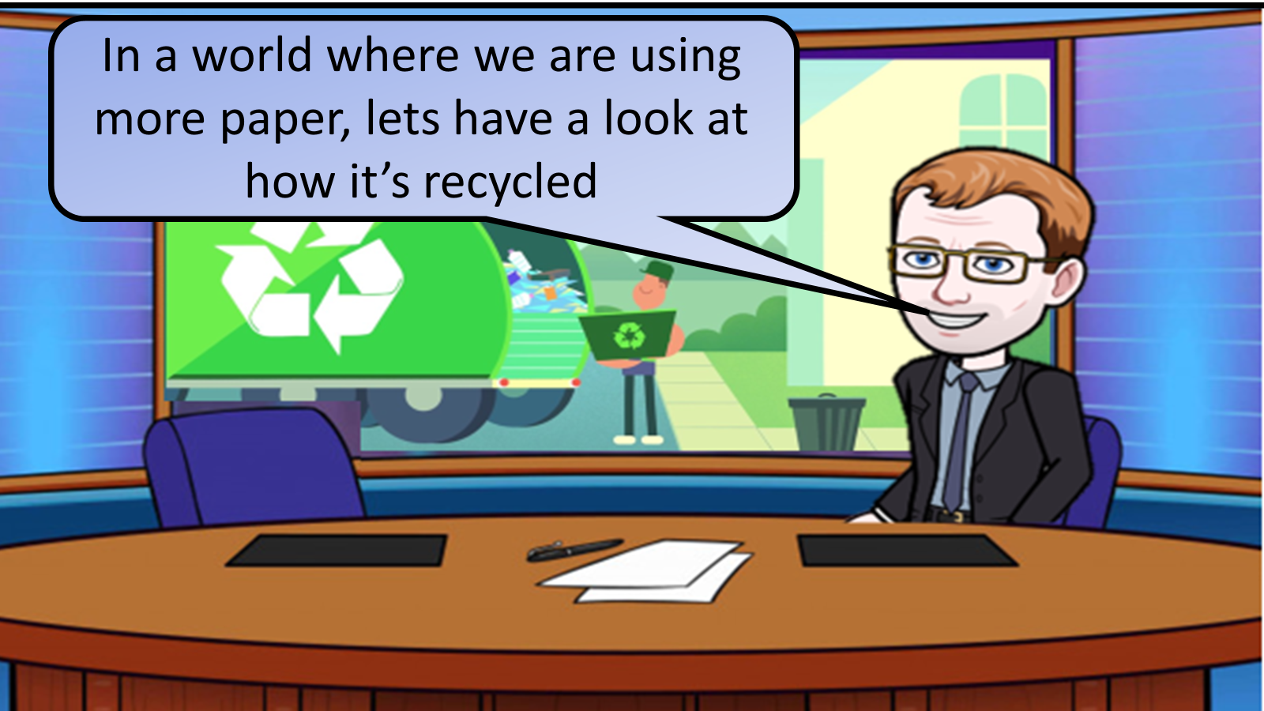


Click on the links below for lessons this resource can be used with
TPT lesson on
TES lesson on
Follow this link for a video running through this activity
Youtube video link
Follow me on social media to stay in touch
Keep up to date with my new content:

