Slide 1


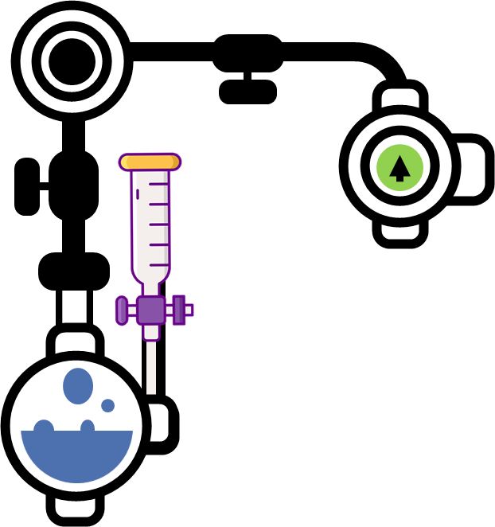

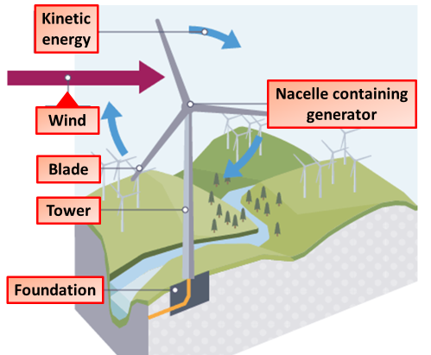
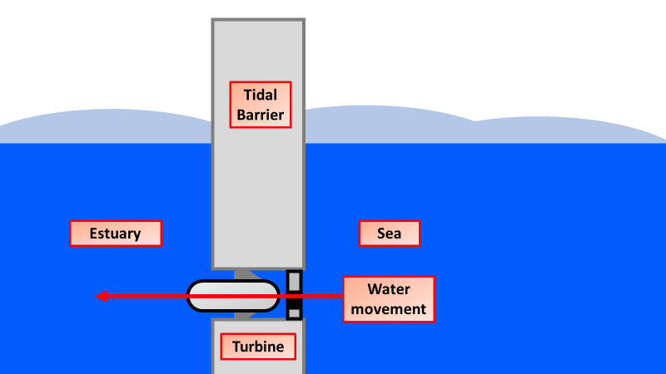

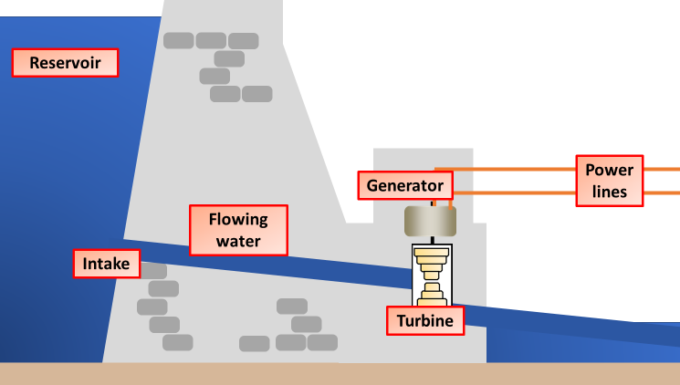
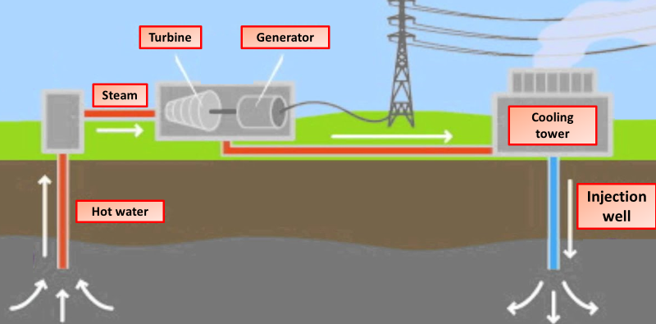

Renewable Energy Notes
Renewable energy is energy that is collected from renewable resources that are naturally replenished on a human timescale. It includes sources such as sunlight, wind, rain, tides, waves, and geothermal heat. Although most renewable energy sources are sustainable, some are not.
At the present time, most renewable energy generators are expensive to set up. Also, sources such as wind turbines and solar cells rely heavily on the weather. If it is not a windy day, wind turbines will not turn. And if it is not sunny, solar cells will not produce much electricity.
Wind energy (or wind power) describes the process by which wind is used to generate electricity. Wind turbines convert the kinetic energy in the wind into mechanical power.
Wind turbines operate on a simple principle. The energy in the wind turns two or three propeller-like blades around a rotor. The rotor is connected to the main shaft, which spins a generator to create electricity.
Energy in the gravitational store of a body of water held above sea level can be used as the water is allowed to run down pipes containing turbines
The Moon's gravitational pull lifts the level of the seas twice a day and this is the force that gives us tidal power.
At high tide, the sea is trapped behind a barrage/dam. The water is allowed to run out through pipes that lead back to the sea. As the water runs through the pipes it spins turbines that are linked to generators.
Hydroelectric schemes use a dam to block a valley or a major river, often creating a reservoir behind the dam. Once the water has built up behind the dam, it is directed and released by valves through turbines. The turbines turn generators to produce electricity. The kinetic energy of the falling water turns the blades of the turbines. This turns electromagnets in a generator, which changes kinetic energy into electrical energy. Once it's done its job of turning the turbines and generating electricity, the water flows out of the power station and downstream.
Several types of rock contain radioactive substances such as uranium. Radioactive decay of these substances releases heat energy, which warms up the rocks. In volcanic areas, the rocks may heat water so that it rises to the surface naturally as hot water and steam. Here the steam can be used to drive turbines and electricity generators
In some places, the rocks are hot, but no hot water or steam rises to the surface. In this situation, deep wells can be drilled down to the hot rocks and cold water pumped down.

Slide 2
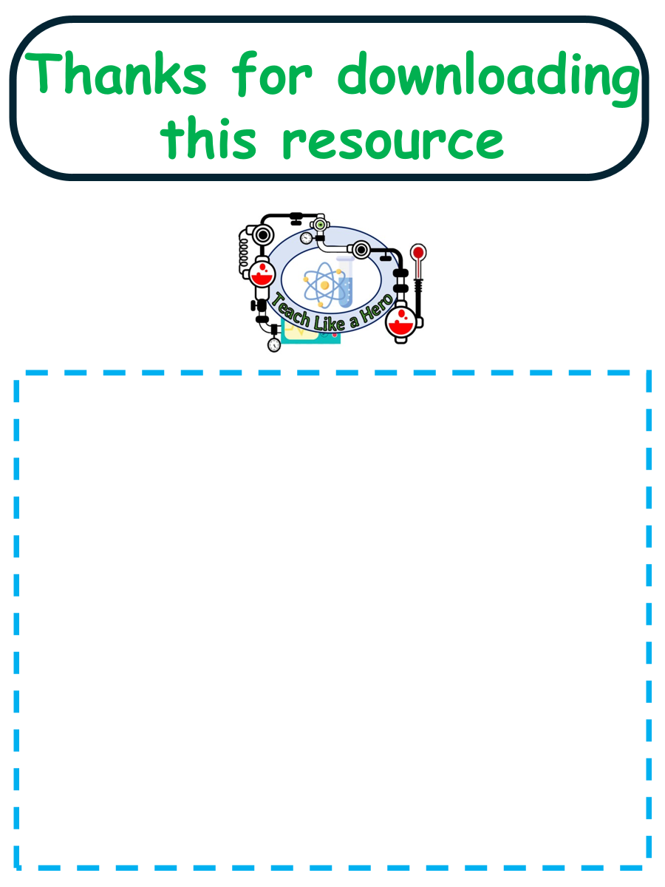
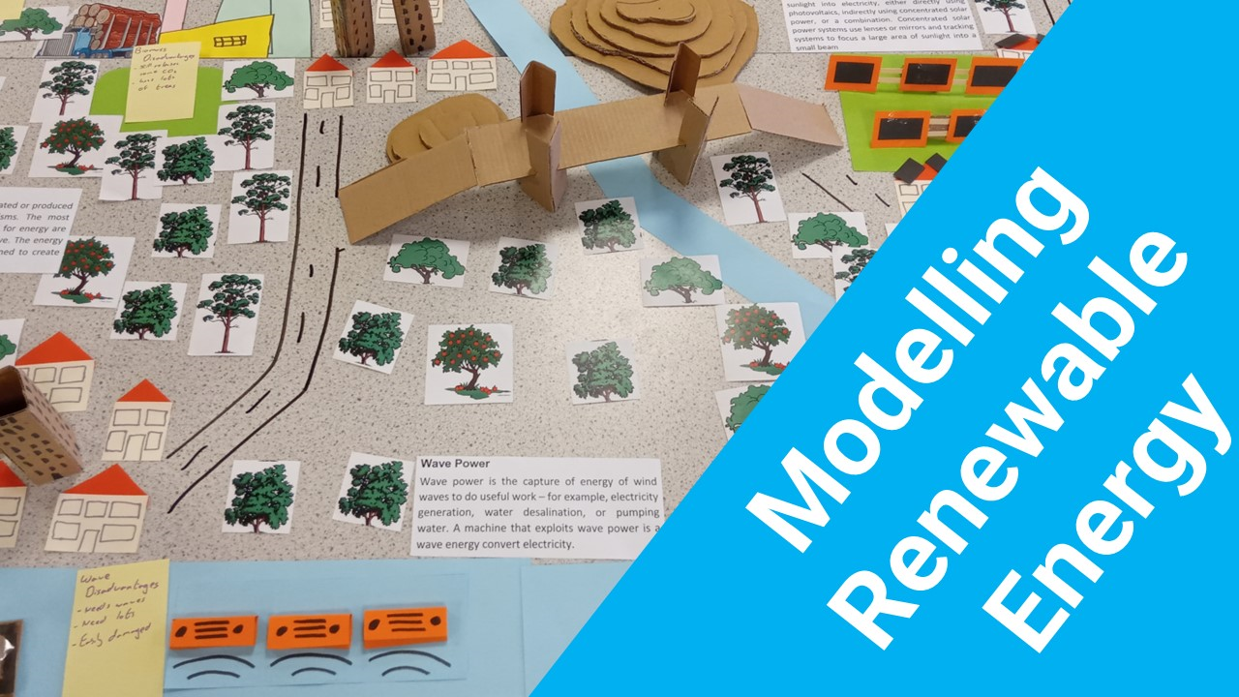


Click here to access my youtube videos
Resources that this activity would work well with
Lessons on TES
Lesson on TPT
Follow me on social media to stay in touch
Keep up to date with my new content:

