Slide 1
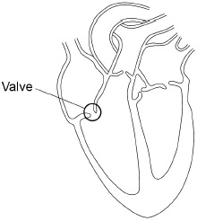

Replacement Heart Valve Question
The figure below shows the internal structure of the human heart. One of the heart valves is labelled. Sometimes a valve in the heart can start to leak.
Explain why a person with a leaking heart valve has difficulty exercising.
Key things to include:
How is it going to affect how blood is pumped
What are cells in the body going to have less of
What effect will this have on respiration
How could it affect oxygen debt
______________________________________________________________________________________________________________________________________________________________________________________________________________________________________________________________________________________________________________________________________________________________________________________________________________________________________________________________________________________
Answer
Link to video

Slide 2
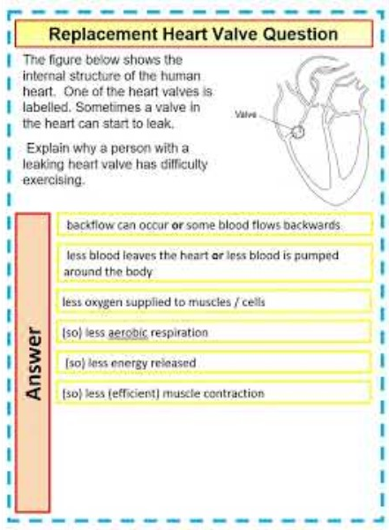
Replacement Heart Valve Question

Slide 3




Click here to access my youtube videos
Resources that this activity would work well with
Lesson on TES
Lesson on TPT
Follow me on social media to stay in touch
Keep up to date with my new content:

