Slide 1
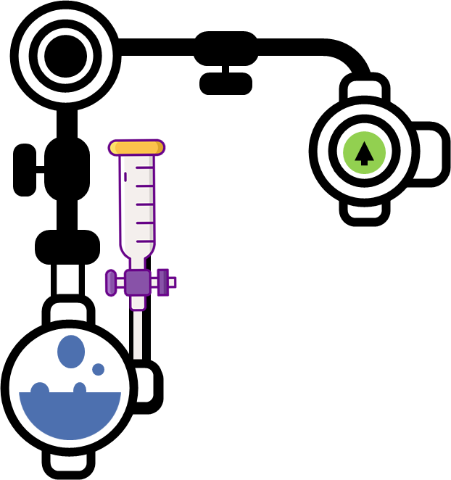
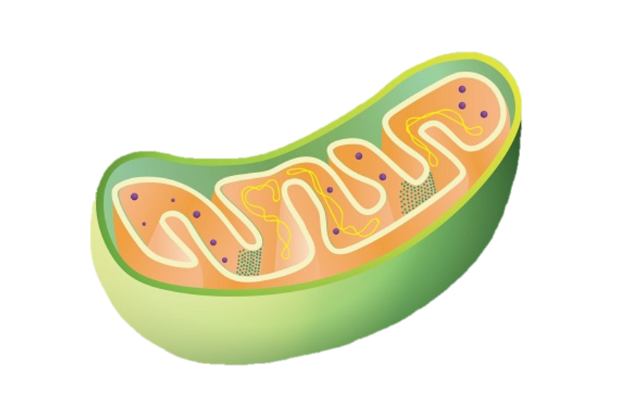
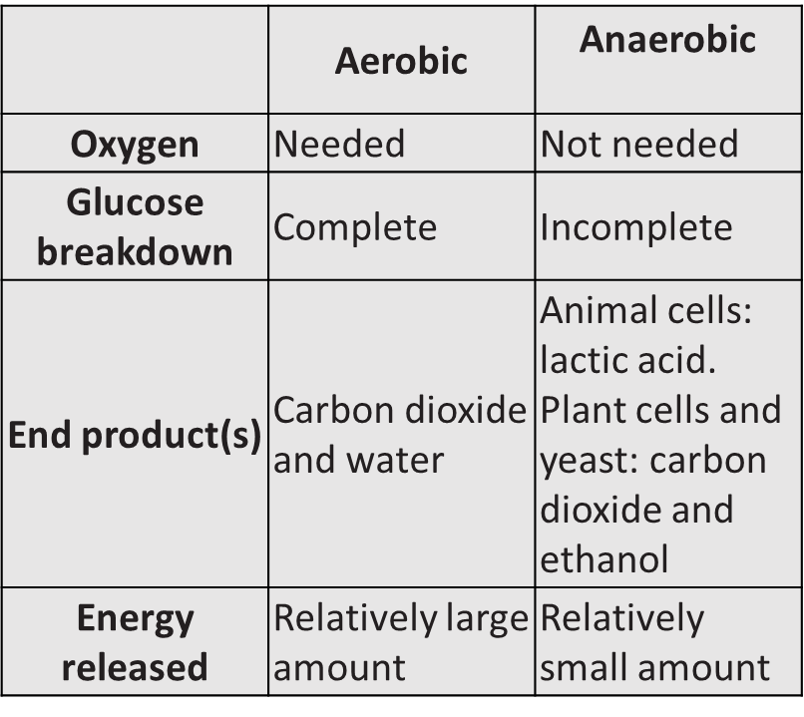
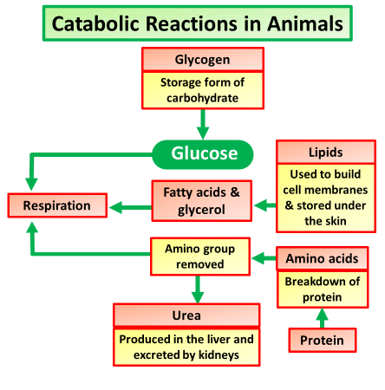
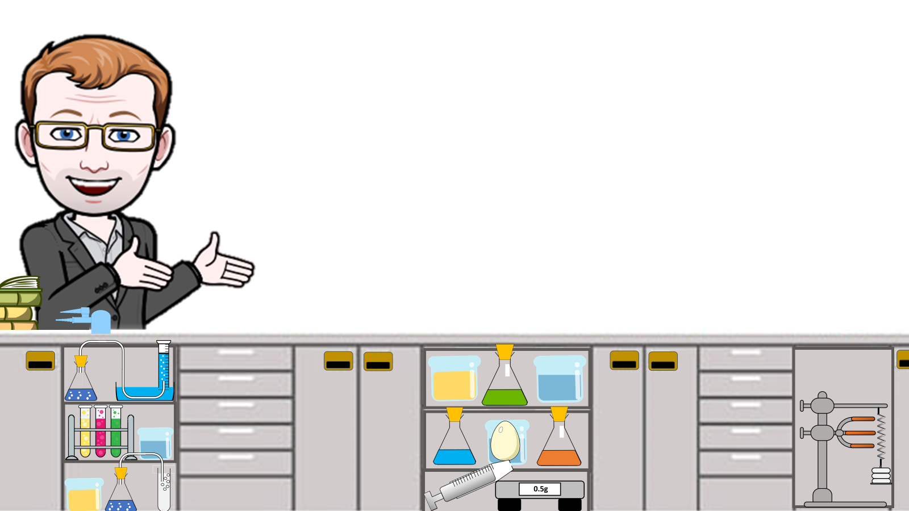
Respiration Notes
Respiration is a chemical reaction that happens in all living cells, including plant cells and animal cells. It is the way that energy is released from glucose so that all the other chemical processes needed for life can happen.
Mitochondria are known as the powerhouses of the cell. They are organelles that take in nutrients, break them down, and create energy for the cell. Most of the chemical reactions involved in cellular respiration happen in the mitochondria. A mitochondrion is shaped perfectly to maximize its efforts.
Fermentation: It occurs when yeast breaks down sugars in the absence of oxygen. Fermentation is used to make alcoholic drinks, such as beer and wine. Carbon dioxide gas is also produced during fermentation: glucose (sugar) → ethanol (alcohol) + carbon dioxide. Fermentation is an example of anaerobic respiration
Metabolism is the set of life-sustaining chemical transformations within the cells of living organisms. The three main purposes of metabolism are the conversion of food/fuel to energy to run cellular processes, the conversion of food/fuel to building blocks for proteins, lipids, nucleic acids, and some carbohydrates, and the elimination of nitrogenous wastes.
Types of Metabolism
There are different types of metabolic pathways – some are anabolic and some are catabolic.
Anabolic – this type of pathway requires energy and is used to build up large molecules from smaller ones (biosynthesis).
Catabolic – this type of pathway makes energy and is used to break down large molecules into smaller ones (degradation).
Response to Exercise
Introduction
Muscles need energy to contract. While exercising, the muscles need additional energy as:
the breathing rate and volume of each breath increases to bring more oxygen into the body and remove the carbon dioxide produced
the heart rate increases, to supply the muscles with extra oxygen and remove the carbon dioxide produced

Slide 2
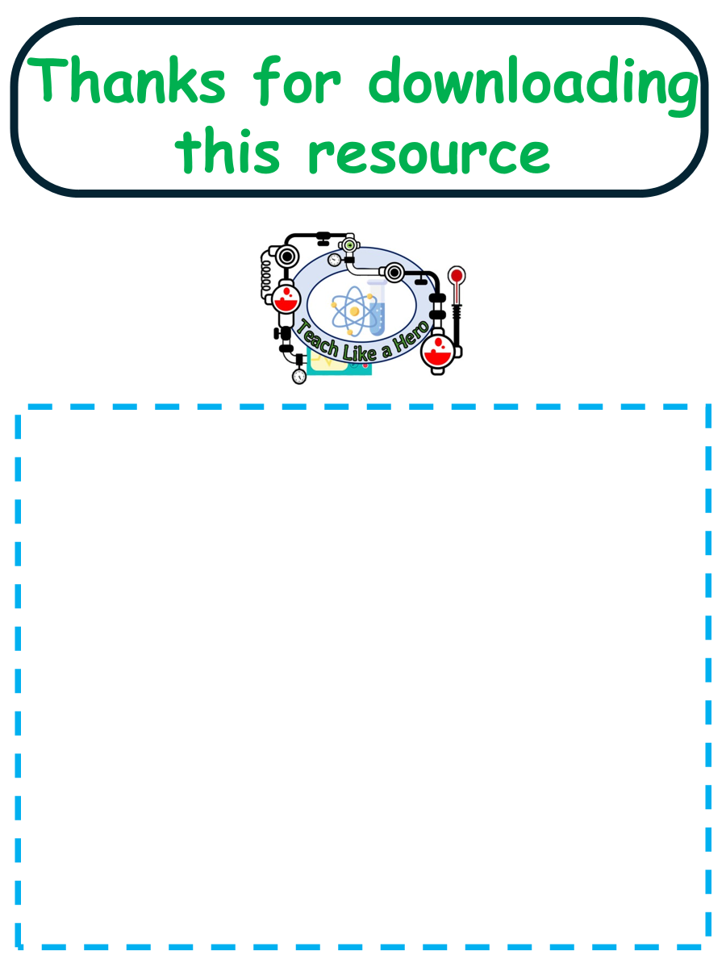
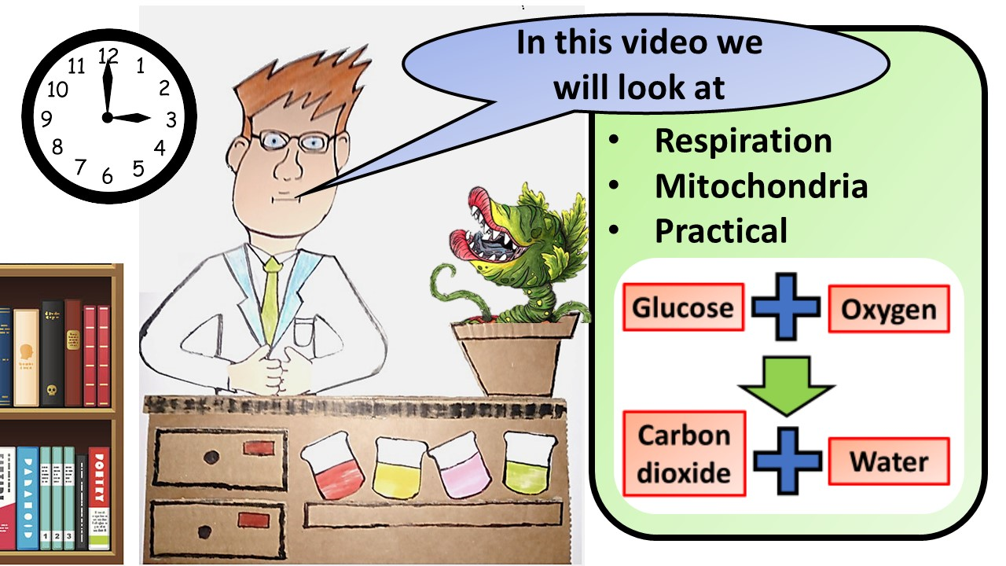
Click here to access my respiration videos
Resources that this activity would work well with
Lessons on TES
Lesson on TPT
Follow me on social media to stay in touch
Keep up to date with my new content:

