Slide 1

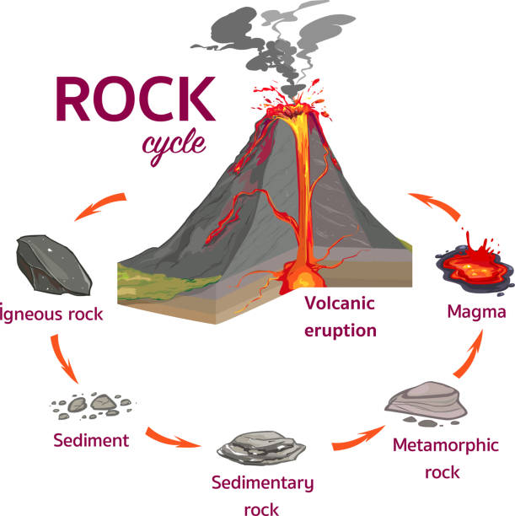
Rocks Article
Rocks are fascinating objects that have been around since the beginning of time and have played an important role in the formation of our planet. From providing the building blocks of life to shaping the landscapes around us, rocks are an essential part of our lives.
1. There are three different types of rock: There isn’t only one type of rock you know! There are three different types. They are Igneous, Sedimentary and Metamorphic.
2. Rocks are made of minerals: Each rock has varying minerals which is why there are so many different ones. Some of the most well known minerals are calcite, quartz, olivine and mica. Minerals are made naturally in the Earth and are made from chemicals.
3. Igneous rock comes from molten magma: Molten magma is the very hot stuff you find in volcanos! The magma turns to rock when it cools. There are two different types of igneous rock, depending on if the magma has cooled on the Earth’s surface or beneath. It is plutonic rock if it has cooled beneath and volcanic rock if it has cooled above. Slate and pumice are types of igneous rock!
4. Sedimentary rock is very common: It is formed of layers from things such as sand, mud and small stones. Over the years, the bottom layers are compacted with new layers joining on top. Types of sedimentary rock are chalk, sandstone, shale and limestone.
5. Metamorphic rock has been put under a lot of pressure and heat: Metamorphic rock are from rocks that have been put under a lot of pressure and heat. The pressure and heat can be made by the Earth’s movements. After all, it is moving all the time! Two examples of metamorphic rock are slate and marble.
Questions
1. What is an example of a metamorphic rock?
2. What are sedentary rocks formed from?
3. Where do we find magma?
4. What are minerals?

