Slide 1
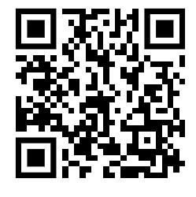
SHC Calculation
A ‘can-chiller’ is used to make a can of drink colder. The initial temperature of the liquid in the can was 25.0 °C.
The can-chiller decreased the temperature of the liquid to 20.0 °C.
The amount of energy transferred from the liquid was 6930 J.
The mass of liquid in the can was 0.330 kg
Calculate the specific heat capacity of the liquid.
Energy = mass × SHC × temp change
Answer
Calculate the temperature change
Rearrange the equation to give SHC
Substitute in the values
Calculate the SHC

Slide 2
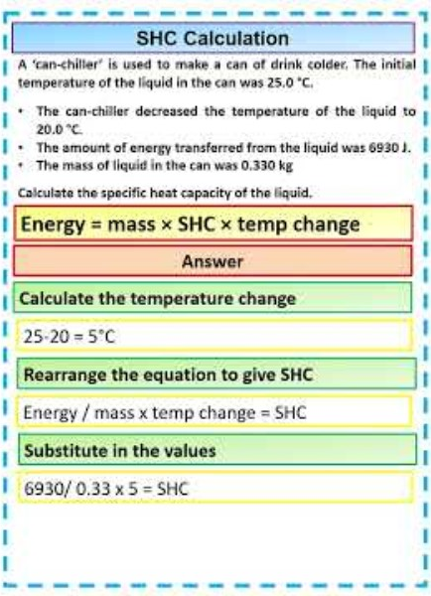
SHC Calculation

