Slide 1

SHC / Power Calculation
The coffee machine heats water from 20 °C to 90 °C.
The power output of the coffee machine is 2.53 kW.
The specific heat capacity of water is 4200 J/kg °C.
Calculate the mass of water that the coffee machine can heat in 14 seconds.
Power = Energy transferred / time
Energy = mass × SHC × temp change
Answer
Rearrange power equation to give energy
Substitute in values
Rearrange SHC equation to give mass
Substitute in values

Slide 2
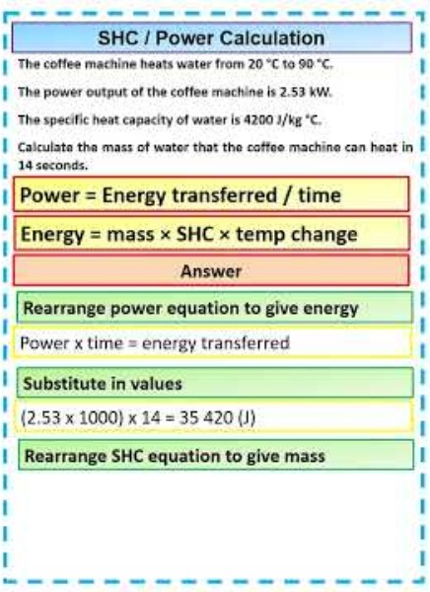
SHC / Power Calculation

