Slide 1
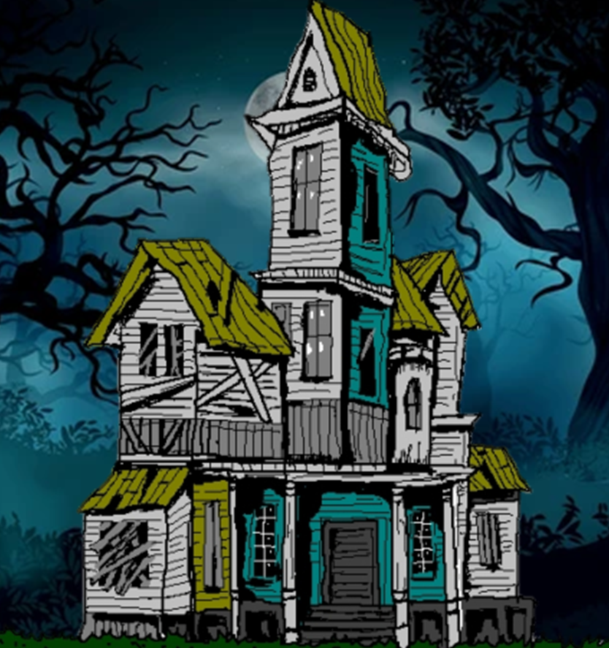
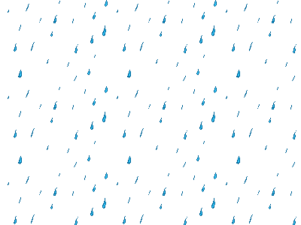

Slide 2
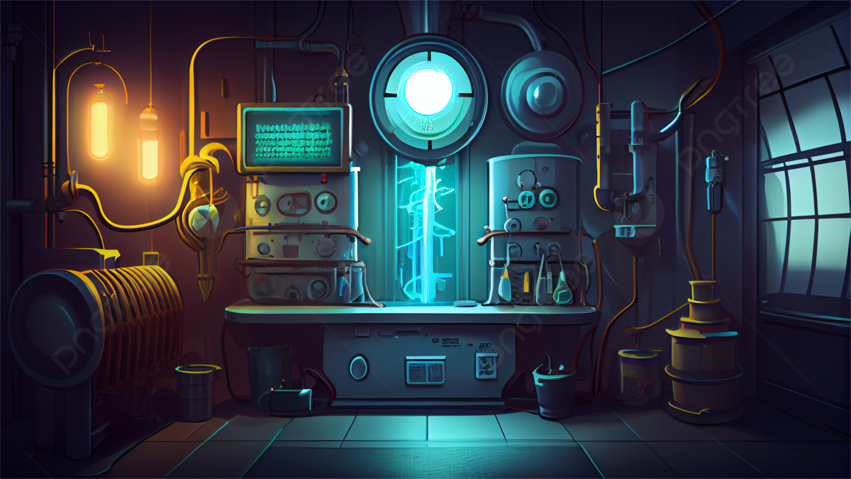
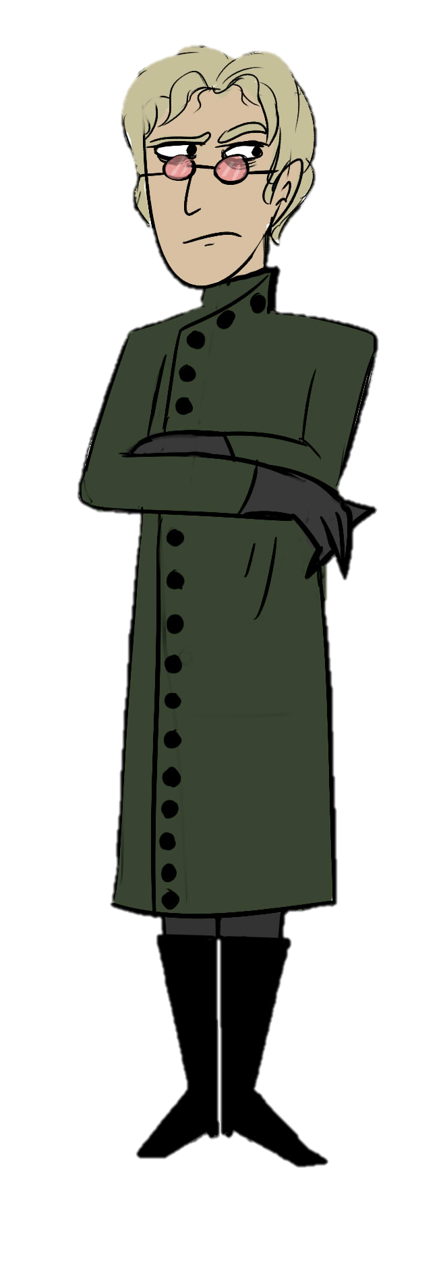
The science that inspired Mary Shelley to write "Frankenstein" is nearly as strange as the novel itself. Written in 1818, the book was influenced by a scientific feud that ushered in the first battery and our modern understanding of electricity.

Slide 3
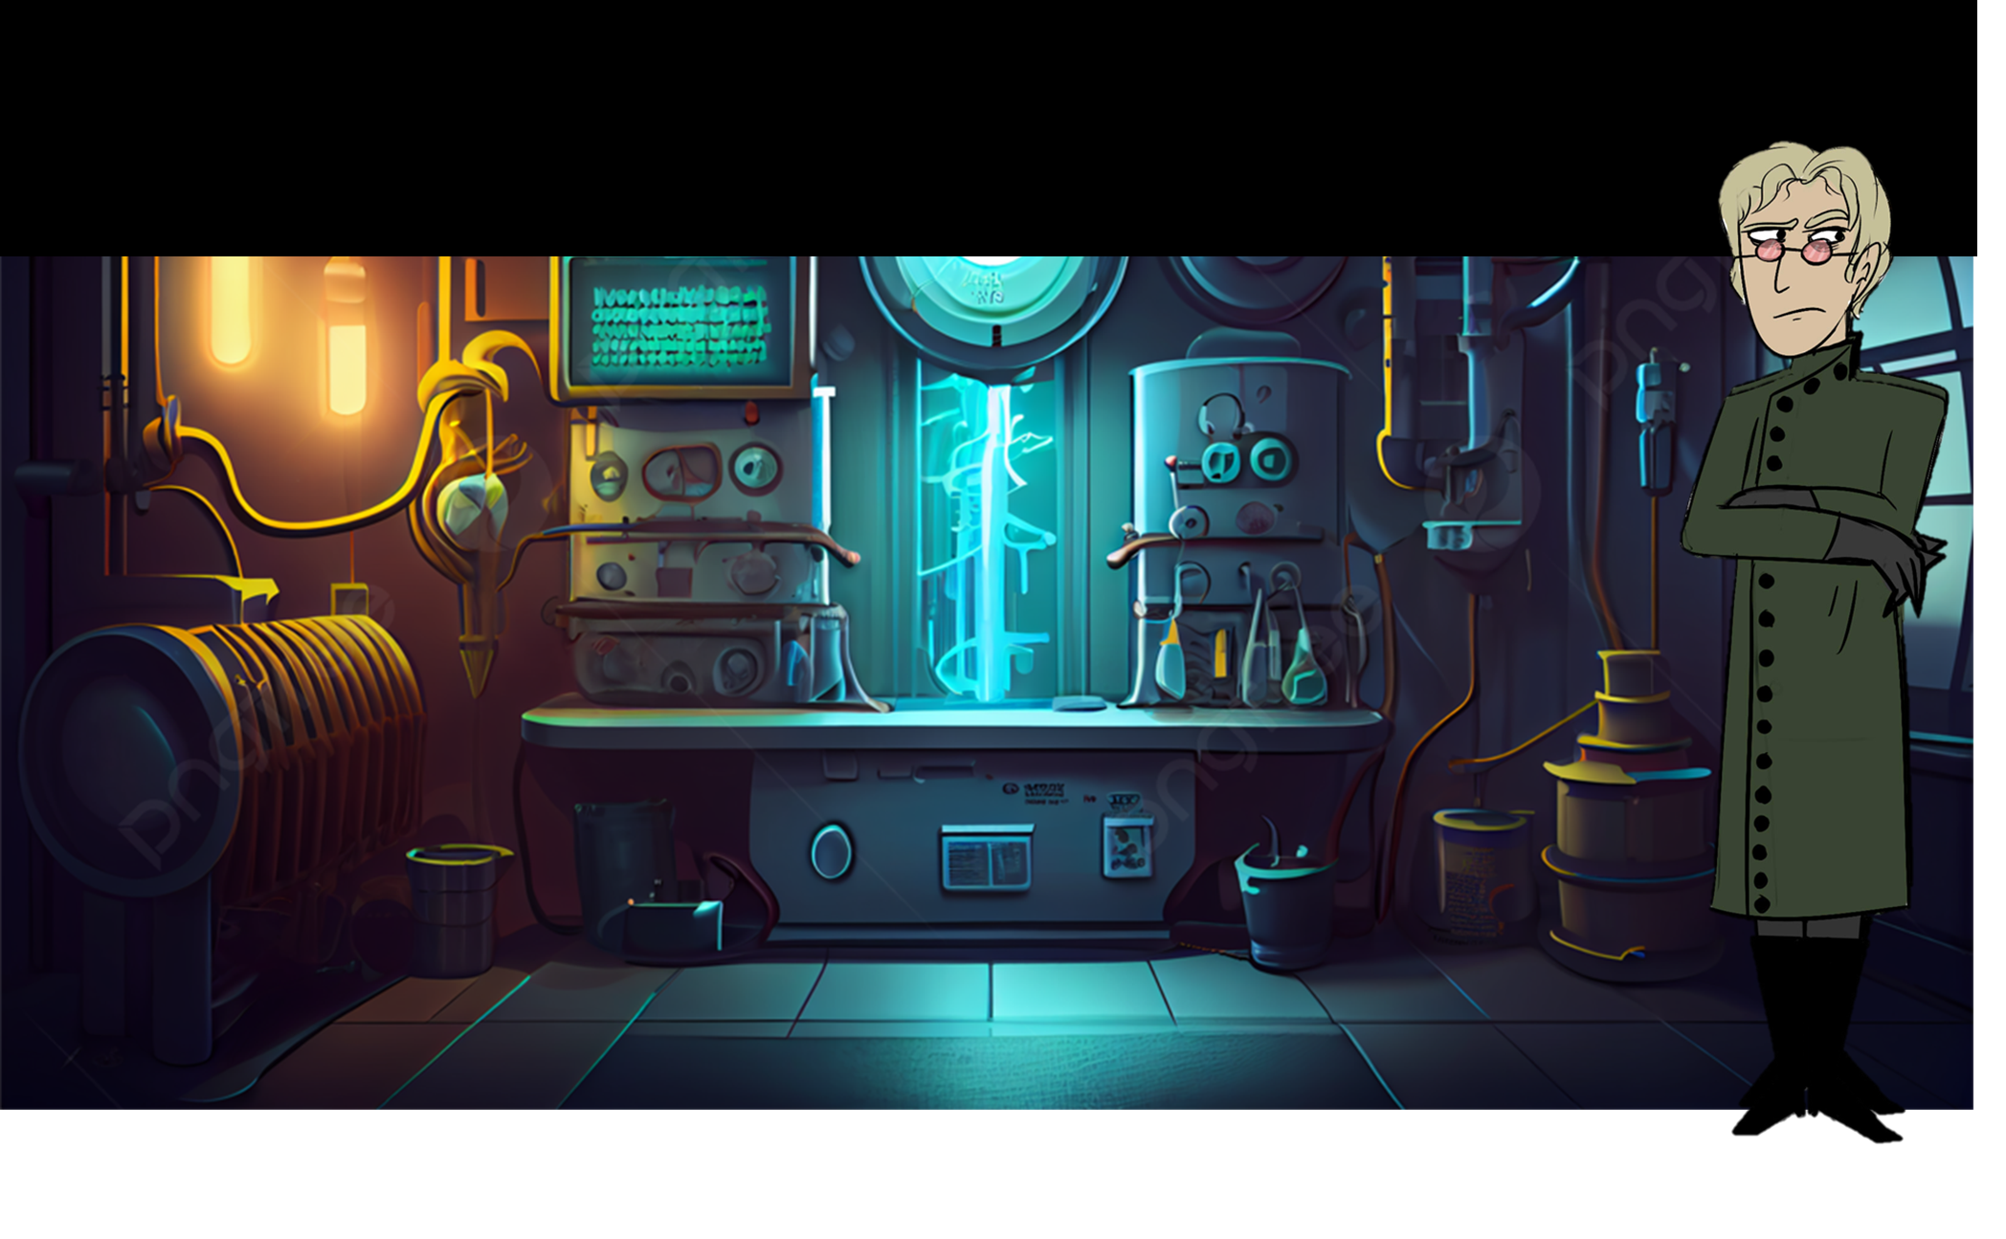
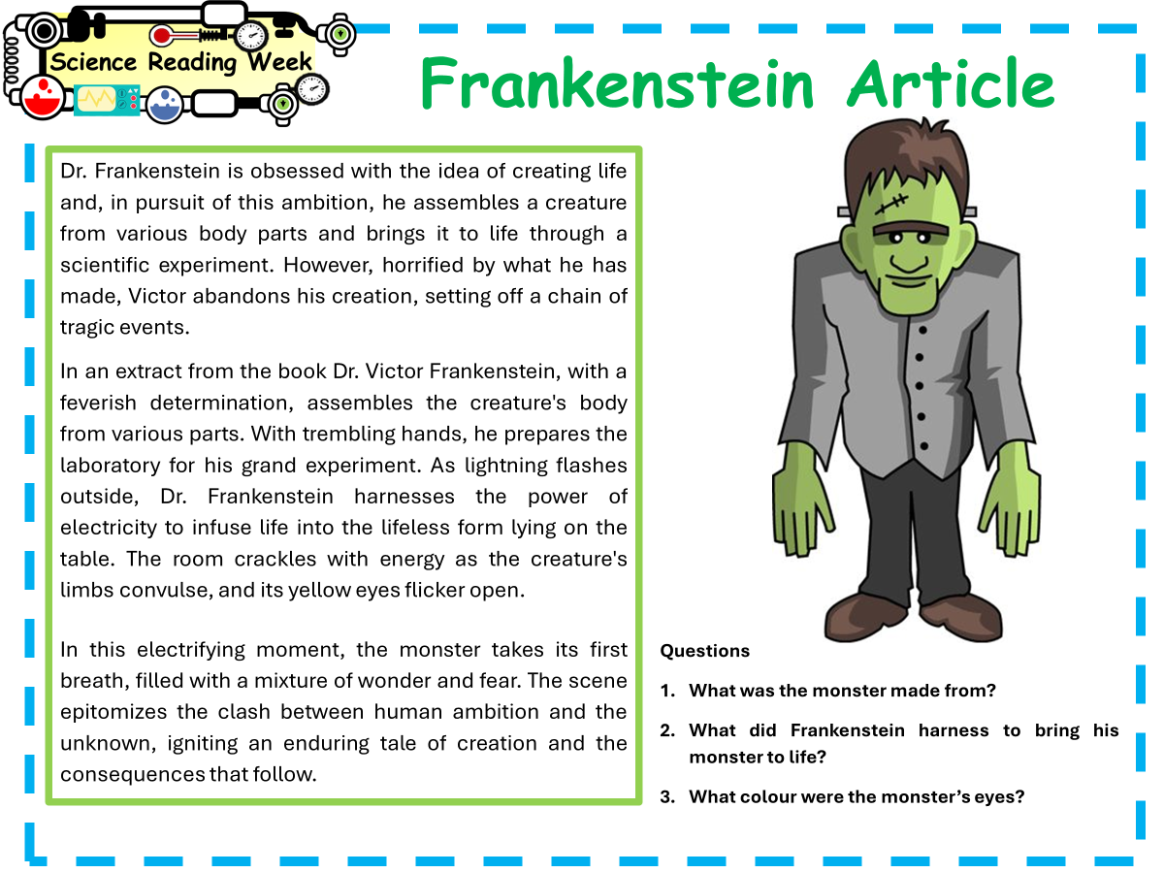
The Science of Frankenstein
Starter task
Read the short article carefully
Answer the questions
Be ready to share what you have come up with

Slide 4
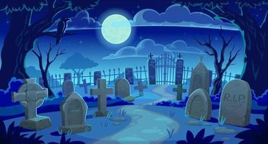
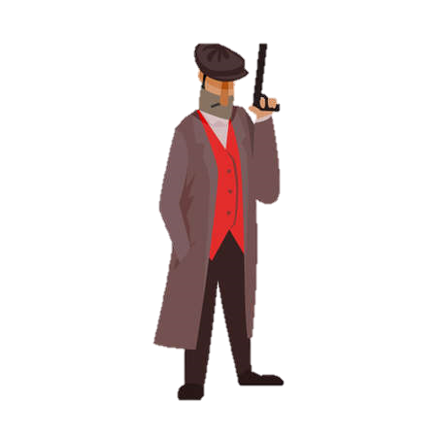
Body snatching was at an all time high in Europe during the 19th century. There was a reduction in executions, which was the traditional source of cadavers for medical schools. There was also, simultaneously, an influx in students wanting to study anatomy
It is easy to see how the story of Frankenstein isn’t that crazy when you compare it to the events occurring while Shelley was writing her book.
The punishment for convicted body snatchers was very lax and usually only resulted in a fine. Many medical professionals condoned the practice as a necessary evil, which benefits towards science would outweigh its moral controversy
Notes:
body snatching was at an all time high in Europe during the 19th century. There was a reduction in executions, which was the traditional source of cadavers for medical schools. There was also, simultaneously, an influx in students wanting to study anatomy
The punishment for convicted body snatchers was very lax and usually only resulted in a fine. Many medical professionals condoned the practice as a necessary evil, which benefits towards science would outweigh its moral controversy
It is easy to see how the story of Frankenstein isn’t that crazy when you compare it to the events occurring while Shelley was writing her book.

Slide 5
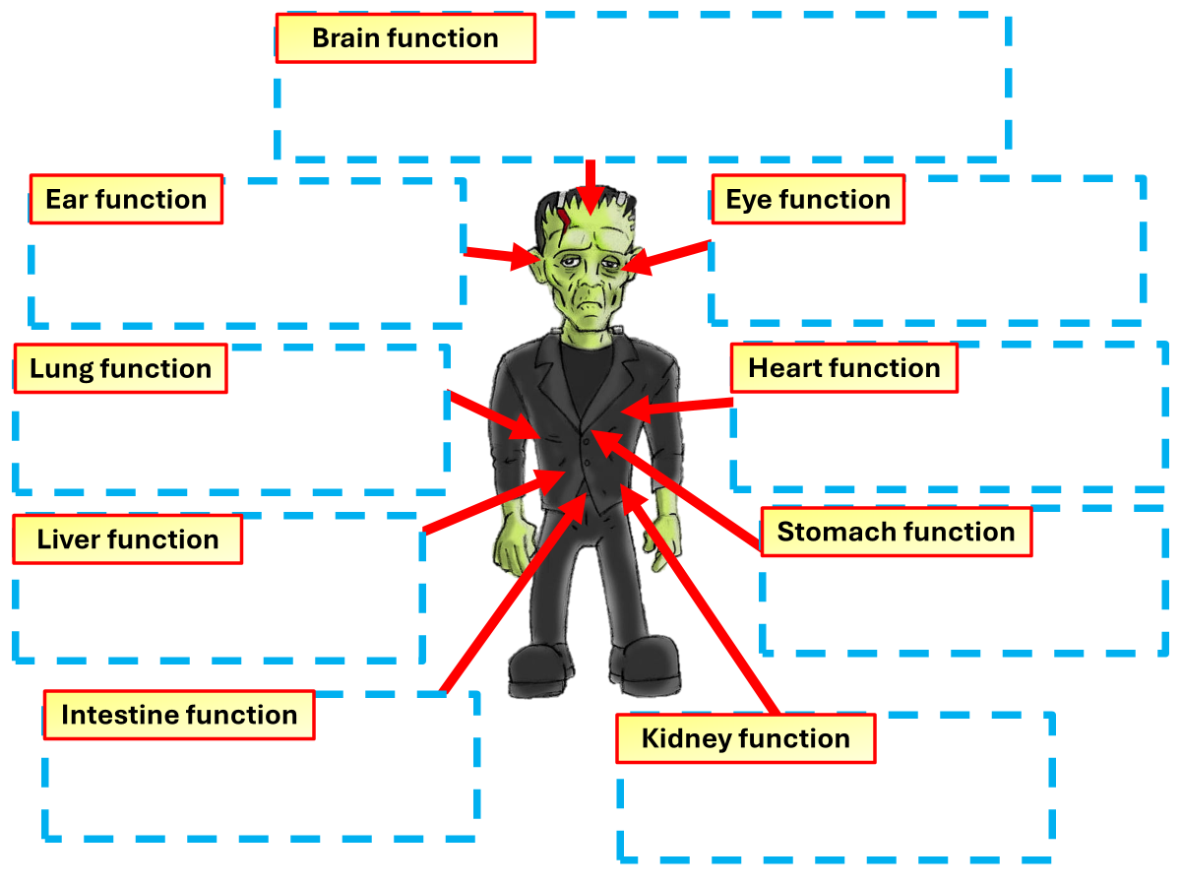
The Science of Frankenstein
Task
Hunt around the room for the body parts you’ll need
Make a brief note on what the parts do

Slide 6
The Science of Frankenstein
Heart: Pumps blood throughout the body.
Lungs: Exchange oxygen and carbon dioxide between blood and air.
Brain: Controls thoughts, movements, and bodily functions
Task
Hunt around the room for the body parts you’ll need
Make a brief note on what the parts do
Liver: Processes nutrients and detoxifies harmful substances.
Stomach: Breaks down food with acids and enzymes.
Kidneys: Filter waste from the blood to produce urine.
Intestines: Absorb nutrients from food and remove waste

Slide 7
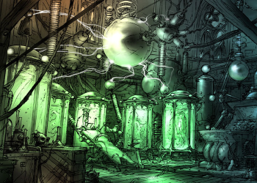
At the University of Bologna in Italy, noted surgeon Luigi Galvani was investigating the effects of electricity on animals. It was not an unusual line of inquiry. Researchers knew electrical shocks produced violent spasms and speculated that electricity might cause muscular contractions.
The story begins in the mid-18th century. Electricity had captured the imaginations of many of Europe's top scientists, and at that time very little was understood about the nature of electricity. Scientists could generate static electricity using spinning machines, but it was not until Benjamin Franklin's famous kite experiment in 1752 that they proved that lightning was of the same essence.

Slide 8
The Science of Frankenstein
Task
What does the body use electricity for?
Highlight and SPAG errors that you spot

Slide 9
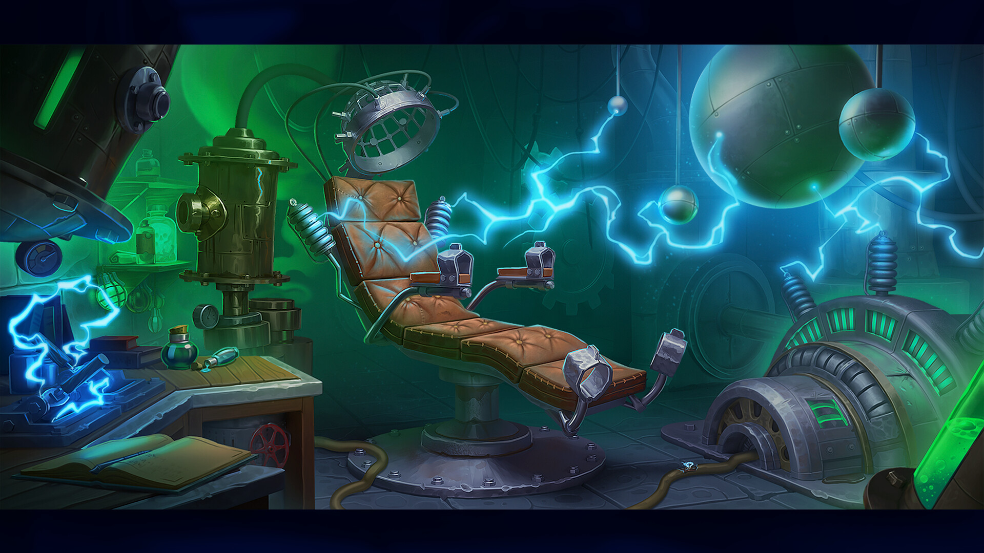
As lightning flashes outside, Dr. Frankenstein harnesses the power of electricity to infuse life into the lifeless form lying on the table. The room crackles with energy as the creature's limbs convulse, and its yellow eyes flicker open. In this electrifying moment, the monster takes its first breath, filled with a mixture of wonder and fear. The scene epitomizes the clash between human ambition and the unknown, igniting an enduring tale of creation and the consequences that follow.

Slide 10
The Science of Frankenstein
Things to include
What Frankenstein's monster was
What organs did the monster need to have to give it life
Task
Making the monster
Short presentation of what you’d need
Why did the monster need electricity to give it life

