Slide 1

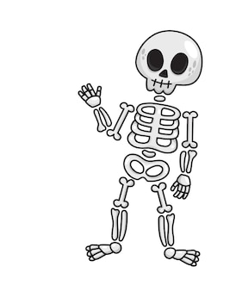
Skeleton Article
Embark on a skeletal adventure as we journey into the captivating world of bones, unlocking the mysteries that support our bodies and make every movement possible. For KS3 students, understanding the role of bones goes beyond the classroom – it's a fascinating exploration of the intricate framework that shapes our anatomy.
Did You Know?
The adult human body has 206 of them.
There are 26 bones in the human foot.
The human hand, including the wrist, contains 54 bones.
The femur, or thighbone, is the longest and strongest bone of the human skeleton.
The stapes, in the middle ear, is the smallest and lightest bone of the human skeleton.
Arms are among the most commonly broken bones, accounting for almost half of all adults' broken bones. The collarbone is the most commonly broken bone among children.
Bones stop growing in length during puberty. Bone density and strength will change over the course of life, however.
The only bone in the human body not connected to another is the hyoid, a V-shaped bone located at the base of the tongue.
Bones are made up of calcium, phosphorus, sodium, and other minerals, as well as the protein collagen.
Bones function as the skeleton of the human body, allow body parts to move and protect organs from impact damage. They also produce red and white blood cells.
Questions
How many bones are in the human foot?
What are the strongest bones in the human body?
What is the name of the V shaped bone?
What are bones made from?
What else is produced in the bones?

