Slide 1
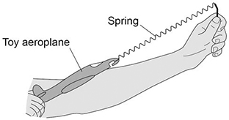

KE / Spring Constant Calculation
The figure below shows a student launching a toy aeroplane. To launch the aeroplane, the student pulls on it to stretch the spring and then releases it. Just before the toy aeroplane is released, the spring has an extension of 0.12 m. Calculate the maximum speed of the toy aeroplane just after it is launched.
mass of aeroplane = 0.020 kg.
spring constant of the spring = 50 N/m.
EPE = 0.5 x spring constant x (extension)²
KE = 0.5 x mass x V²
Calculate the EPE
Rearrange KE equation to give V²
Answer
Substitute in to calculate V²
Calculate the value for V

Slide 2
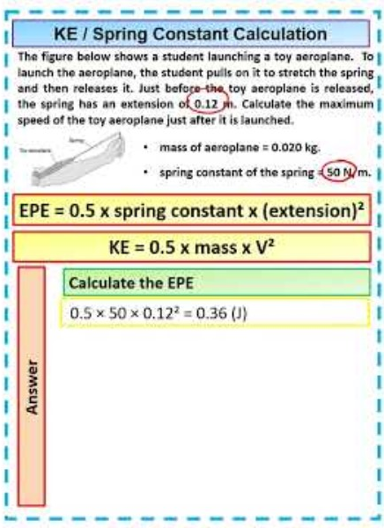
KE / Spring Constant Calculation

