Slide 1


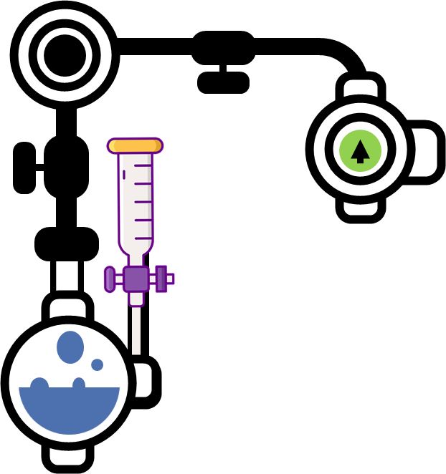

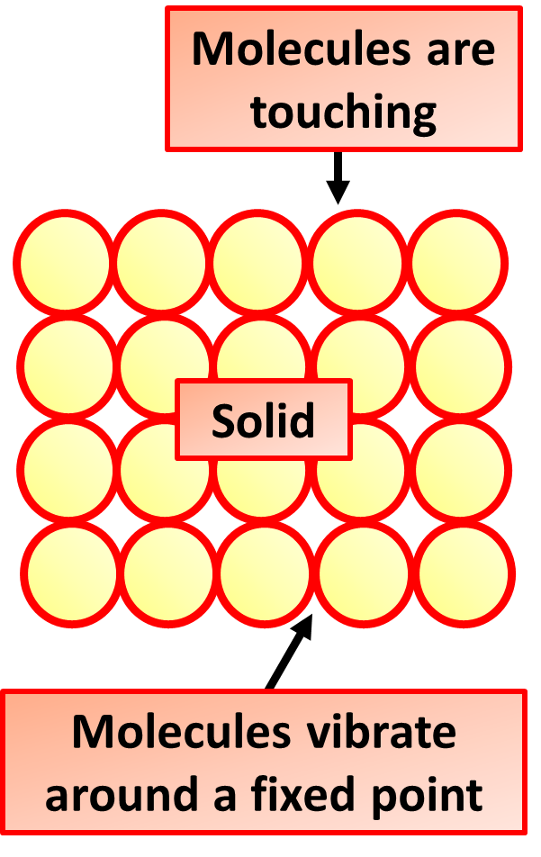
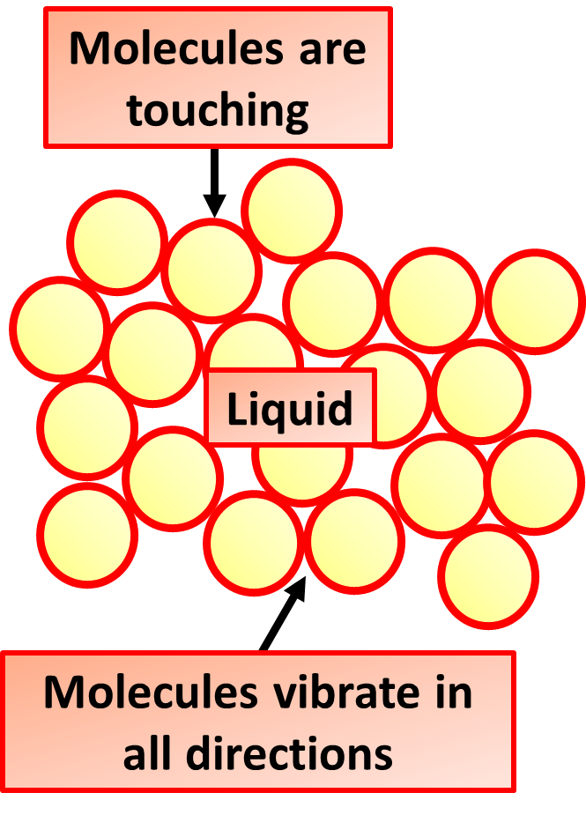
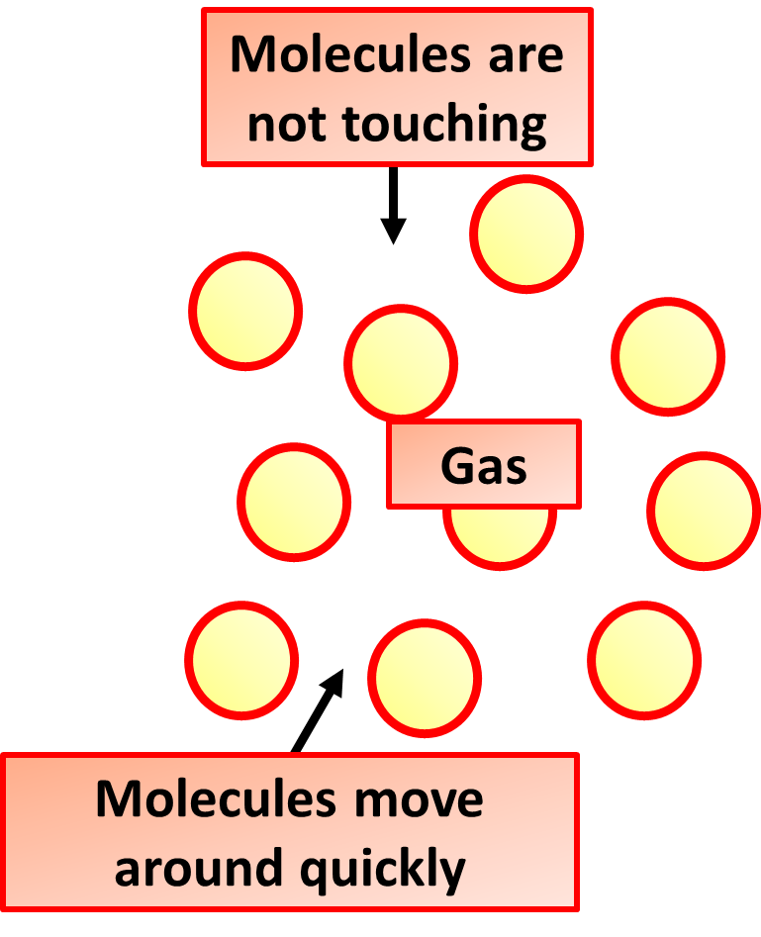
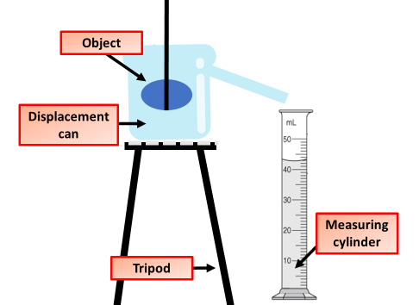


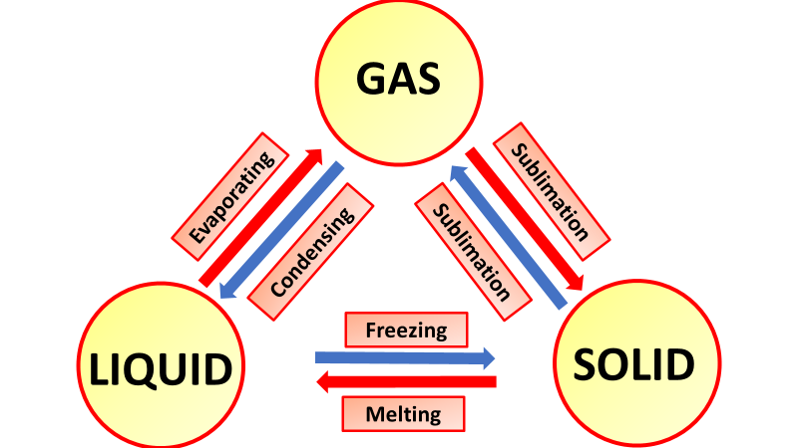
States of Matter Notes
The three states of matter are solid, liquid and gas. The particle model represents particles by small, solid spheres. It describes the arrangement, movement and energy of particles in a substance. The model can be used to explain the physical properties of solids, liquids and gases.
Changes of state are physical changes in matter. They are reversible changes that do not involve changes in matter's chemical makeup or chemical properties. Common changes of state include melting, freezing, sublimation, deposition, condensation, and vaporization.
Solids
They are held in fixed positions but they do vibrate. Because the particles don't move, solids have a definite shape and volume, and can't flow. Because the particles are already packed closely together, solids can't easily be compressed. Because there are lots of particles in a small volume, solids are dense
Liquids
Liquids: flow and take the shape of their container, because their particles can move around each other. cannot be compressed, because their particles are close together and have no space to move into.
Gases
Gas is a state of matter that has no fixed shape and no fixed volume. Gases have lower density than other states of matter, such as solids and liquids. The particles exert more force on the interior volume of the container.
Kinetic Energy of Particles
The kinetic particle theory explains the properties of the different states of matter. The particles in solids, liquids and gases have different amounts of energy. They are arranged differently and move in different ways.
Density
Density is the mass per unit volume. The most accurate way to calculate the density of any solid, liquid or gas is to divide its mass in kilograms by its volume (length × width × height) in cubic metres..
A eureka can is a container large enough to hold the object with a spout positioned near the top. The can is filled to the top with water and the object placed in it. The volume of the object is equal to the volume of the water that is forced through the spout.
Eureka cans are named after a scientist called Archimedes who first recorded this idea. They are sometimes also called displacement vessels.

Slide 2

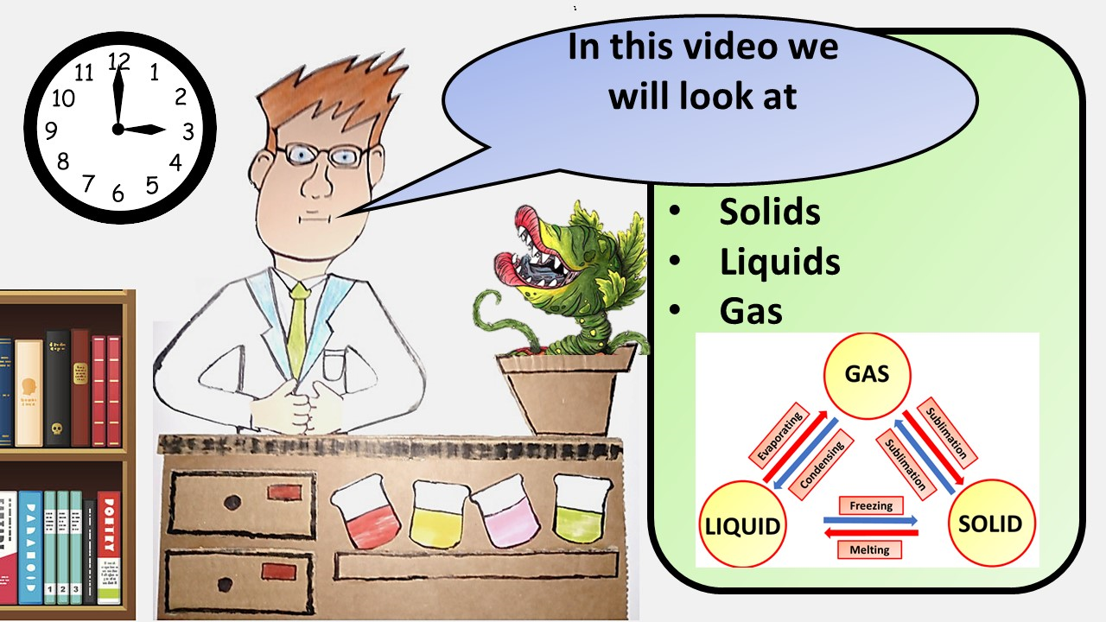


Click here to access my youtube videos
Resources that this activity would work well with
Lesson on TES
Lesson on TPT
Follow me on social media to stay in touch
Keep up to date with my new content:

