Slide 1
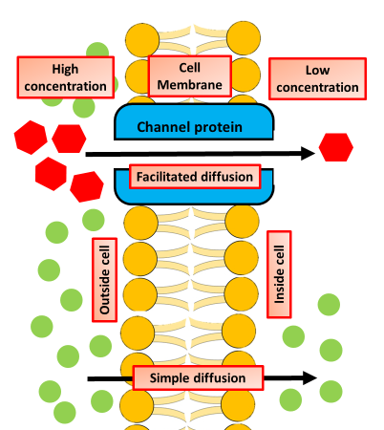
Leaf Structure Question
Specification Link:
Bioenergetics
Highlight key words in the information below:
Functions of a Leaf
Photosynthesis: This is the most important function of a leaf. They contain chloroplasts which have the pigment chlorophyll that is responsible for helping in photosynthesis. The prepared food is transported to the other parts of the plant via phloem tissue.
Helps the plant breathe: The epidermis of the leaf contains guard cells that control and regulate the small pores on the undersurface of the leaves. These pores are called stomata. Stomata are responsible for regulating water in and out of the cell. It is also responsible for the exchange of gases across the epidermis.
Storage of food: In some plants, the leaves are modified to store food. The glucose produced can be stored as starch
Where in the leaf does most photosynthesis take place?
__________________________________________________________________________________
Diffusion diagram below
What is the function of the large air spaces?
__________________________________________________________________________________
How does water reach the palisade cells?
__________________________________________________________________________________
How is the glucose made in photosynthesis transported away?
__________________________________________________________________________________
Diffusion is the movement of a substance from an area of high concentration to an area of low concentration. Diffusion happens in liquids and gases because their particles move randomly from place to place. Diffusion is an important process for living things; it is how substances move in and out of cells.
What is diffusion?
____________________________________________________________________________________________________________________________________________________________________________________
Describe how gases diffuse in and out of a leaf
_______________________________________________________________________________________________________________________________________________________________________________________________________________________

Slide 2
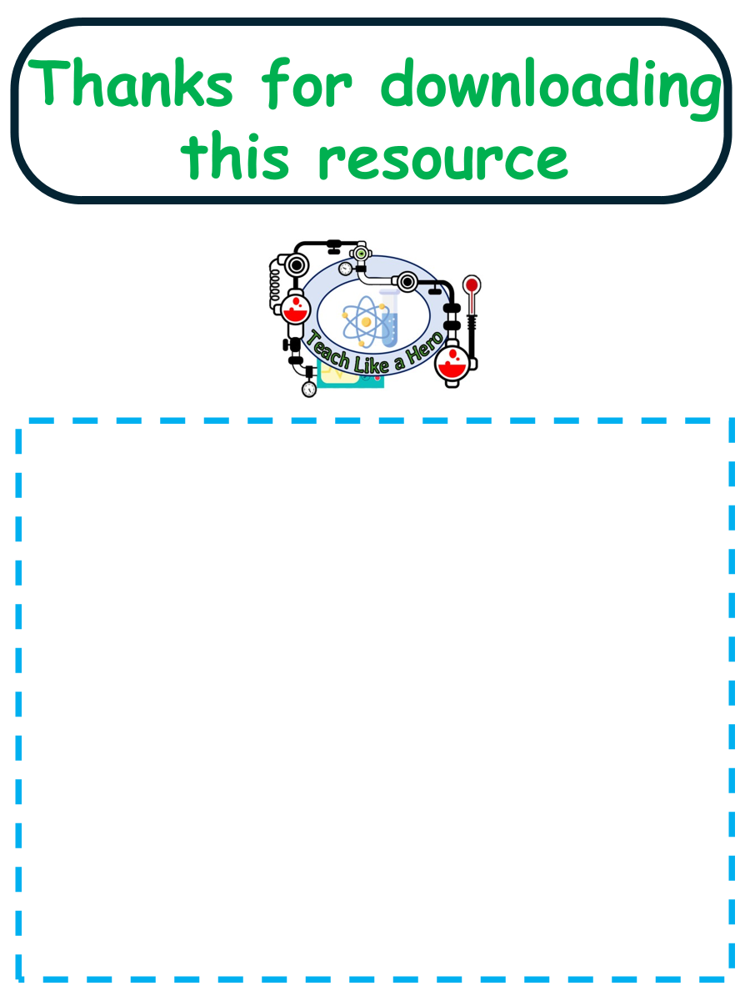
Click here to access my percentage composition youtube videos
Resources that this activity would work well with
Lessons on TES
Lesson on TPT
Follow me on social media to stay in touch
Keep up to date with my new content:

