Slide 1
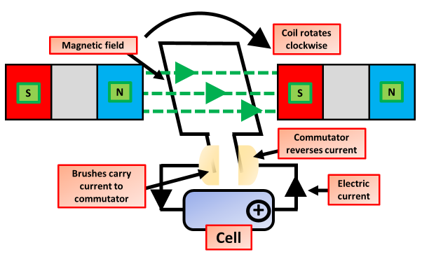
The Motor Effect Question
Specification Link:
Magnets: 4.7.2.1
Highlight key words or phrases
The motor effect is the term used when a current-carrying wire in the presence of a magnetic field experiences a force. A simple experimental demonstration will show you that this is true. Place a wire that is connected to a power pack in between the poles of a horseshoe magnet.
Suggest two changes that would increase the force acting on the coil of wire
________________________________________________________________________________________________________________________
What happens when alike magnetic fields interact
________________________________________________________________________
Annotate the diagram above
Describe what the motor effect is and how it applies when explaining how an electric motor works.
________________________________________________________________________________________________________________________________________________________________________________________________________________________________________________________________________________________________________________________________________________________________________________________________________________________________________________
What is the role of the communicator?
____________________________________________________________________________________________________________
What causes the coil of wire to rotate
____________________________________________________________________________________________________________
Suggest three changes that would decrease the force acting on the coil of wire.
__________________________________________________________________
__________________________________________________________________
__________________________________________________________________

