Slide 1
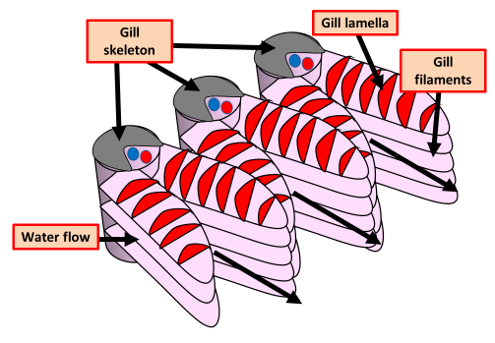
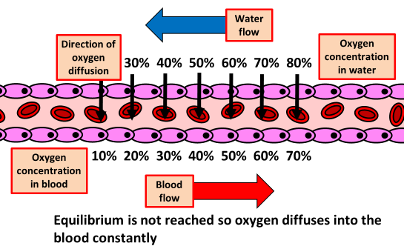
The Structure of Gills Practice Question
Specification Link:
Exchange Systems: 3.1.1
Highlight key words in the information below:
Fish use specialised surfaces called gills to carry out gas exchange. Gills are highly folded, giving them a large surface area and maximising the efficiency of gas exchange. This is important because there isn't much oxygen in the water, and fish need to absorb enough oxygen to survive.
Fish use specialised surfaces called gills to carry out gas exchange. Gills are highly folded, giving them a large surface area and maximising the efficiency of gas exchange. The gill filaments have many protrusions called gill lamellae.
Explain how the diagram shows that gills are adapted for efficient gas exchange.
________________________________________________________________________________________________________________________________________________________________________________________________________________________________________________________________________________________________________________________________________________________________________________________________________________
Highlight key words in the information below:
An aggregation of morphologically similar cells and associated intercellular matter acting together to perform specific functions in the body. There are four basic types of tissue: muscle, nerve, epithelial, and connective.
Epithelial tissues act as coverings, controlling the movement of materials across their surface. Connective tissue binds the various parts of the body together, providing support and protection. Muscle tissue allows the body to move and nervous tissues functions in communication.
Each gill is supported by a gill bar made of bone. Bone tissue is made of bone cells, collagen and an inorganic component. Explain why bone is described as a tissue and gills are described as organs.
________________________________________________________________________________________________________________________________________________________________________________________________________________________________________________________________________________________________________________________________________________________________________________________________________________________________________________________________________________________________________________________________________
The diagram shows counter current flow. Describe why it is important
________________________________________________________________________________________________________________________________________________________________________________________________________________________________________________________________________________________

Slide 2

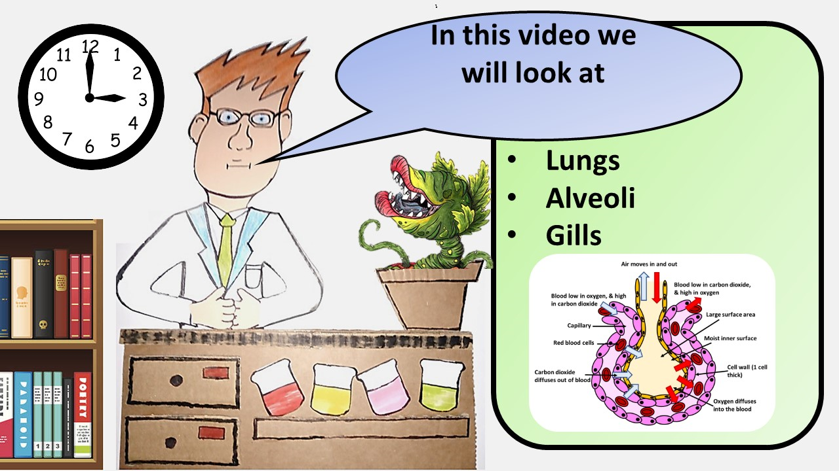


Click here to access my percentage composition youtube videos
Resources that this activity would work well with
Lesson on TES
Lesson on TPT
Follow me on social media to stay in touch
Keep up to date with my new content:

