Slide 1
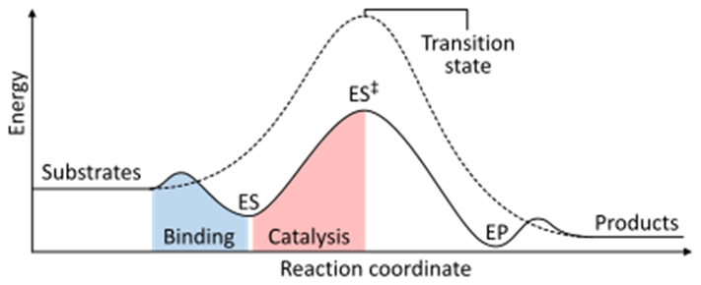
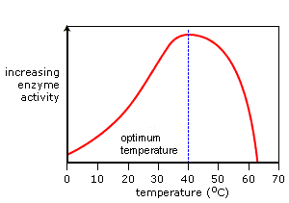
How Enzymes Affect Rate Question
Specification Link
Enzymes
Highlight key words in the information below:
Enzymes speed chemical reactions without themselves being consumed. Enzymes accomplish this by lowering activation energy which is the energy required for a chemical reaction to proceed. The rate of chemical reactions can be altered by changing pH, temperature, and/or the substrate concentration.
What is activation energy?
________________________________________________________________________________
Describe the effect enzymes have on the rate of reaction
________________________________________________________________________________________________________________________________________________________________________________________________________________________________________________________________________________________________________________________________________
What happens during the transition state?
________________________________________________________________________________
How do the energy levels change throughout a reaction?
________________________________________________________________________________
Highlight key words in the information below:
Like most chemical reactions, the rate of an enzyme-catalyzed reaction increases as the temperature is raised. A ten degree Centigrade rise in temperature will increase the activity of most enzymes by 50 to 100%.
Increases in temperature increase molecular activity, and can result in a higher rate of collisions between enzymes and substrates. If the temperature rises too high, however, the enzymes could become denatured, and the positive effects of the temperature increase could be nullified.
How does increasing temperature increase rate of reaction (collision theory)
____________________________________________________________________________________
Describe why changing temperature affects enzymes
_________________________________________________________________________________________________________________________________________________________________________________________________________________________________________________________________________________
What happens as an enzyme is denatured?
________________________________________________________________________________________________________________________________________________________________________

