Slide 1
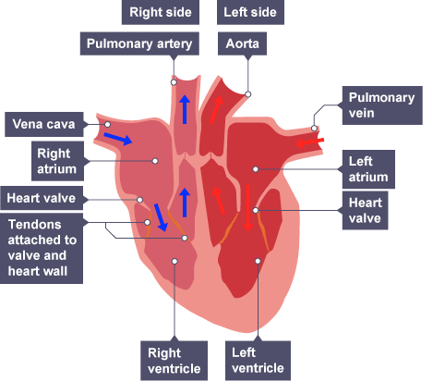
The Heart Practice Question
Specification Link:
Biological Organisation
Highlight key words in the information below:
Five great vessels enter and leave the heart: the superior and inferior vena cava, the pulmonary artery, the pulmonary vein, and the aorta. The superior vena cava and inferior vena cava are veins that return deoxygenated blood from circulation in the body and empty it into the right atrium.
Describe how blood flows around the heart:
________________________________________________________________________________________________________________________________________________________________________________________________________________________________________________________________________________________________________________________
The heart beat
Specialised cells in the right atrium generate electrical signals that make the heart contract independently of the nervous system. These specialised cells act as a natural pacemaker.
A wave of contraction spreads across the heart - to the left atrium and then to the ventricles. This enables the ventricles to contract together.
What happens when the pacemaker stops working properly?
___________________________________________________________________________________________________________________________________________________________
What is CHD?
________________________________________________________________________________________________________________________________________________
Coronary heart disease
The heart is a muscular pump. Like all muscles, it needs oxygen for aerobic respiration to contract. The coronary arteries supply blood, and therefore oxygen, to the heart muscle.
The coronary arteries may become blocked by a build-up of fatty material, caused by certain kinds of 'bad' cholesterol. As the fatty material increases, one or more coronary arteries narrow, and can become blocked.
If a blockage builds up, the amount of oxygen reaching the heart muscle is reduced. A person will develop chest pain, and if left untreated, a heart attack is the result. This can cause damage to, or death of the heart muscle. Part of the heart muscle, or the whole heart, will die
How is CHD caused?
________________________________________________________________________________________________________________________________________________
Describe the treatments for CHD
________________________________________________________________________________________________________________________________________________________________________________________________________________________________________________________________________________________________________________________________________________

Slide 2
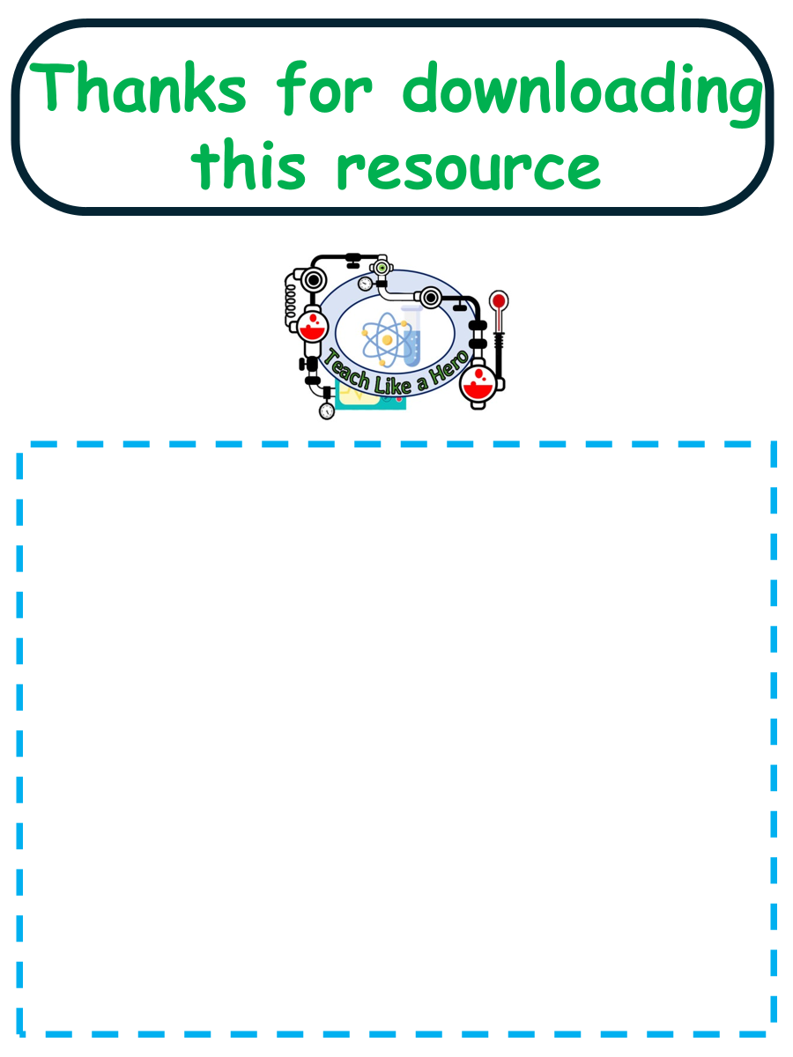
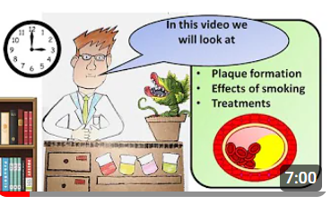


Click here to access my youtube videos
Resources that this activity would work well with
Lesson on TES
Lesson on TPT
Follow me on social media to stay in touch
Keep up to date with my new content:

