Slide 1
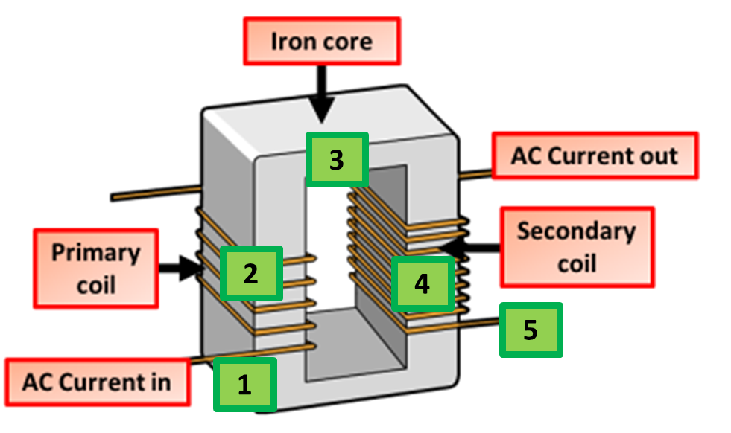
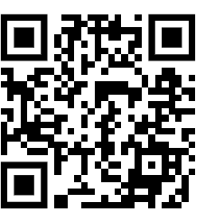
Transformer Practice Question
The National Grid uses transformers to change potential difference (pd). Figure 1 shows a transformer.
The input pd causes an alternating current. Explain why there is an alternating current in the output when the transformer is connected to a circuit.
Key things to include:
What sort of current goes in
What effect will this have on the magnetic field
How will that generate a current
Answer
_____________________________________________________________________________________________________________________________________________________________________________________________________________________________________________________________________________________________________________________________________
Link to video

Slide 2
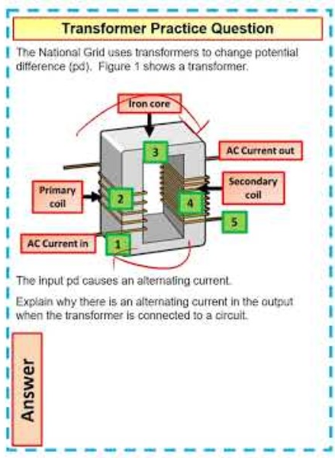
Transformer Practice Question

Slide 3

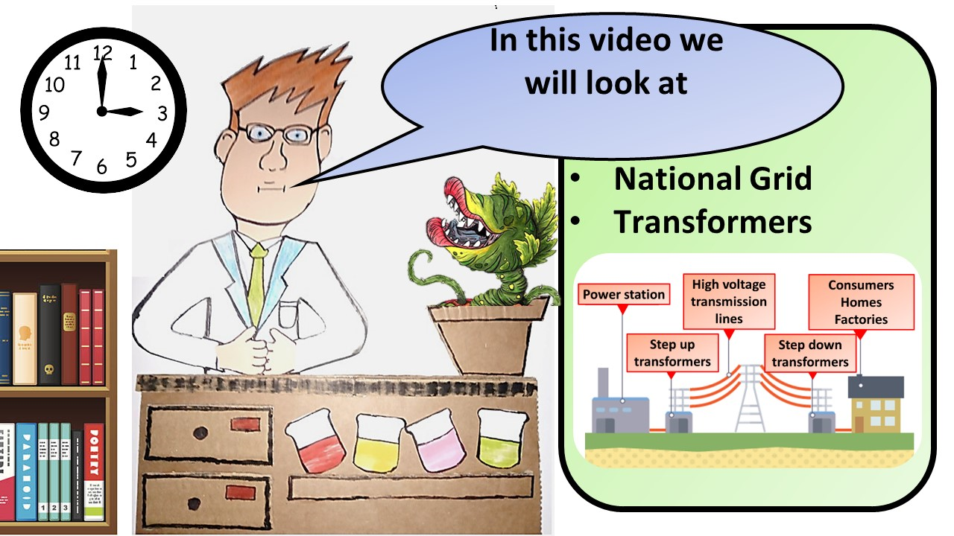


Click here to access my youtube videos
Resources that this activity would work well with
Lesson on TES
Lesson on TPT
Follow me on social media to stay in touch
Keep up to date with my new content:

