Slide 1
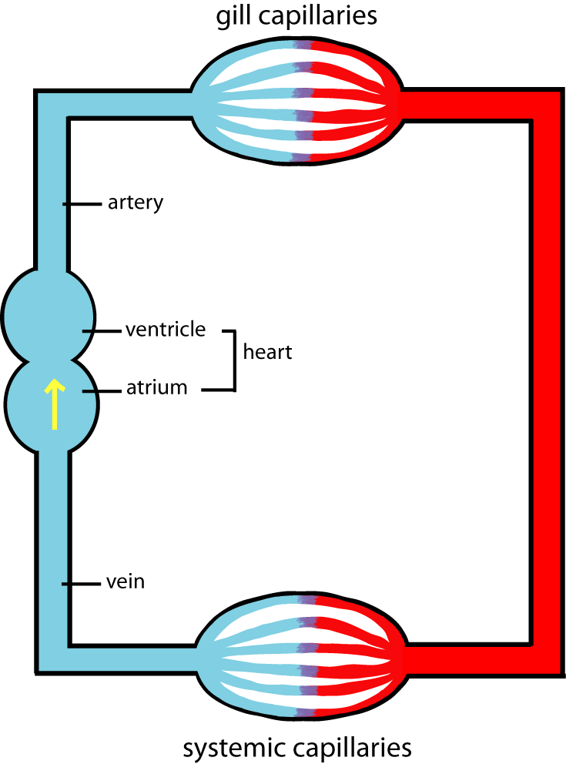
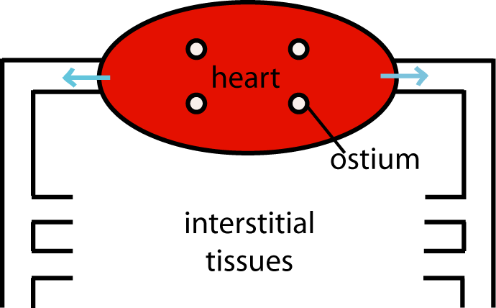
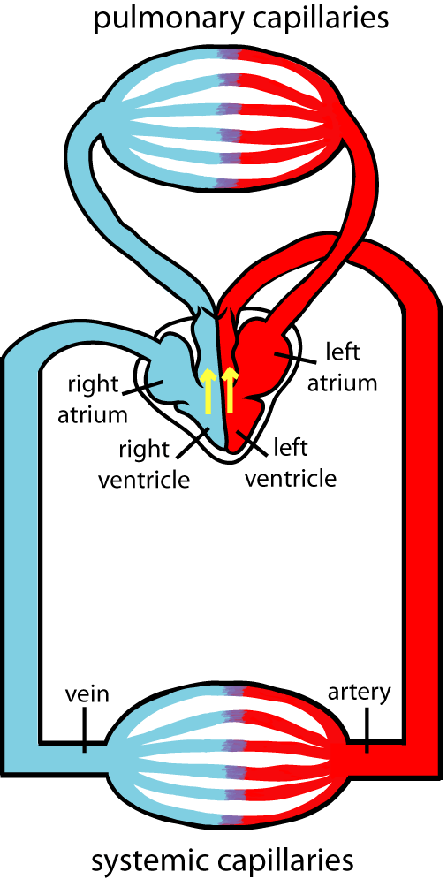
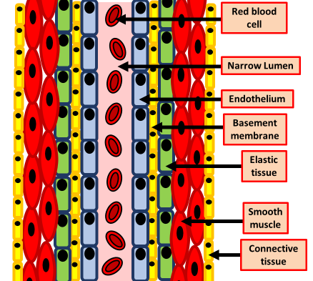
Explain what open circulation is
Explain what single closed circulation is
Key information to include:
How the blood is moved through organisms
What fluids are involved
What are the limitations of open circulation
Key information to include:
How is blood moved through fish
How does the blood move through the heart
What are the limitations of this type of circulation
Explain what a double circulation system is
Explain the structure & function of arteries
Key information to include:
How blood is moved around the body
What happens to the blood in the organs
What happens to the blood in the lungs
What is the blood pressure like in different parts
Key information to include:
Blood pressure
How is blood pressure controlled
What are the key adaptations
What role is played by the elastic tissue
What role is played by the smooth muscle

Slide 2
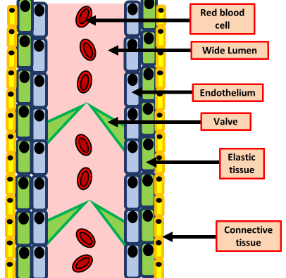
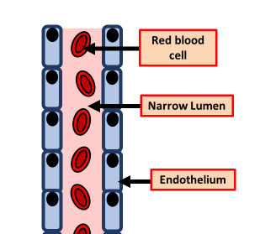
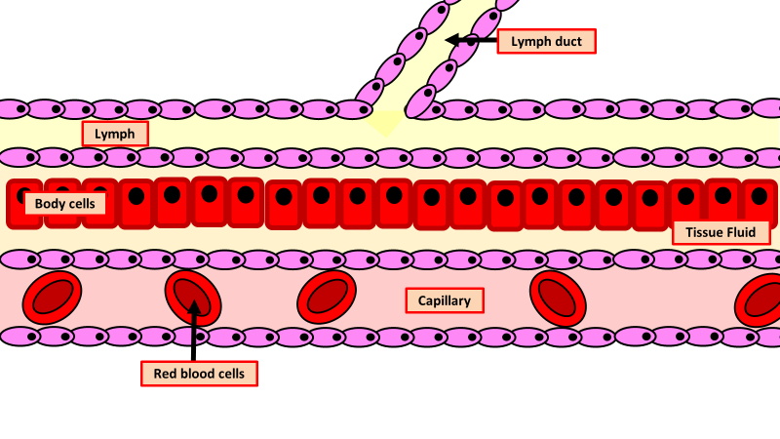
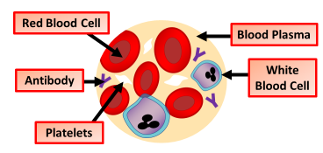
Explain the structure & function of veins
Explain the structure & function of capillaries
Key information to include:
What sort of blood we find in veins
How is blood forced through the veins
What is the role of valves in veins
Key information to include:
What is the functions of capillaries
How are capillaries adapted
How does the blood pressure change
Describe the composition of blood
Explain how tissue fluid forms
Key information to include:
The role of blood plasma
The role of red blood cells
The role of platelets
The role of white blood cells
Key information to include:
How water concentration changes
What moves in and out of the blood
What the role of hydrostatic pressure is

Slide 3
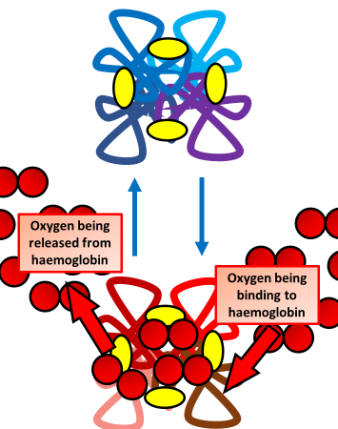
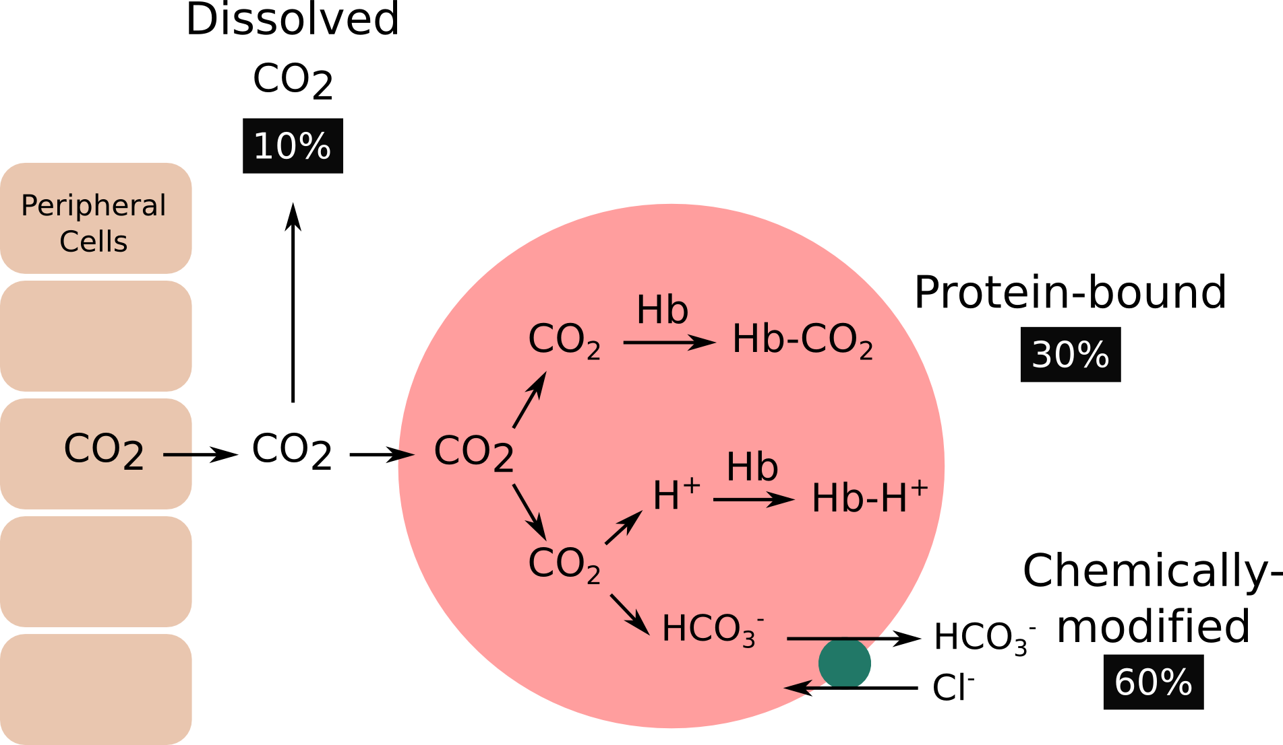
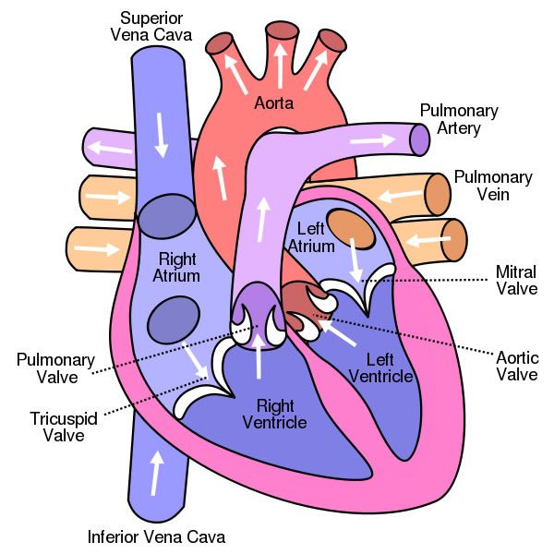
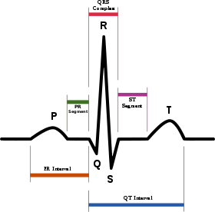
Explain how oxygen is carried by the blood
Explain how carbon dioxide is carried
Key information to include:
The structure of haemoglobin
The effect oxygen has on haemoglobin
When and why haemoglobin picks up and releases oxygen
Key information to include:
What happens to carbon dioxide when it enters the blood
What effect does it have on the pH of the blood
What effect does carbon dioxide have on haemoglobin
Describe the function of the heart
Explain what ECG traces show
Key information to include:
What happens during P
What happens during Q
What happens during R
What happens during S
What happens during T
Key information to include:
How does blood move through the heart
How is the heart beat nervously controlled
What role do valves play

