Slide 1
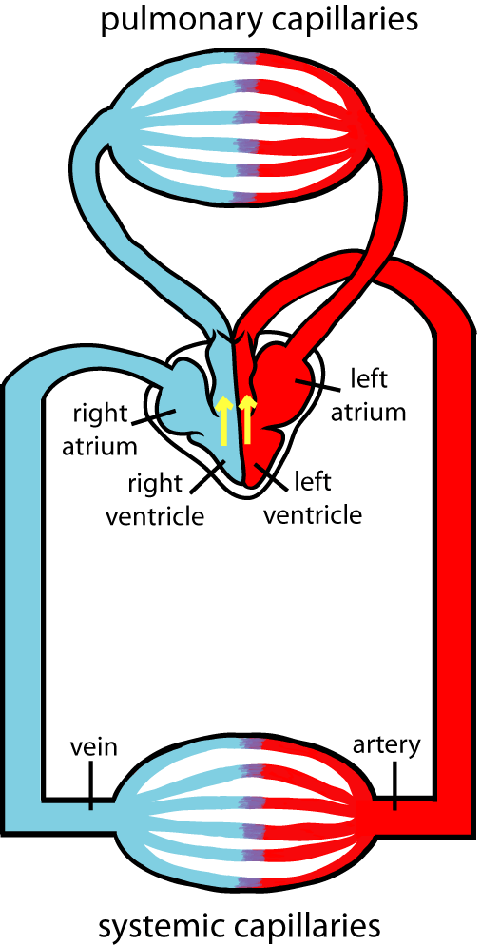
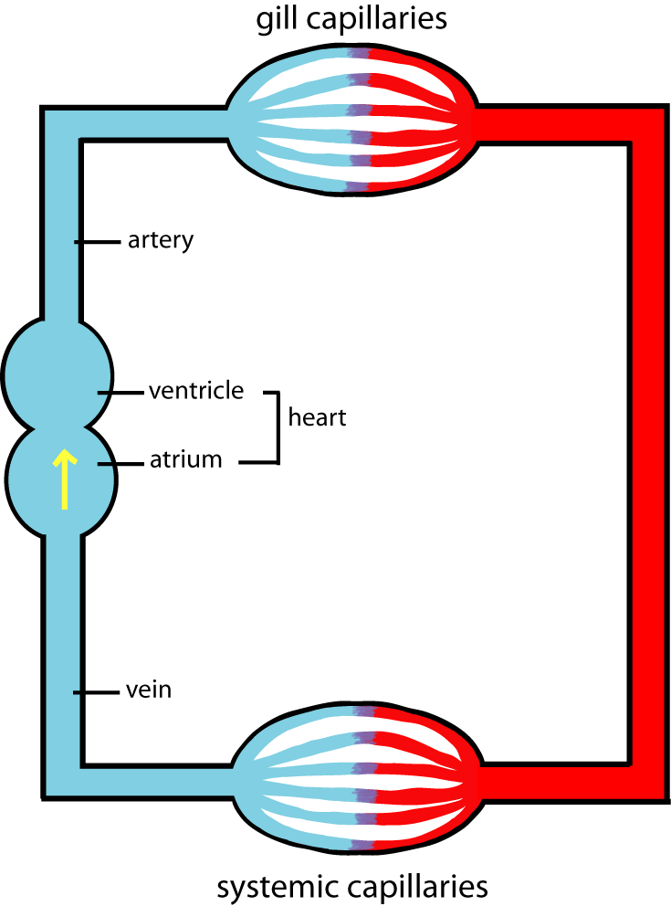
Types of Circulation Question
Specification Link:
Transport in Animals
Highlight key words in the information below:
Describe the circulatory system found in insects:
________________________________________________________________________________________________________________________________________________________________________________________________________________________________________________________________________________________________________________________________________
Open and closed circulatory systems
Living cells need to absorb nutrients and oxygen, and to release waste products, such as carbon dioxide. Some animals – such as the single-celled amoeba - are small enough to do this by diffusion from their surface, and do not require a circulatory system. But larger, multicellular animals need a circulatory system to transport substances to and from their cells.
The double circulatory system is advantageous for active animals since, while in the single circulatory system the blood pressure is limited by the delicate nature of the tiny capillaries in the gills, in the double circulatory system the blood pressure can be high in the systemic circuit while remaining low and safe in the pulmonary circuit. This allows animals with a double circulatory system to be more active, since blood can reach their respiring tissues faster due to the higher pressure.
Describe the path that blood takes as it moves around an organism with a double circulatory system
__________________________________________________________________________________________________________________________________________________________________________________________________________________________________________________________________________________________________________________________________________________________________________________________
Vertebrates, and a few invertebrates, have a closed circulatory system. Closed circulatory systems have the blood closed at all times within vessels of different size and wall thickness. In this type of system, blood is pumped by a heart through vessels, and does not normally fill body cavities.
Blood flow rate and blood pressure falls when blood leaves a fish's gills. The low blood pressure in the single circulatory systems present in fish is fine for fish but would be insufficient for efficient kidney function in mammals. (Mammals have double circulation systems.)
Compare single circulatory systems to double circulatory systems
______________________________________________________________________________________________________________________________________________________________________________________________________________________________________________________________________________________________________

