Slide 1
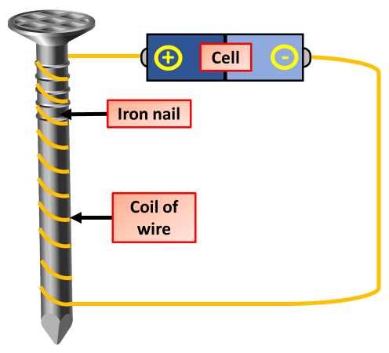
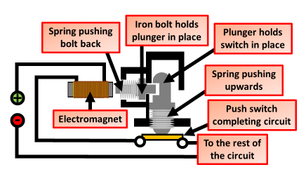
Uses of Electromagnets
Specification Link:
Magnets: 4.7.2.1
Highlight key words in the information below:
An electromagnet is a magnet that runs on electricity. Unlike a permanent magnet, the strength of an electromagnet can easily be changed by changing the amount of electric current that flows through it. The poles of an electromagnet can even be reversed by reversing the flow of electricity.
Describe briefly how to make an electromagnet
__________________________________________________________________________________________________________________________________________________________________________________________________________________
Some electrical circuits are protected by a circuit breaker. These switch the circuit off if a fault causes a larger than normal current to flow. The diagram shows one type of circuit breaker. A normal current (15 A) is flowing.
What effect does increasing the number of coils of wire have on the electromagnet?
____________________________________________________________________________
What effect does increasing the current have on the electromagnet?
____________________________________________________________________________
Explain what happens when a current larger than 15A flows. The answer has been started for you.
When the current goes above 15 A, the electromagnet becomes stronger and___________________________________________________________________________________________________________________________________________________________________________________________________________________________________________________________________________________________________________________________________________________________________________________________________________________________________________________________________________________________________________
What turns the electromagnet on?
____________________________________________________________________________________
What happens to the bolt when the electromagnet turns on?
____________________________________________________________________________________
What happens to the switch when the bolt is pulled out?
____________________________________________________________________________________

Slide 2
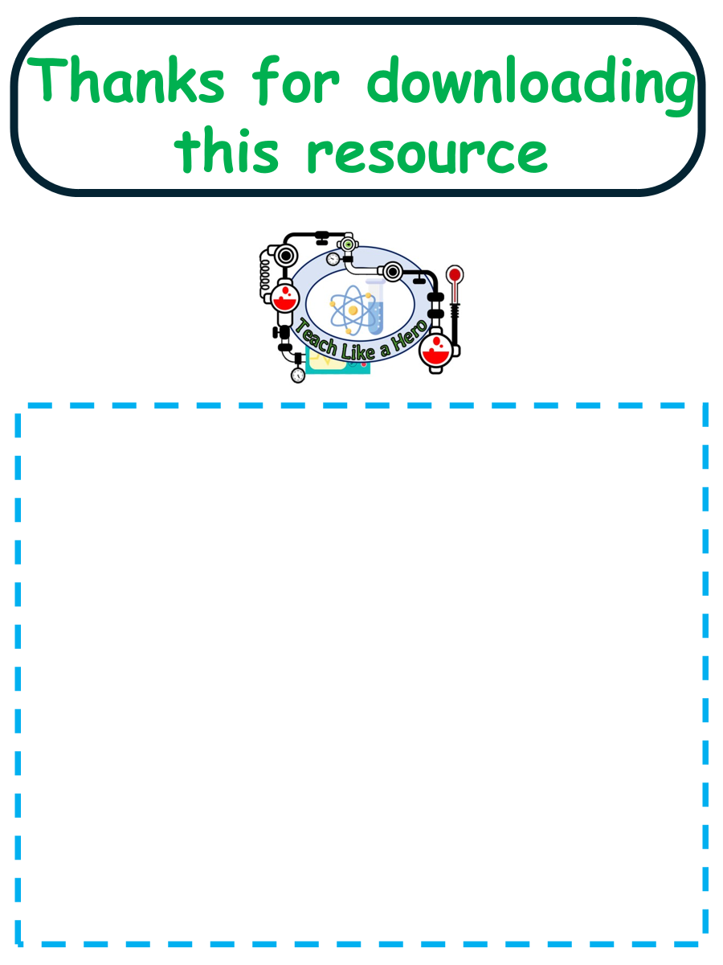
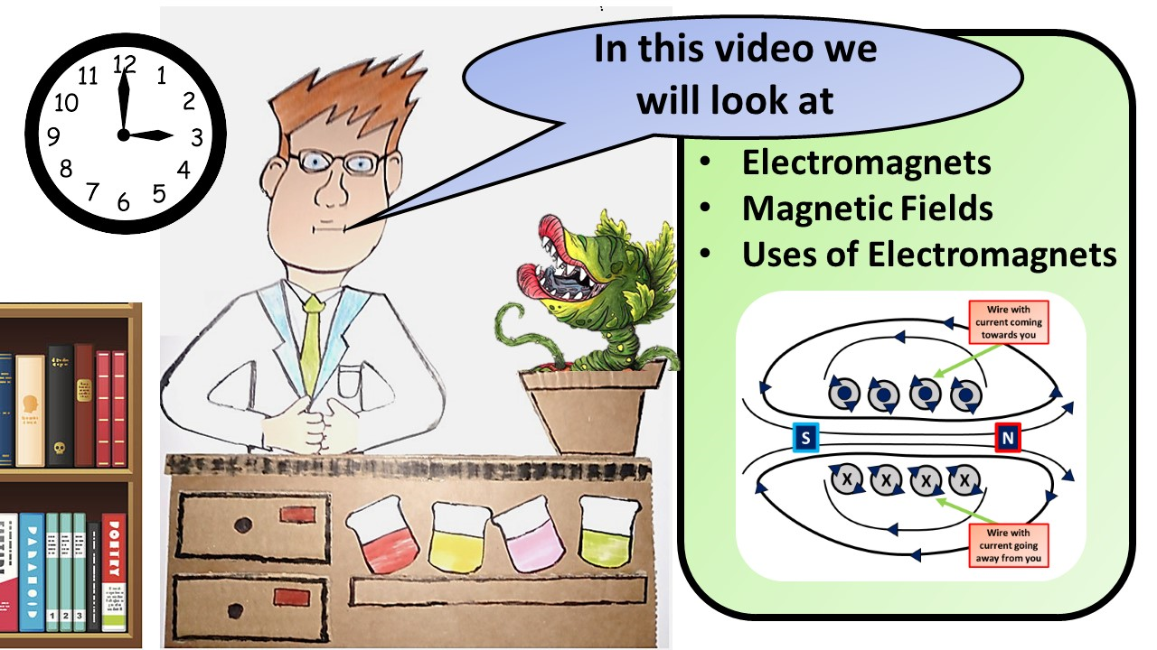


Click here to access my youtube videos
Resources that this activity would work well with
Lesson on TES
Lesson on TPT
Follow me on social media to stay in touch
Keep up to date with my new content:

