Slide 1
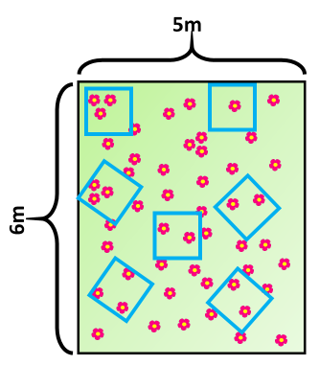
Using Quadrats
Specification Link:
Ecology: 4.7.2.1
Highlight key words in the information below:
Key word | Definition
Species
Species richness
Reliable
Accurate
Quadrats are used for sampling purposes. They are squares of a set size placed in a particular habitat such as a rocky shore or forest floor. Plant and/or animal species within the quadrat are identified and their numbers recorded. Photos of individual quadrats, along with the species information, often form baseline monitoring data or are used to measure changes in species and habitats over time.
Quadrats are square frames of wire usually 0.25 m2. These are placed on the ground to look at the plants or slow-moving animals within them. When looking at plants in a quadrat the following sampling can be used:
Number of an individual species
Species richness
Percentage cover
Use the diagram to fill out the table below
The diagram below shows another area sampled for flowers. Each quadrat was 1m².
Quadrat | Number of flower
1
2
3
4
5
6
7
Mean
What is the total area of the sampled field?
__________________________________________________________________________________
How many quadrats can you fit into that area?
__________________________________________________________________________________
Using your mean, estimate how many flowers are in the area:
__________________________________________________________________________________
Sunlight is one environmental factor that might affect the distribution of the buttercup plants. Give three other environmental factors that might affect the distribution of the buttercup plants
________________________________________________________________________________________________________________________________________________________________

