Slide 1
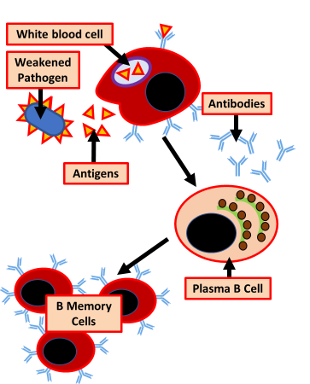
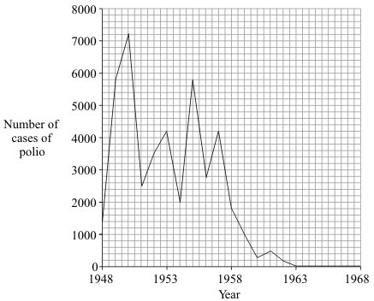
Vaccination
Specification Link:
Infection & Response
Highlight key words in the question below:
What are vaccines made from?
______________________________________________________________________________________
Vaccines allow a dead or altered form of the disease causing pathogen to be introduced into the body, which contain a specific antigen . This causes the immune system, specifically the white blood cells , to produce complementary antibodies , which target and attach to the antigen.
What do vaccines contain?
______________________________________________________________________________________
What do vaccines cause to be produced inside the body?
______________________________________________________________________________________
Vaccines containing these weakened or killed germs are introduced into your body, usually by injection. Your immune system reacts to the vaccine in a similar way that it would if it were being invaded by the disease — by making antibodies.
Using the diagram to the left, explain how vaccinations help prevent infection by pathogens in the future
__________________________________________________________________________________________________________________________________________________________________________________________________________________________________________________________________
In which year was the number of cases of polio highest?
______________________________________________
Polio vaccination was first used in the UK in 1955. How many years did it take for the number of cases of polio to fall to zero?
_______________________________________________________________________________________________________________
What is herd immunity?
_______________________________________________________________________________________________________________

Slide 2
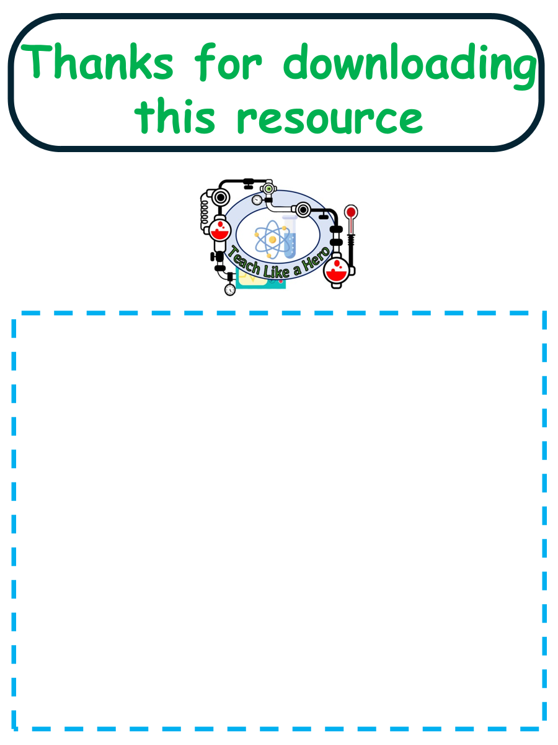
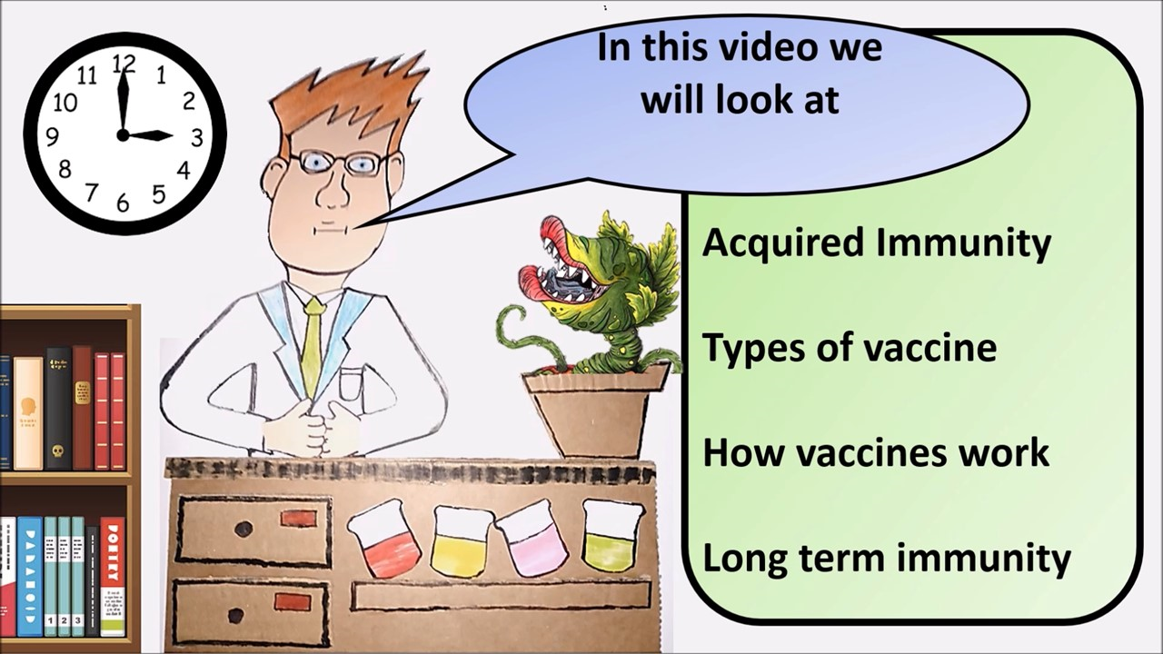


Click here to access my youtube videos
Resources that this activity would work well with
Lesson on TES
Lesson on TPT
Follow me on social media to stay in touch
Keep up to date with my new content:

