Slide 1

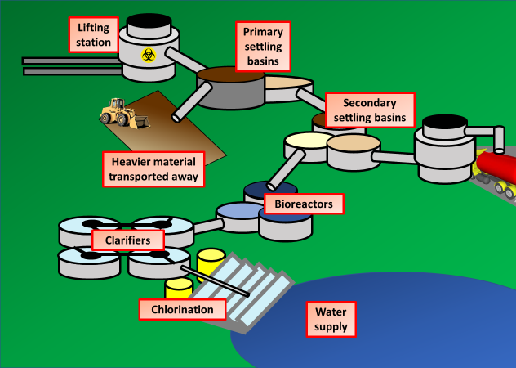
Welcome to your virtual tour of a sewage treatment plant

Slide 2

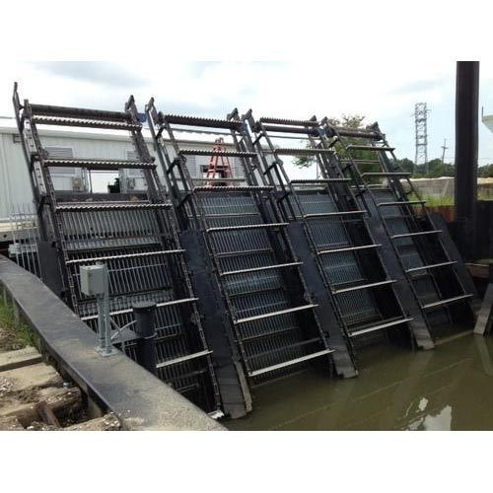

Waste water is pumped to the plant and large waste is removed by a rotating grid
Key questions
What sort of matter could the grids remove?
Why is it important that this material is removed?

Slide 3

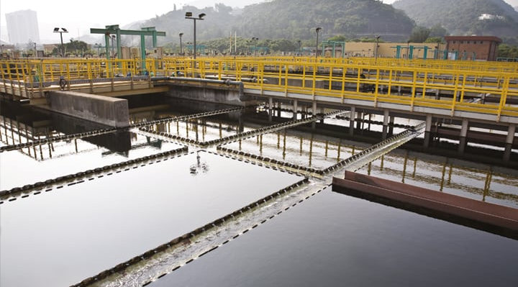
Primary settling basins allow heavier material to sink and be scrapped away.
Key questions
What sort of material might sink to the bottom?
What could the material that sinks to the bottom be used for?

Slide 4
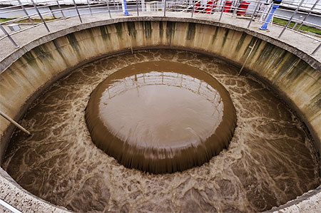
The solid material can now be processed and turned into fertilizer to be used on farms

Slide 5
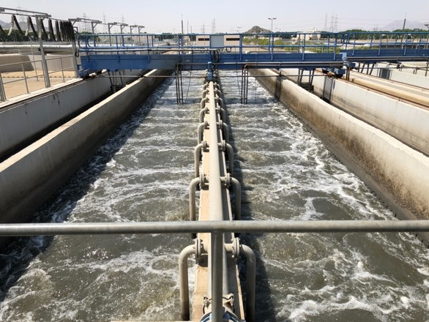

The water flows through a series of channels to a secondary settling basin

Slide 6
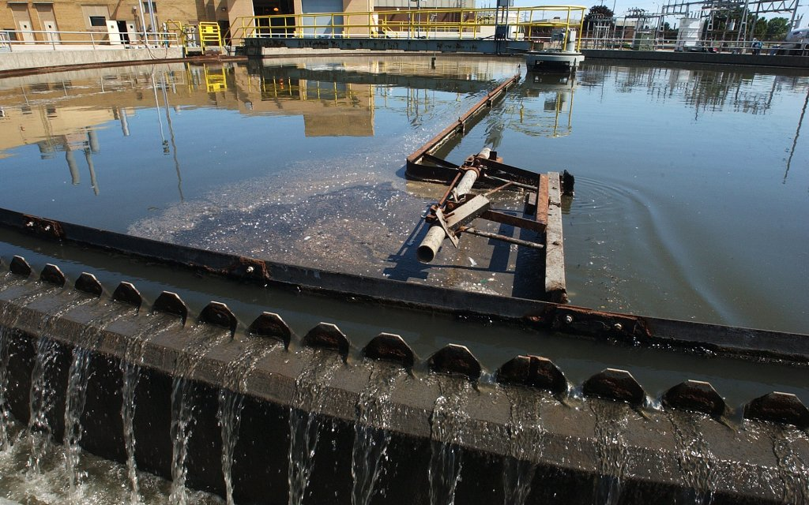
Secondary settling basins allow small particles to sediment out
Key questions
How long do you think the water is left for?
Could anything be added to clump small particles together?
What is still left in the water?

Slide 7
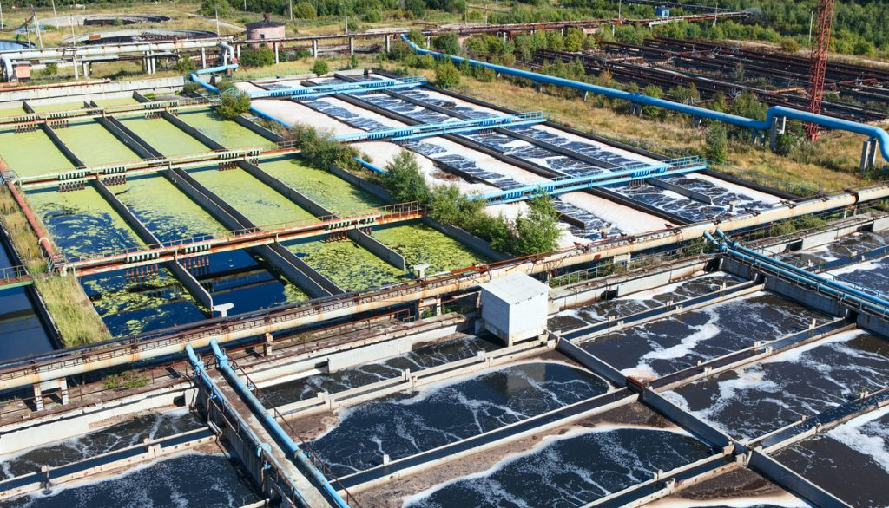

Effluent is then pumped to the bio-reactors for 9 hours. Through a series of stages bacteria break down harmful matter & clean water
Key questions
What sort of biological matter broken down be?
Why do the bacteria break the matter down?
Why is it cost effective?

Slide 8
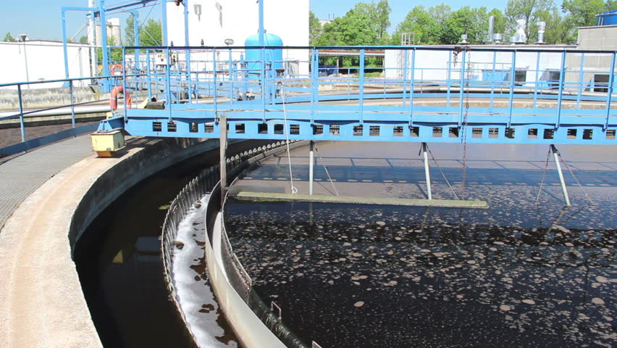

Secondary clarifiers gravity feed the water through, this removes more biological matter
Key questions
What sort of coal is used?
Why do we want to remove as much bacteria as possible?

Slide 9
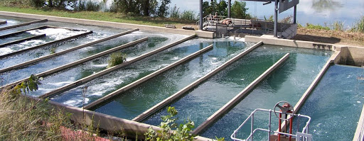

The water is finally chemically treated with chlorine to ensure it is free from bacteria
Key questions
Why is chlorine added?
What problems could bacteria cause?
Why must the level of chlorine used not be too high?

Slide 10
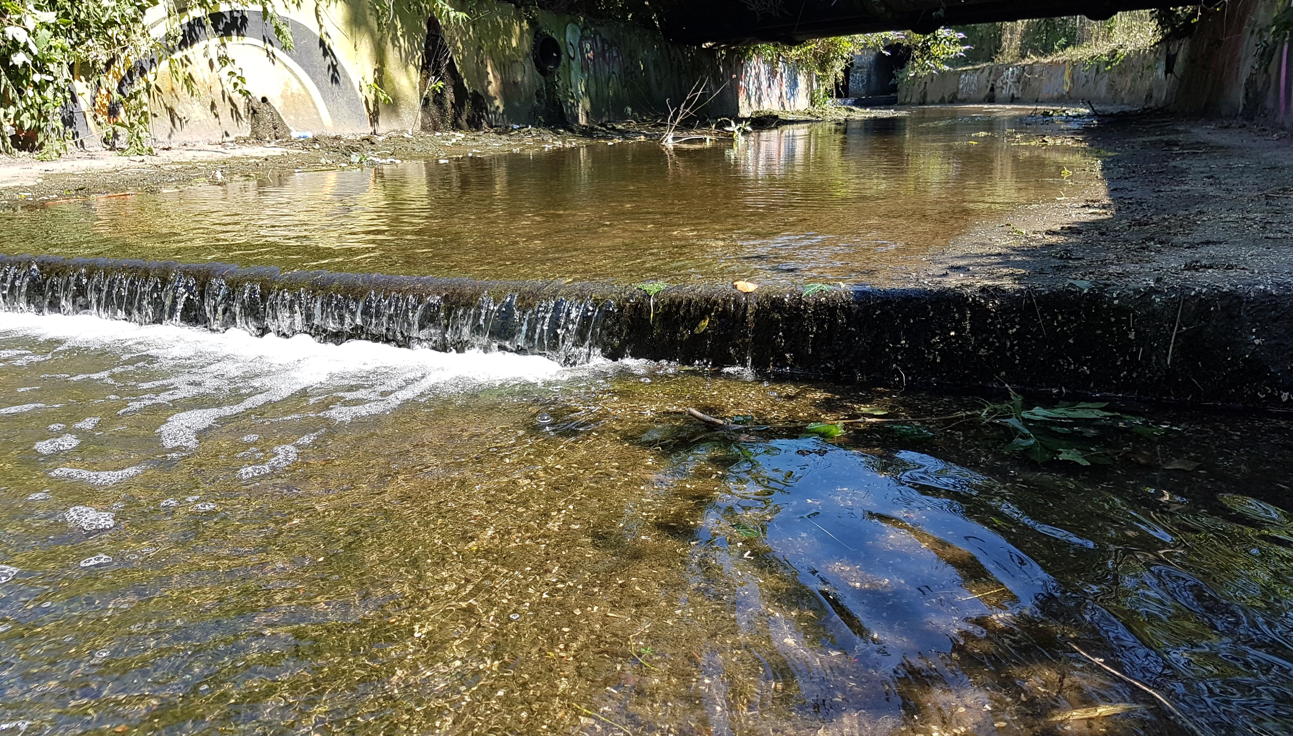

The water finally runs down a series of weirs until it rejoins a river or stream

Slide 11
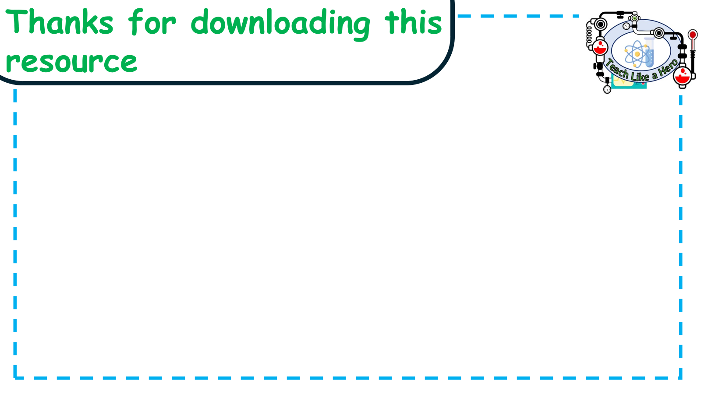
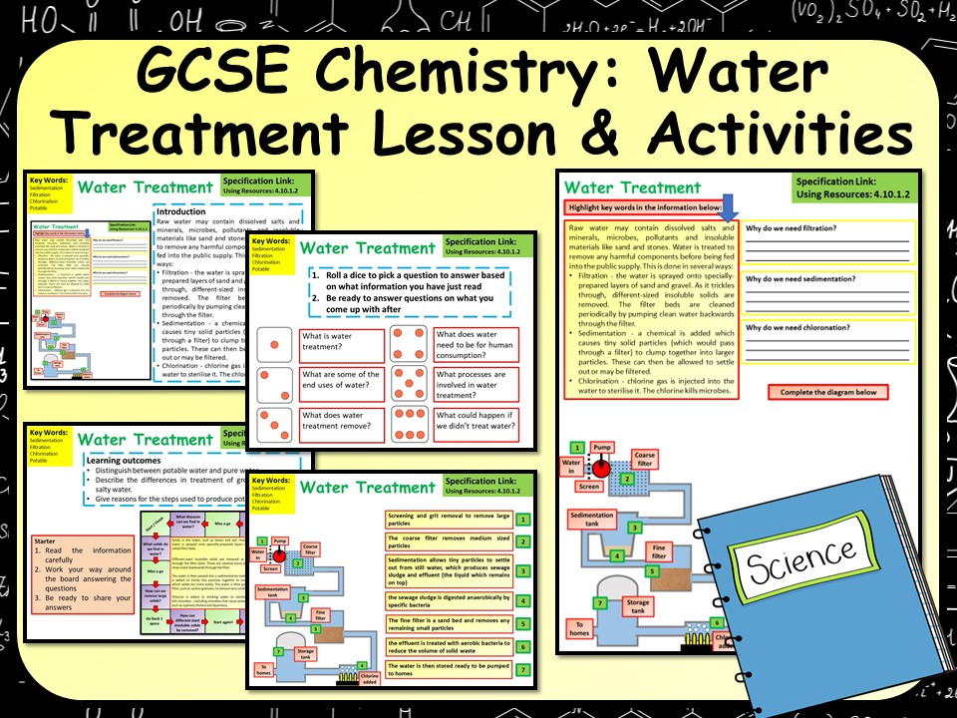
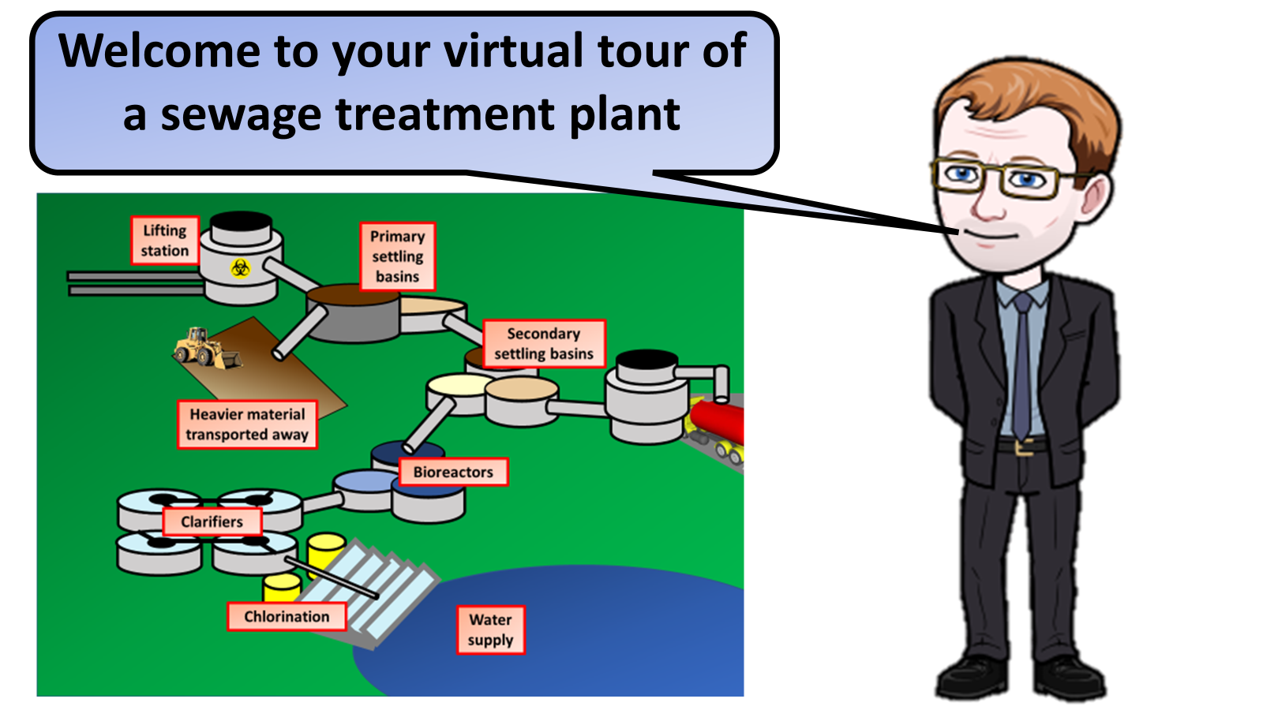


Click on the links below for lessons this resource can be used with
TPT lesson on drinking water
TES lesson on water treatment
Follow this link for a video running through this activity
Youtube video link
Follow me on social media to stay in touch
Keep up to date with my new content:

