Slide 1
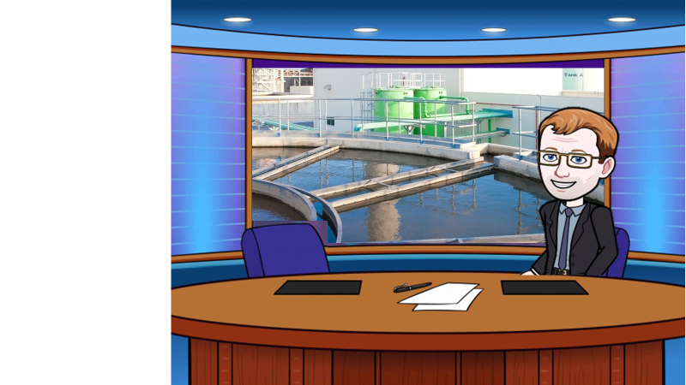
In a world where we are using more water, lets have a look how it’s produced

Slide 2
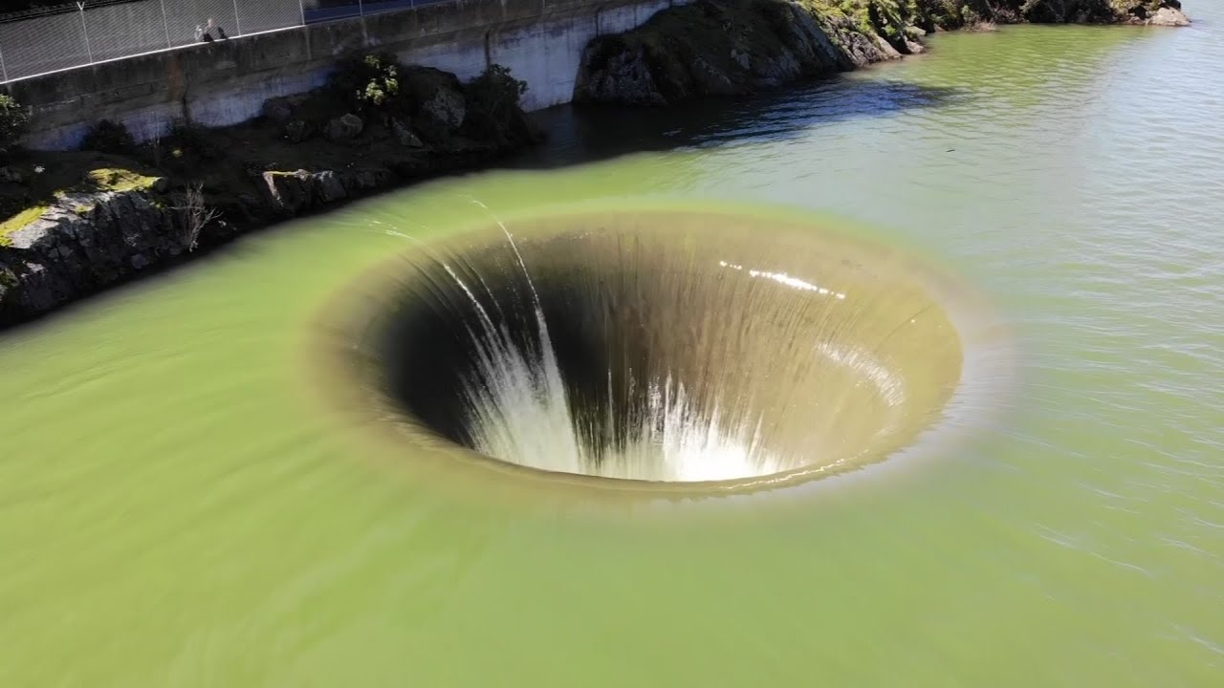


Screening and grit removal to remove large particles The coarse filter removes medium sized particles
Key questions
Where does the water in the reservoirs come from?
What else might fall into the water?

Slide 3

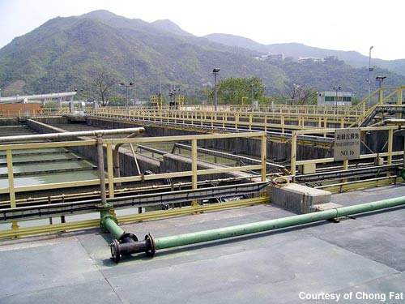
Sedimentation allows tiny particles to settle out from still water, which produces sewage sludge and effluent (the liquid which remains on top)
Key questions
How long do you thing this process takes?
Does this process take any extra energy?

Slide 4
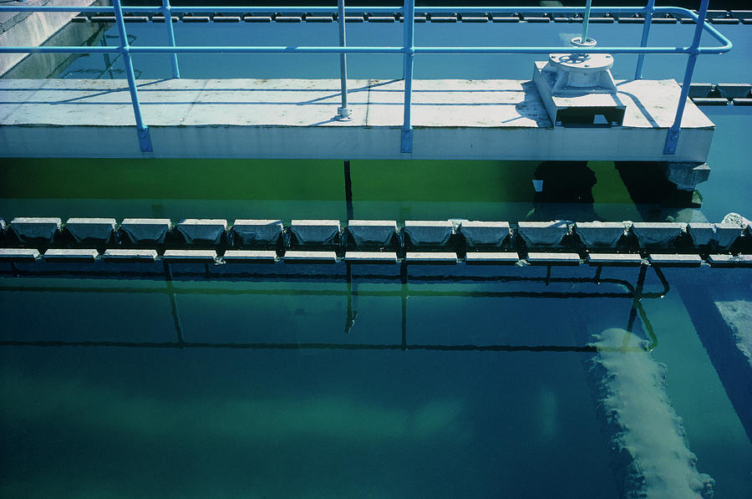

Aluminium sulphate is added to clump together tiny particles
Key questions
Why do the small particles need clumping together?
What might the small particles be made of?

Slide 5
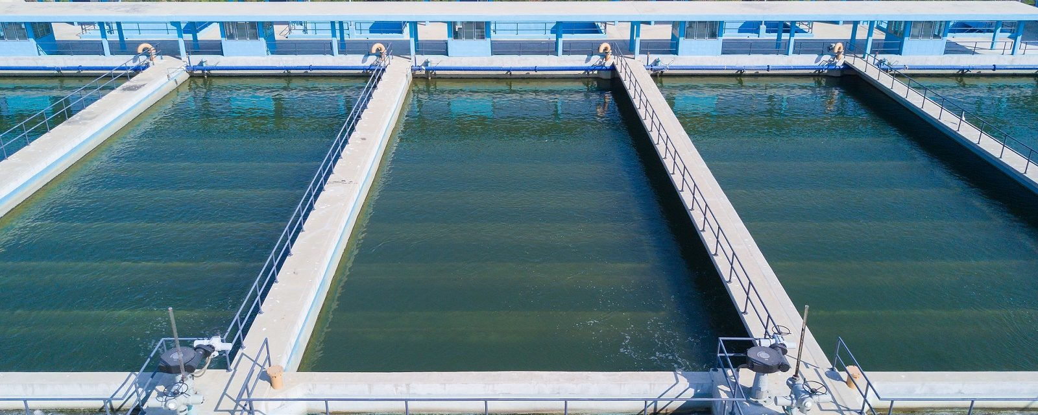

The fine filter is a sand bed and removes any remaining small particles
Key questions
How does the sand filter out small particles?
What does the phrase ‘gravity fed’ mean?

Slide 6

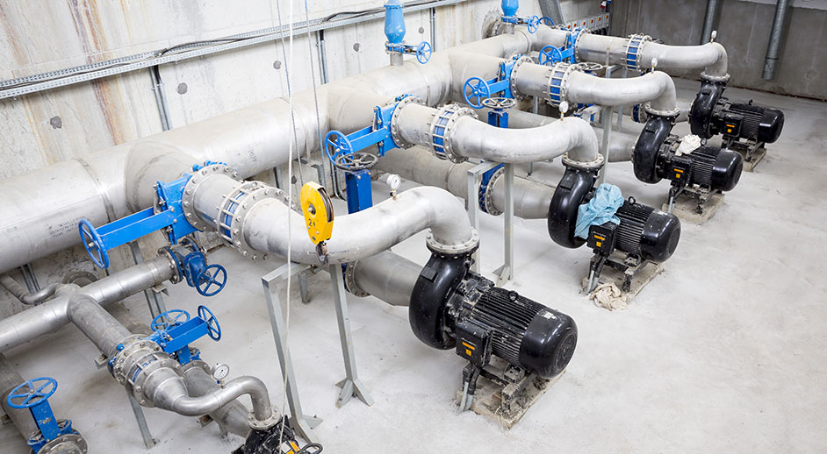
Chlorine is added to kill bacteria
Key questions
What does the chlorine kill?
Why is this process important?
What might happen if the bacteria wasn’t killed?

Slide 7
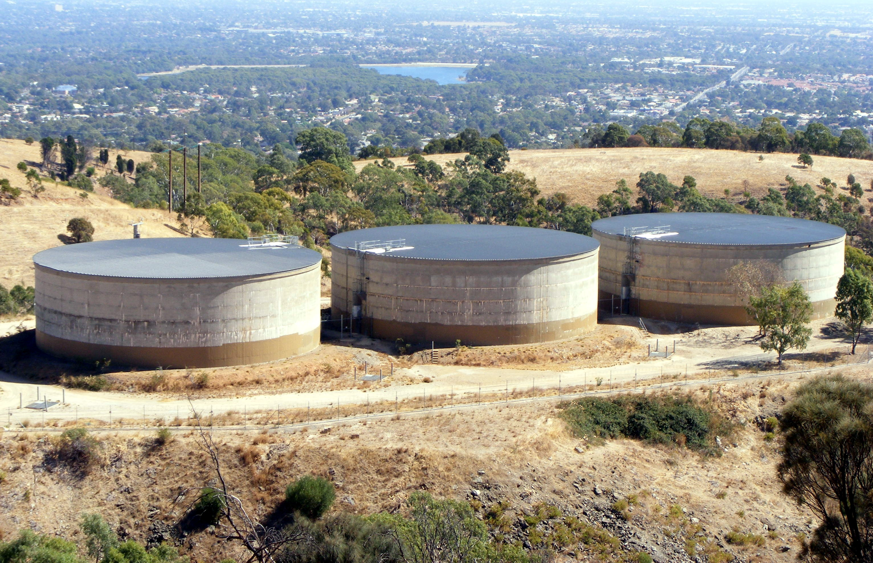
The water is then stored ready to be pumped to homes
Key questions
Where is water stored?
When is more water stored?
When might we need to use more water?

Slide 8
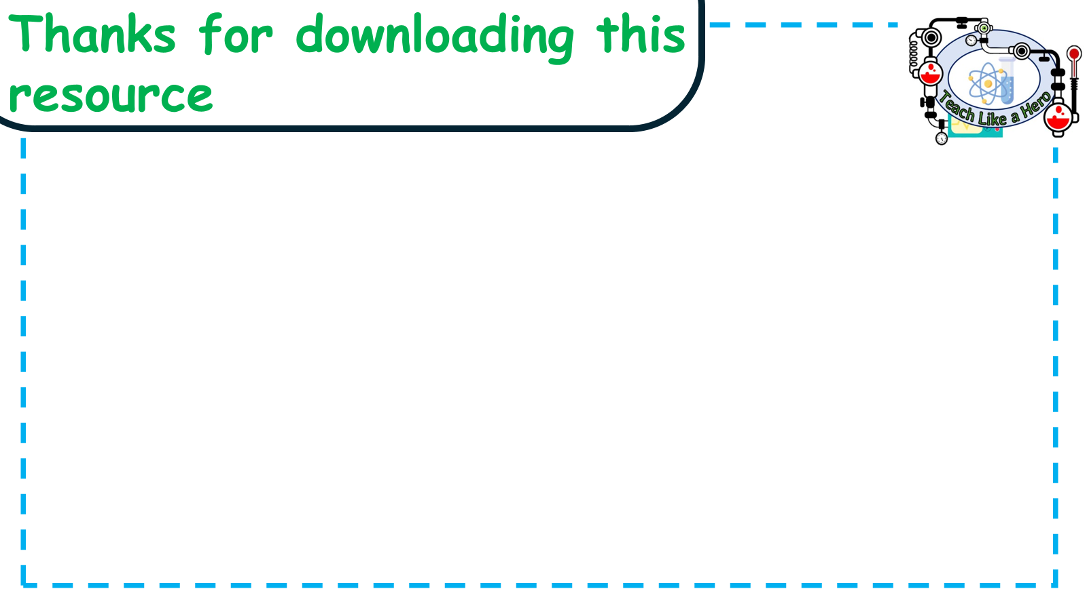
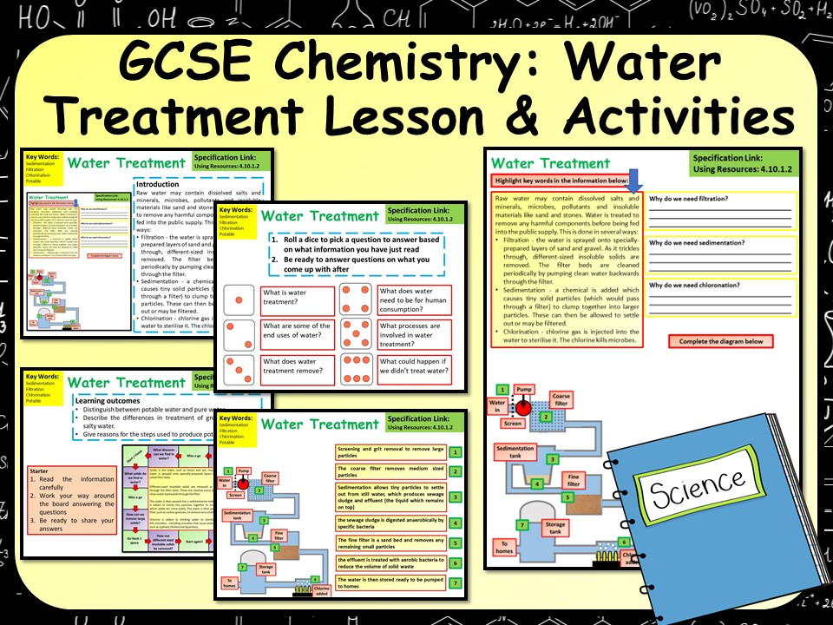
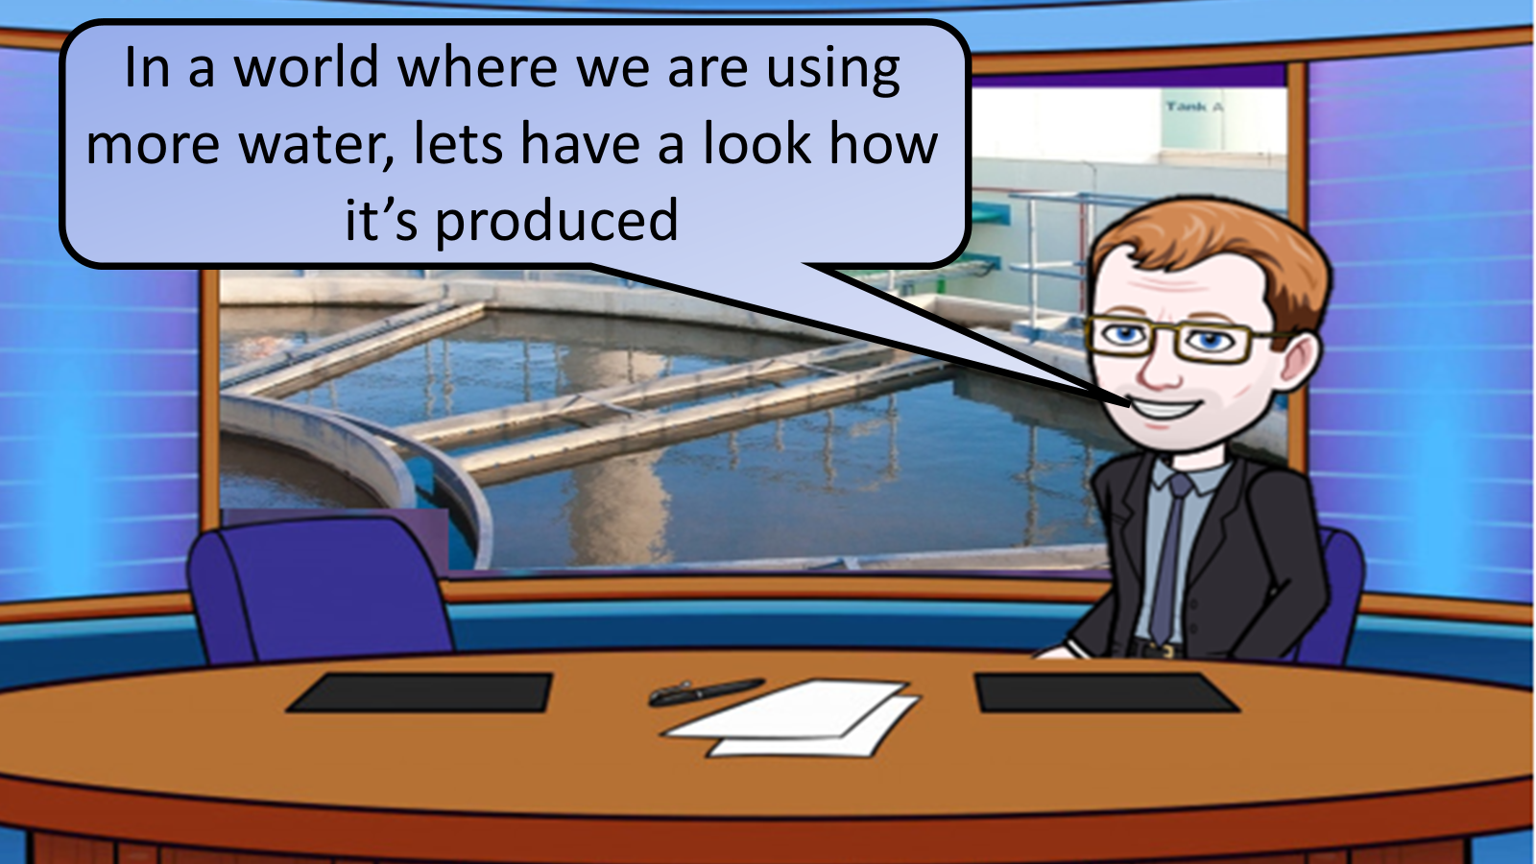


Click on the links below for lessons this resource can be used with
TPT lesson on drinking water
TES lesson on water treatment
Follow this link for a video running through this activity
Youtube video link
Follow me on social media to stay in touch
Keep up to date with my new content:

