Slide 1
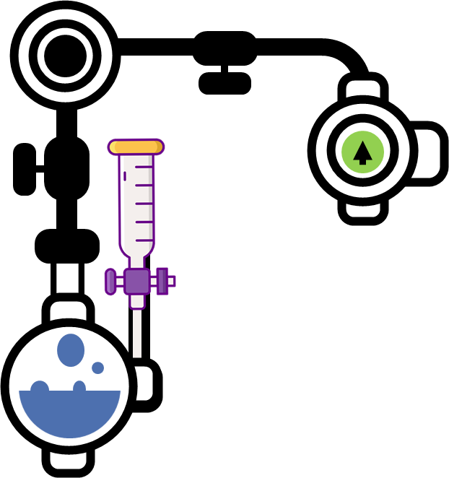
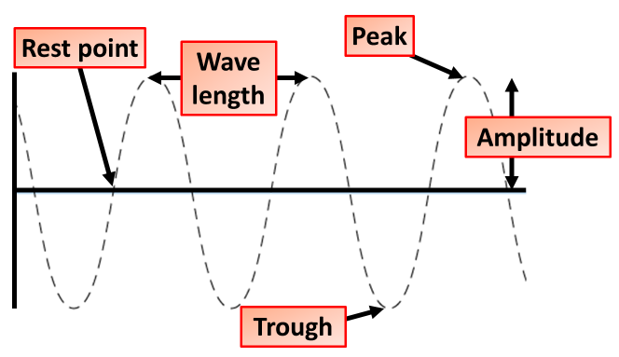
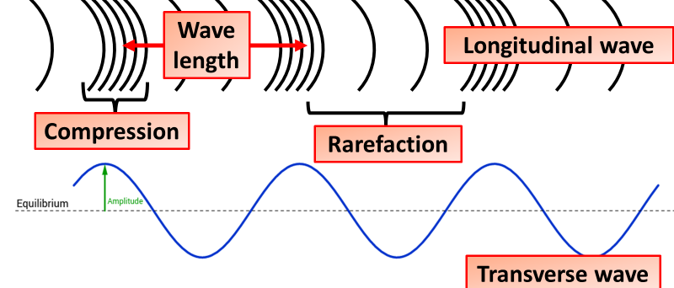
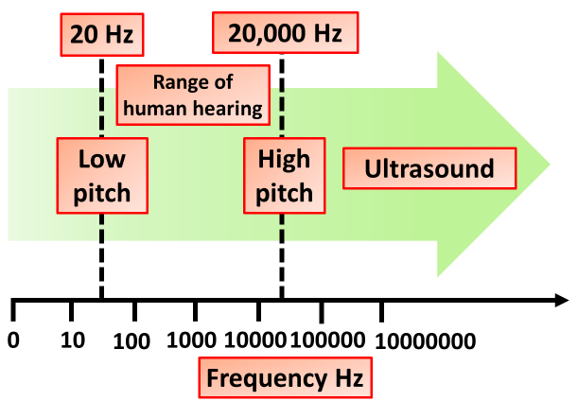
Waves Notes
In a transverse wave, the particles of the medium move perpendicular to the wave's direction of travel. This type of wave gets its name from the fact that the particles move in a direction transverse to the direction of the wave.
Sound waves and waves in a stretched spring are longitudinal waves. P waves (relatively fast moving longitudinal seismic waves that travel through liquids and solids) are also longitudinal waves. In longitudinal waves, the vibrations are along the same direction as the direction of travel.
Transverse Waves
Longitudinal Waves
Sound waves are longitudinal waves. They cause particles to vibrate parallel to the direction of wave travel. The vibrations can travel through solids, liquids or gases. The speed of sound depends on the medium through which it is travelling. When travelling through air, the speed of sound is about 330 metres per second (m/s). Sound cannot travel through a vacuum because there are no particles to carry the vibrations.
Amplitude
As waves travel, they set up patterns of disturbance.
The amplitude of a wave is its maximum disturbance from its undisturbed position.
Frequency f
The frequency of a wave is the number of waves produced by a source each second.
It is also the number of waves that pass a certain point each second.
The unit of frequency is the hertz (Hz).
It is common for kilohertz (kHz), megahertz (MHz) and gigahertz (GHz) to be used when waves have very high frequencies.
Wavelength λ
The wavelength of a wave is the distance between a point on one wave and the same point on the next wave.
It is often easiest to measure this from the trough of one wave to the trough of the next wave, or from the crest of one wave to the crest of the next wave.
But it doesn't matter where you measure it - as long as it is the same point on each wave.

Slide 2
Click here to access my waves youtube videos
Resources that this activity would work well with
Lesson on TES
Lessons on TPT
Follow me on social media to stay in touch
Keep up to date with my new content:

