Slide 1



Here are some ideas to help you get started:
You’re telling admissions staff why you’re suitable to study at their university or college.
What to write about
Look at course descriptions and identify the qualities, skills, and experience it requires – you can use these to help you decide what to write about.
Think about what makes you suitable – this could be relevant experience, skills, or achievements you’ve gained from education, work, or other activities.
Include any clubs or societies you belong to – sporting, creative, or musical.
Mention any relevant employment experience or volunteering you’ve done

Slide 2
If you’ve developed skills through Duke of Edinburgh, ASDAN, National Citizen Service, the Crest Awards scheme, or young enterprise, tell them.
Here are some ideas to help you get started:
If you took part in a higher education taster course, placement, or summer school, or something similar, include it.

Slide 3
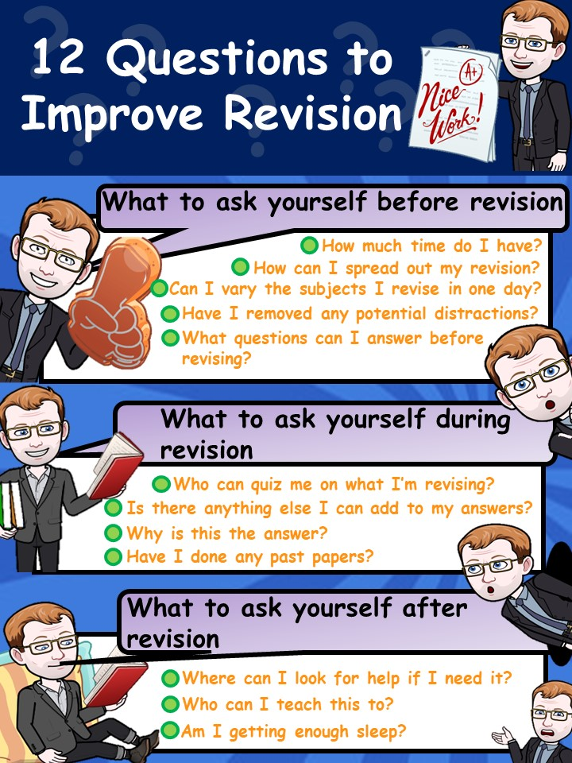






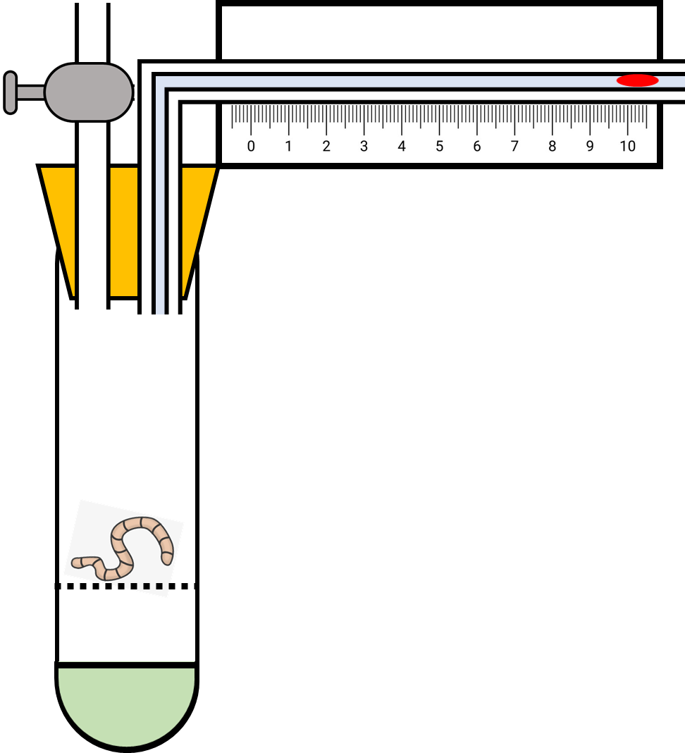















What to write about
What do you want to study? Why do you want to study it? What makes you suitable for the course? What else do you do outside of school? What are your ambitions, where do you want to go?
Here are a few things to ask yourself

Slide 4
Your personal statement should be unique, so there’s no definite format for you to follow here – just take your time.
How to write it
Write in an enthusiastic, concise, and natural style – nothing too complex.
Try to stand out, but be careful with humour, quotes, or anything unusual – just in case the admissions tutor doesn’t have the same sense of humour as you.
Structure your info to reflect the skills and qualities the unis and colleges value most – use the course descriptions to help you.

Slide 5
Check the character and line limit – you have 4,000 characters and 47 lines. Some word processors get different values if they don’t count tabs and paragraph spacing as individual characters.
How to write it
Proofread aloud, and get your teachers, advisers, and family to check. Then redraft it until you’re happy with it, and the spelling, punctuation, and grammar are correct.

Slide 6
What to write about
How are you going to start your personal statement? What do you want to include and what can you leave out? Is your personal statement going to stand out from others?
Here are a few things to ask yourself

Slide 7
Personal statement dos
Do show you know your strengths, and outline your ideas clearly.
Do be enthusiastic – if you show you’re interested in the course, it may help you get a place.
Do expect to produce several drafts of your personal statement before being totally happy with it.
Do ask people you trust for their feedback

Slide 8
Personal statement don'ts
Don’t be tempted to buy or copy a personal statement, or share yours
Don’t exaggerate – if you do, you may get caught out in an interview when asked to elaborate on an interesting achievement.
Don’t rely on a spellchecker, as it will not pick up everything – proofread as many times as possible.
Don’t leave it to the last minute – your statement will seem rushed, and important information could be left out.

Slide 9
What happens to personal statements that have been copied?
Every personal statement received by UCAS is added to our personal statement library, which means we’re able to quickly identify if your personal statement is similar to someone else’s.
Once we receive your application, your personal statement is scanned by our Copycatch system – if your statement shows a similarity of 10% or more, it will be flagged.
Where similarities are confirmed, the universities, colleges, and applicant are notified at the same time. The university and college admissions staff will then decide what action to take.

Slide 10



