Slide 1

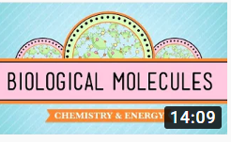
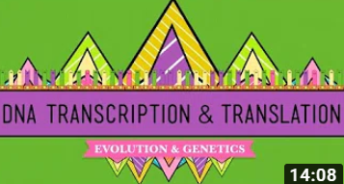
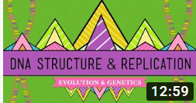
A Level Biology Watch List
Biological Molecules - You Are What You Eat:
https://www.youtube.com/watch?v=H8WJ2KENlK0
Key things to think about:
What are the roles of biological molecules?
What some of the main carbon based molecules?
DNA, Hot Pockets, & The Longest Word Ever
https://www.youtube.com/watch?v=itsb2SqR-R0
Key things to think about:
What is the process of transcription?
What is the process of translation?
DNA Structure and Replication
https://www.youtube.com/watch?v=8kK2zwjRV0M
Key things to think about:
What is the structure of DNA?
How does DNA replicate?

