Slide 1
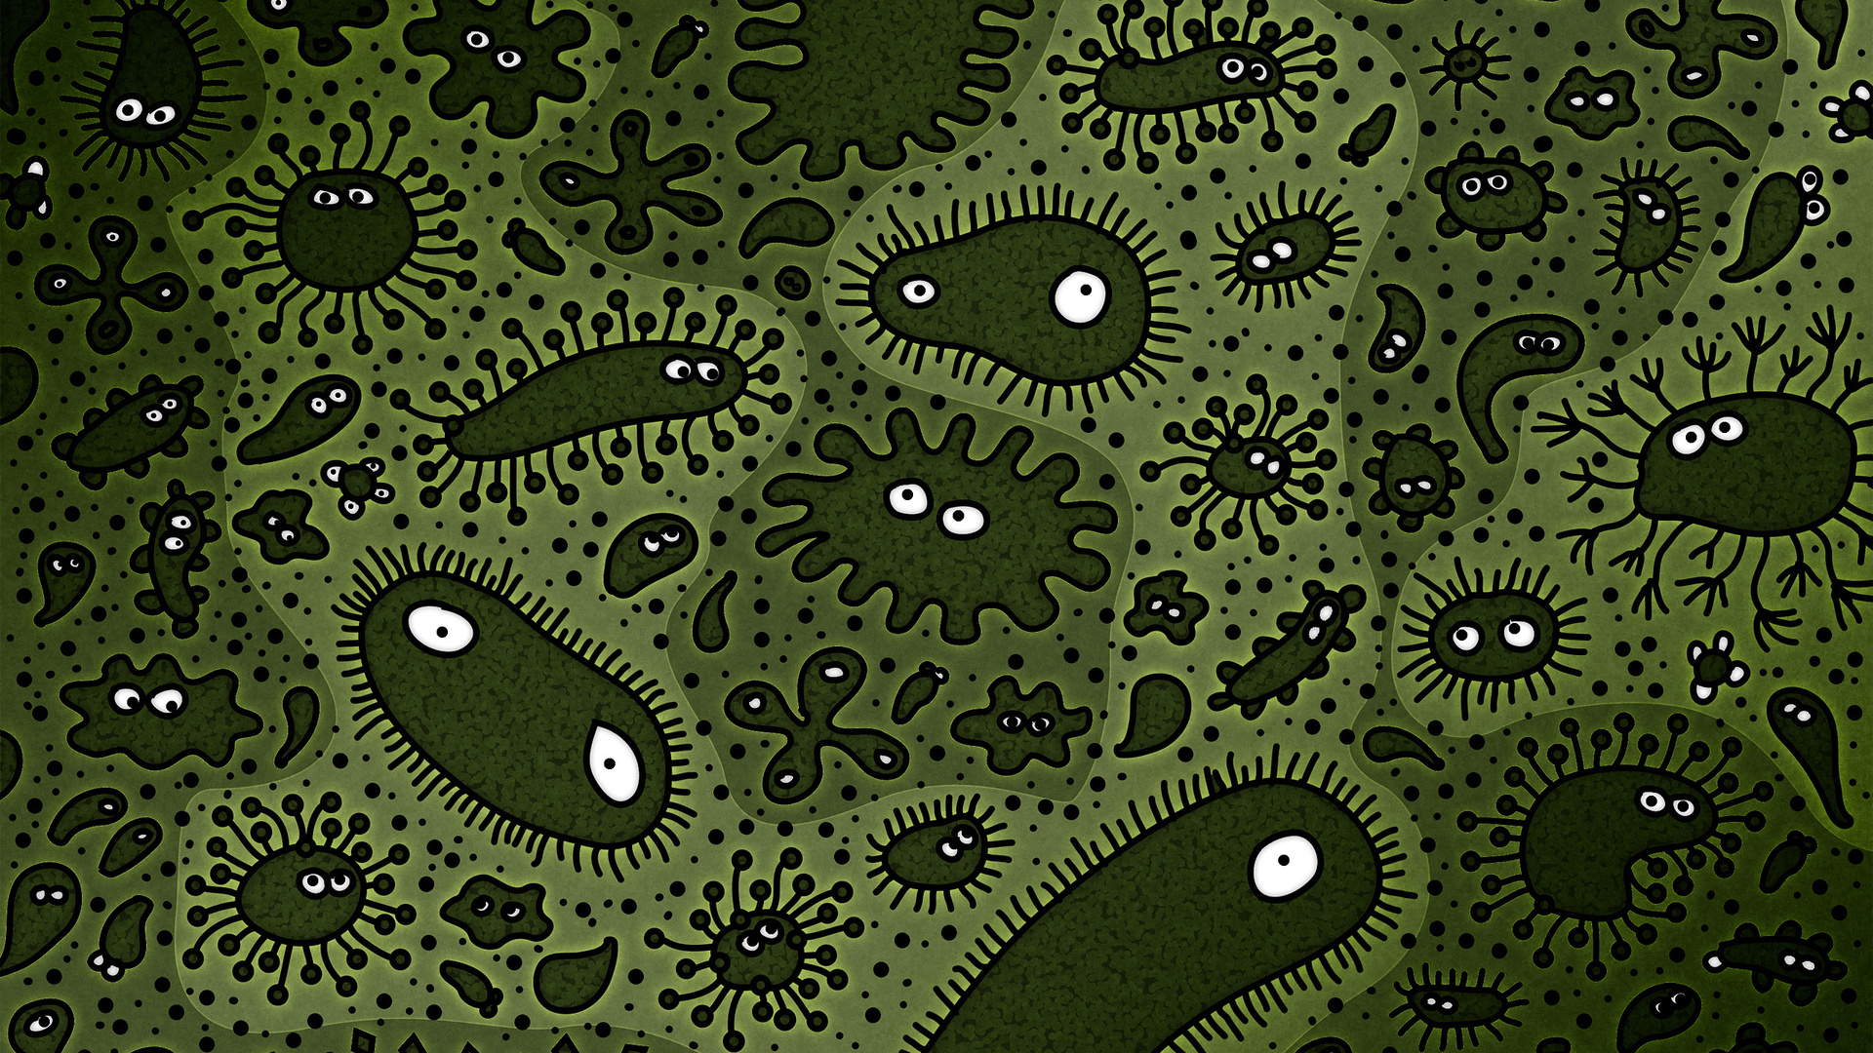
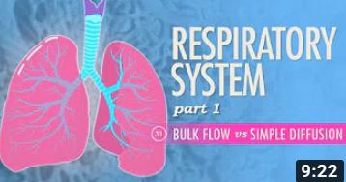
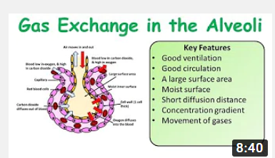
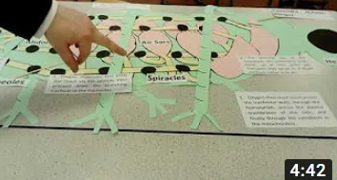
A Level Biology Watch List
Respiratory System, Part 1
https://www.youtube.com/watch?v=bHZsvBdUC2I
Key things to think about:
What is the structure of the lungs?
How is air moved in and out of the lungs?
A Level & GCSE Biology Alveoli:
https://www.youtube.com/watch?v=wpB5b7N_7iU
Key things to think about:
How are concentration gradients maintained?
What are the adaptations of the alveoli?
A Level Biology Ventilation in Insects
https://www.youtube.com/watch?v=qz_2JFG0iLs
Key things to think about:
How do insects move air in and out?
What are the differences between animal & insect ventilation?

