Slide 1

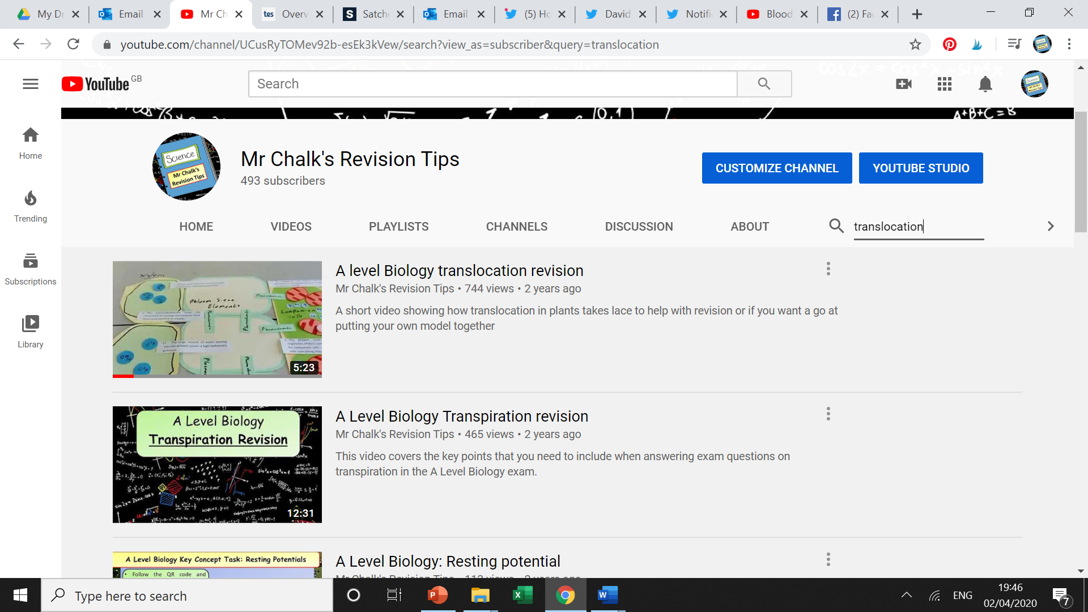
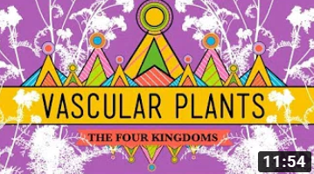
A Level Biology Watch List
A level Biology translocation revision
https://www.youtube.com/watch?v=2yplIh0kPqc&t=3s
Key things to think about:
How does sucrose move into the phloem?
What causes the sucrose to move from source to sink?
A Level Biology Transpiration revision
https://www.youtube.com/watch?v=9X3KBFOkZXo
Key things to think about:
What is transpiration?
What factors affect the rate of transpiration?
Vascular Plants = Winning!
https://www.youtube.com/watch?v=h9oDTMXM7M8
Key things to think about:
What are vascular plants?
What is the structure of phloem & xylem?

