Slide 1
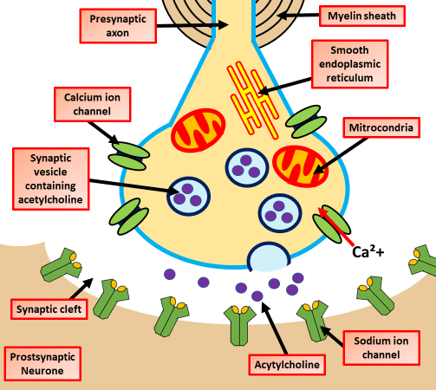

The Synapse Question
Describe how a nerve impulse is transmitted across a cholinergic synapse.
____________________________________________________________________________________________________________________________________________________________________________________________________________________________________________________________________________________________________________________________________________________________________________________________________________________________________________________________________________________________________________________________________________________________________________________
Answer
Video link

