Slide 1
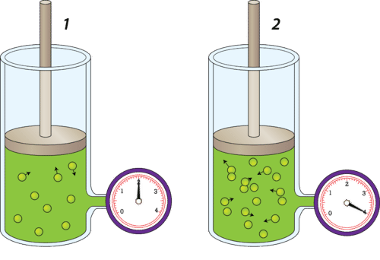

Gas Pressure Question
Describe two ways to increase the pressure of a gas in a closed container, and explain why these changes have this effect.
Key things to include:
What effect does increasing temperature have
What effect does decreasing volume have
______________________________________________________________________________________________________________________________________________________________________________________________________________________________________________________________________________________________________________________________________________________________________________________________________________________________________________________________________________________
Answer
Link to video

