Slide 1
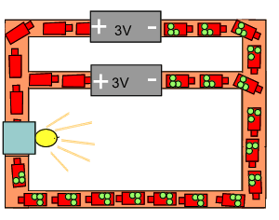

What is Potential Difference Question
The diagram below represents electron in a circuit
Mark Scheme
What is potential difference measured in?
What instrument is used to measure potential difference?
In a series circuit, how is the total potential difference distributed?
In a parallel circuit, what is the potential difference across each branch?

