Slide 1

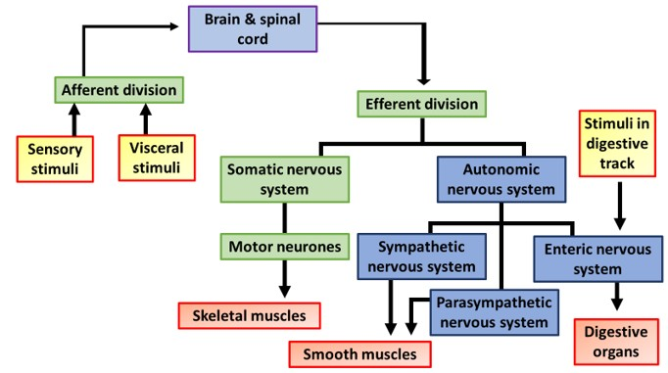

The Great Biology Pubish Quiz
Organisation of the Nervous System

Slide 2

The Great Biology Pubish Quiz
Organisation of the Nervous System
Which division of the nervous system includes the brain and spinal cord?
A
Peripheral
Somatic
B
C
Central
D
Autonomic

Slide 3
The Great Biology Pubish Quiz
Organisation of the Nervous System
What type of neuron carries impulses from receptors to the central nervous system?
A
Motor
Relay
B
C
Interneuron
D
Sensory

Slide 4
The Great Biology Pubish Quiz
Organisation of the Nervous System
The autonomic nervous system controls which type of activity?
A
Conscious
Voluntary
B
C
Involuntary
D
Learned

Slide 5
The Great Biology Pubish Quiz
Organisation of the Nervous System
Which part of the nervous system prepares the body for 'fight or flight'?
A
Parasympathetic
Somatic
B
C
Central
D
Sympathetic

Slide 6
The Great Biology Pubish Quiz
Organisation of the Nervous System
What is the function of the somatic nervous system?
A
Hormone release
Reflex coordination
B
C
Voluntary muscle control
D
Involuntary organ regulation

Slide 7
The Great Biology Pubish Quiz
Organisation of the Nervous System
Relay neurons are located in which part of the nervous system?
A
Spinal cord
B
Muscles
C
Skin
D
Glands

Slide 8

The Great Biology Pubish Quiz
Organisation of the Nervous System
Question 1
C
Question 2
D
Question 3
C
Question 4
D
Question 5
C
Question 6
A

