Slide 1
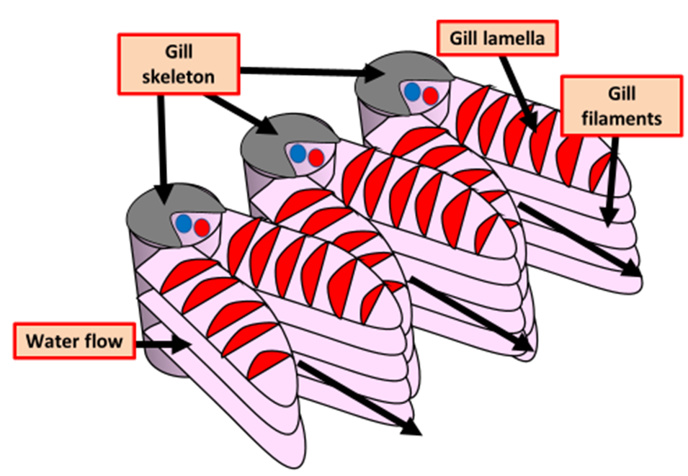

Gas Exchange in Gills Question
Explain how gas exchange occurs in fish gills and how the structure of gills supports efficient gas exchange. (4 marks)
________________________________________________________________________________________________________________________________________________________________________________________________________________________________________________________________________________________________________________________________________________________________________________________________________________________________________________________________________________________________________________________________________________________________________________________________________________________________________________________________________________________________________________________________________________________________________________
Answer
Link to video

