Slide 1
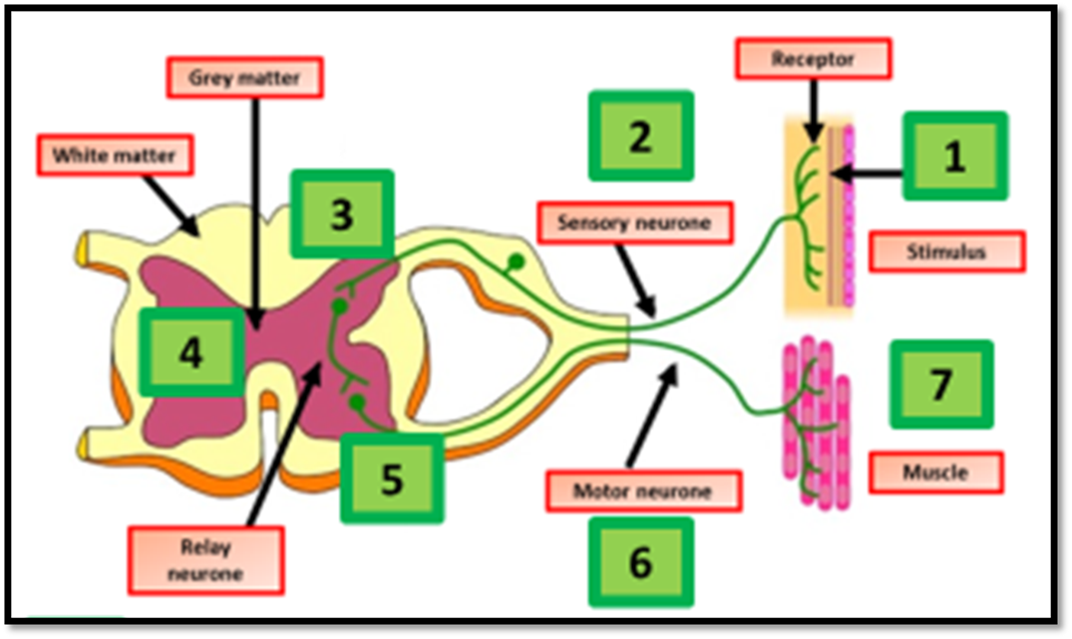

Reflex Arc Question
The diagram below shows the reflex arc
Video Link
What is the main purpose of a reflex arc?
Which part of the nervous system detects the stimulus in a reflex arc?
What type of neuron carries the impulse from the spinal cord to the effector in a reflex arc?
What is the role of the effector in a reflex arc?

