Slide 1
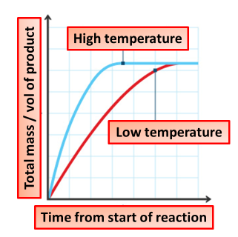

How Temperature Affects Rate Question
The diagram shows how temperature affects the rate of reaction.
Video link
How does increasing temperature affect the rate of reaction?
Why does a higher temperature make a reaction happen faster?
What must particles have for a successful collision to cause a reaction?
What happens to the rate of reaction if the temperature is decreased?

