Slide 1
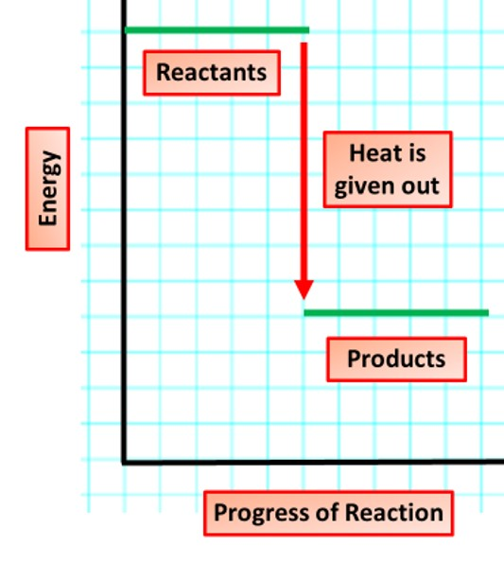

Exothermic Reaction Question
The diagram shows the energy changes in an exothermic reaction
Video link
What is released during an exothermic reaction?
Is the temperature of the surroundings increased or decreased in an exothermic reaction?
Give an example of an exothermic reaction
Is the energy of the products higher or lower than that of the reactants in an exothermic reaction?

