Slide 1

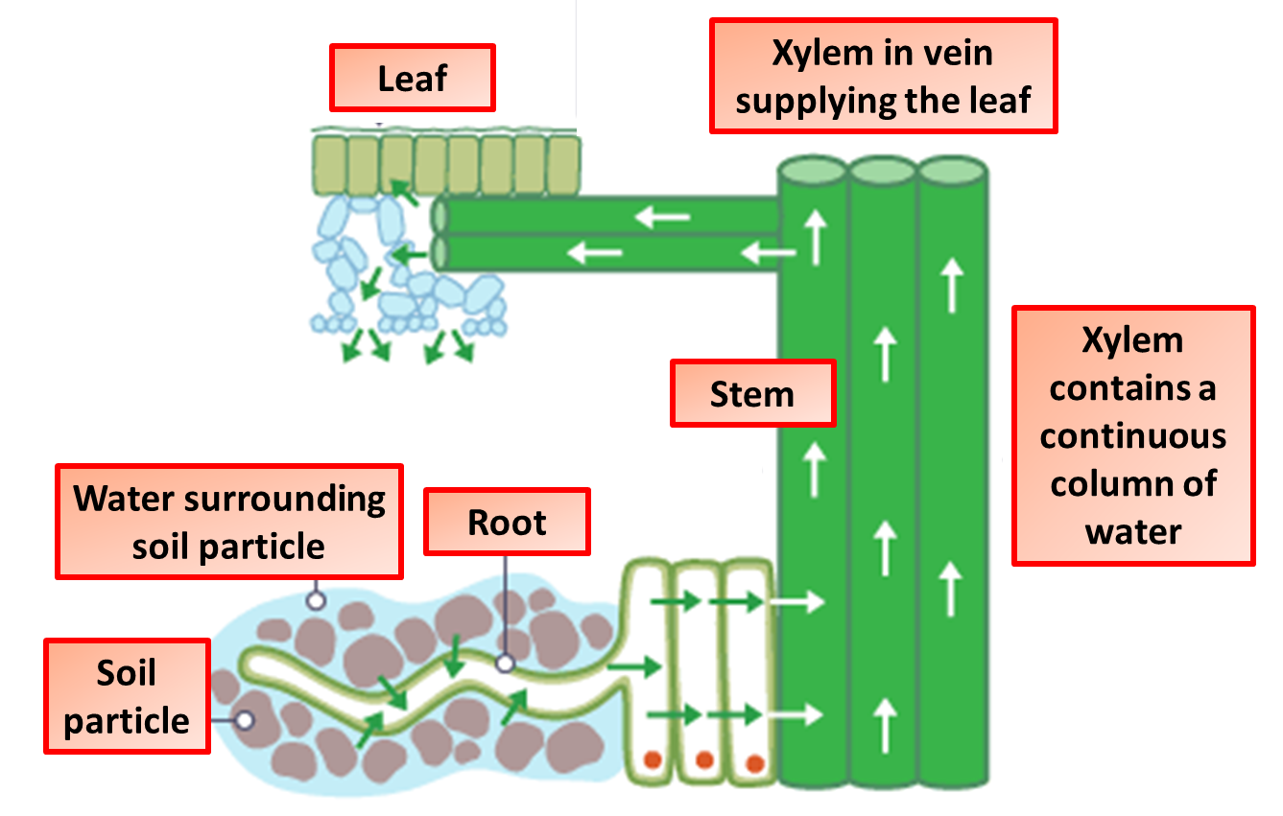

The Great Biology Pubish Quiz
Transpiration

Slide 2

The Great Biology Pubish Quiz
Transpiration
What is the main function of transpiration?
A
Transport of sugars
Cooling the plant
B
C
Absorption of nutrients
D
Transport of water

Slide 3
The Great Biology Pubish Quiz
Transpiration
Which part of the plant is responsible for water loss during transpiration?
A
Roots
Stomata
B
C
Xylem
D
Phloem

Slide 4
The Great Biology Pubish Quiz
Transpiration
Which type of cells surround the stomata and control their opening and closing?
A
Guard cells
Mesophyll cells
B
C
Epidermal cells
D
Xylem cells

Slide 5
The Great Biology Pubish Quiz
Transpiration
Which factor increases the rate of transpiration?
A
Low temperature
High humidity
B
C
High wind speed
D
High soil moisture

Slide 6
The Great Biology Pubish Quiz
Transpiration
What is the primary driving force for water movement in transpiration?
A
Gravity
Osmosis
B
C
Capillary action
D
Evaporation

Slide 7
The Great Biology Pubish Quiz
Transpiration
What is the main route through which water leaves the plant?
A
Phloem
B
Roots
C
Xylem
D
Stomata

Slide 8

The Great Biology Pubish Quiz
Transpiration
Question 1
B
Question 2
B
Question 3
A
Question 4
C
Question 5
D
Question 6
D

