Slide 1

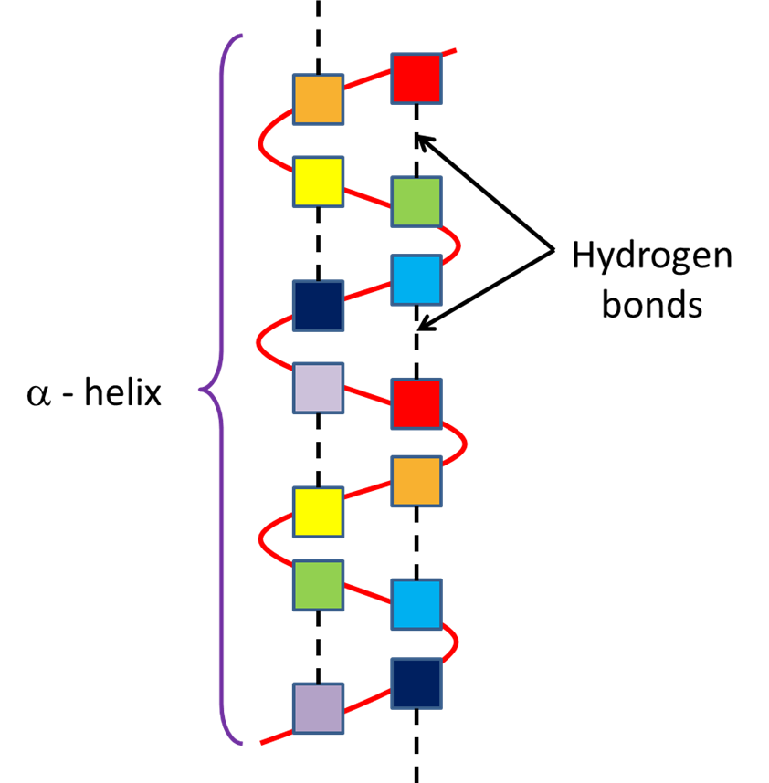

The Great Biology Pubish Quiz
Alpha Helix

Slide 2

The Great Biology Pubish Quiz
Alpha Helix
What type of structure does an alpha helix represent in proteins?
A
Primary
Secondary
B
C
Tertiary
D
Quaternary

Slide 3
The Great Biology Pubish Quiz
Alpha Helix
Which type of bond stabilizes the alpha helix structure?
A
Hydrogen
Peptide
B
C
Ionic
D
Covalent

Slide 4
The Great Biology Pubish Quiz
Alpha Helix
What shape does an alpha helix form?
A
Sheet
Spiral
B
C
Linear
D
Globular

Slide 5
The Great Biology Pubish Quiz
Alpha Helix
In an alpha helix, the hydrogen bonds form between which parts of the amino acids?
A
Side chains
R groups
B
C
Backbone
D
Terminals

Slide 6
The Great Biology Pubish Quiz
Alpha Helix
Which protein is rich in alpha helices?
A
Hemoglobin
Keratin
B
C
Collagen
D
Insulin

Slide 7
The Great Biology Pubish Quiz
Alpha Helix
What type of protein structure typically contains alpha helices?
A
Fibrous
B
Globular
C
Conjugated
D
Lipoprotein

Slide 8

The Great Biology Pubish Quiz
Alpha Helix
Question 1
B
Question 2
A
Question 3
B
Question 4
C
Question 5
B
Question 6
A

