Slide 1
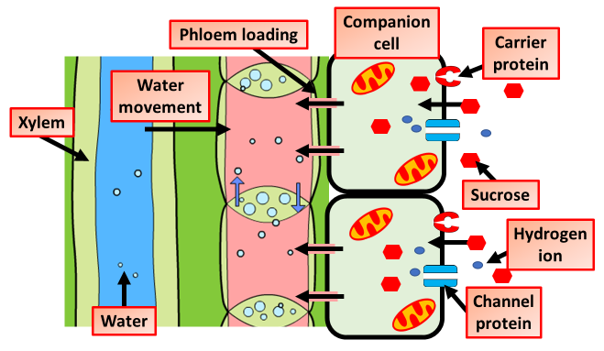

Translocation Question
Explain the importance of translocation in plants
Key things to include:
What is moved by translocation
Where does translocation take place
What does from source to sink mean
_______________________________________________________________________________________________________________________________________________________________________________________________________________________________________________________________________________________________________________________________________________________________________________________________________________________________________
Answer
Link to video

