Slide 1
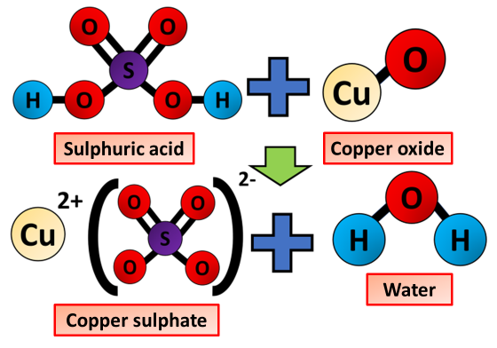

Making Salts Question
The diagram shows what happens during a reaction to make salts
Video Link
What two types of substances react together to make a salt?
What gas is produced when an acid reacts with a metal?
What type of salt is made when hydrochloric acid reacts with a metal?
What is the name of the salt formed when sulfuric acid reacts with copper oxide?

