Slide 1

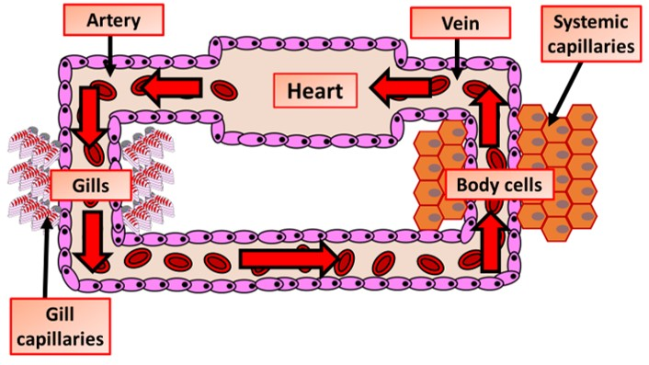

The Great Biology Pubish Quiz
Single Closed Circulation

Slide 2

The Great Biology Pubish Quiz
Single Closed Circulation
What is a defining characteristic of single closed circulation?
A
Blood passes through the heart twice in one circuit.
Blood flows directly into body cavities.
B
C
Blood flows through the heart once per complete circuit of the body.
D
There are no blood vessels.

Slide 3
The Great Biology Pubish Quiz
Single Closed Circulation
Which type of organism typically has single closed circulation?
A
Mammals
Amphibians
B
C
Insects
D
Fish

Slide 4
The Great Biology Pubish Quiz
Single Closed Circulation
In single closed circulation, where does blood go after leaving the heart?
A
Directly to the lungs
To the gills for gas exchange
B
C
To the systemic capillaries
D
To the atria of the heart

Slide 5
The Great Biology Pubish Quiz
Single Closed Circulation
Why is blood flow in single closed circulation slower compared to other systems?
A
Blood is under low pressure after passing through the gills.
The heart does not generate enough force.
B
C
There are no capillaries in the system.
D
The blood flows in an open circuit.

Slide 6
The Great Biology Pubish Quiz
Single Closed Circulation
What is an advantage of single closed circulation?
A
High blood pressure is maintained throughout the circuit.
Efficient oxygen delivery to tissues.
B
C
Efficient oxygen delivery to tissues.
D
Simple system suitable for organisms with lower metabolic demands.

Slide 7
The Great Biology Pubish Quiz
Single Closed Circulation
What is a disadvantage of single closed circulation?
A
Blood does not return to the heart.
B
Blood flow is slower, limiting oxygen supply to tissues.
C
It is only found in vertebrates.
D
It requires more energy than double circulation.

Slide 8

The Great Biology Pubish Quiz
Single Closed Circulation
Question 1
C
Question 2
D
Question 3
B
Question 4
A
Question 5
C
Question 6
B

