Slide 1
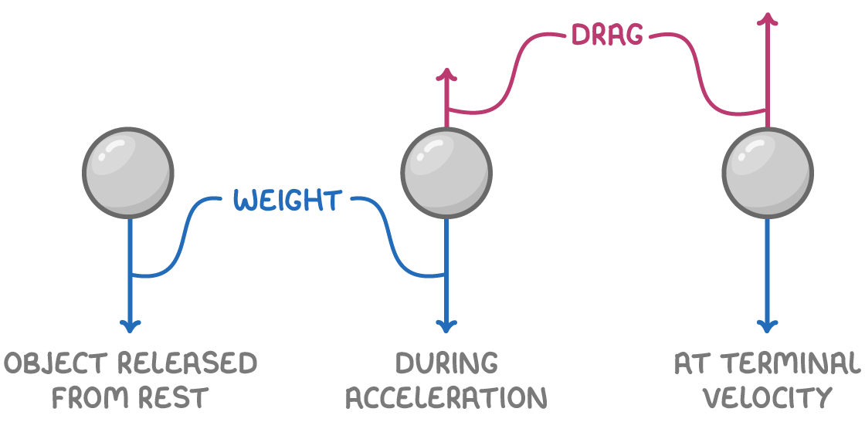

Terminal Velocity Question
Explain how an object reaches terminal velocity when falling through a fluid.
Key things to include:
Why does an object accelerated
What causes it to stop accelerating
Describe the resultant forces acting on it
_______________________________________________________________________________________________________________________________________________________________________________________________________________________________________________________________________________________________________________________________________________________________________________________________________________________________________
Answer
Link to video

