Slide 1

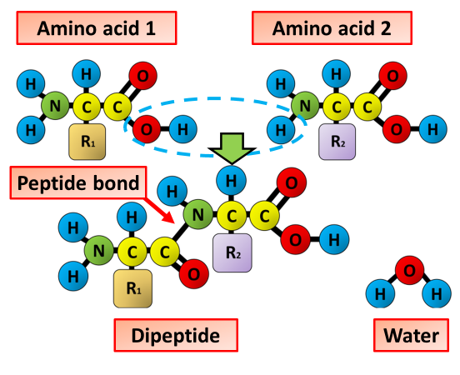

The Great Biology Pubish Quiz
Polypeptides

Slide 2

The Great Biology Pubish Quiz
Polypeptides
What are polypeptide chains made of?
A
Sugars
Amino acids
B
C
Lipids
D
Nucleic acids

Slide 3
The Great Biology Pubish Quiz
Polypeptides
Which type of bond holds amino acids together in a polypeptide?
A
Hydrogen
Peptide
B
C
Ionic
D
Covalent

Slide 4
The Great Biology Pubish Quiz
Polypeptides
Where does the synthesis of polypeptide chains occur in the cell?
A
Nucleus
Golgi
B
C
Cytoplasm
D
Ribosome

Slide 5
The Great Biology Pubish Quiz
Polypeptides
What determines the order of amino acids in a polypeptide?
A
DNA
Lipids
B
C
ATP
D
RNA

Slide 6
The Great Biology Pubish Quiz
Polypeptides
Which level of protein structure is the polypeptide chain itself?
A
Primary
Secondary
B
C
Tertiary
D
Quaternary

Slide 7
The Great Biology Pubish Quiz
Polypeptides
What type of reaction joins amino acids to form a polypeptide chain?
A
Condensation
B
Hydrolysis
C
Oxidation
D
Reduction

Slide 8

The Great Biology Pubish Quiz
Polypeptides
Question 1
B
Question 2
A
Question 3
D
Question 4
A
Question 5
A
Question 6
A

